Slide 1
BONDS UPDATE : Bonds have been a PAIN of late BUT if the EQUITY AND EURO SELL OFF materialises, BONDS are a BUY?! We have hit several moving averages and daily RSI’s are firmly oversold.
** US FRONTEND TRADE IDEA **
The US frontend looks a BUY and a very CHEAP one, see chart 17
IDEAS as follows :
Ref 105-22
TUZ 105.75/105.875 call spread: Mkt 2/2.5.. Has 12% delta
Ref 96.91
2EZ8 97.125/97.375/97.50 broken call fly 3.25/3.5.. Has 10% delta bid is via legs
2EZ8 97.25/97.375 call spread 1.75/2 has 8% delta
The LOWER YIELD CALL remains in play despite the latest POP.
As LABOURED previously the “writing is on the wall” ALREADY relating to direction, ALL warnings signs emanate from MONTHLY and QUARTERLY charts, that won’t change.

Slide 2
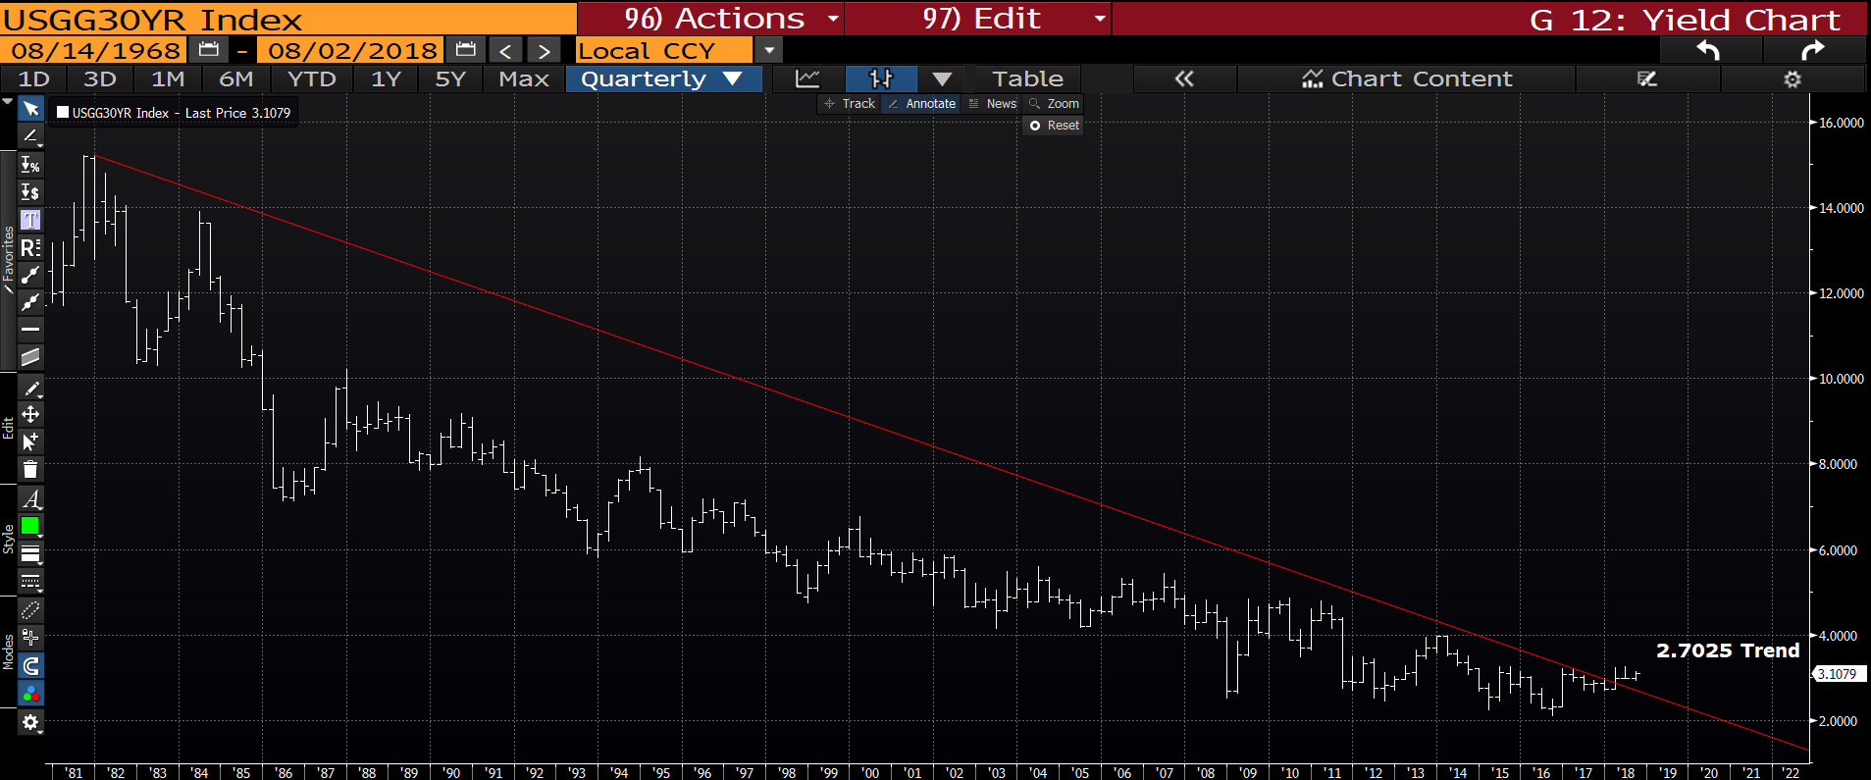
US 30yr yield quarterly : We have previously breached last months low so waiting for the inevitable STALL. The trend line is much closer now at 2.7025.

Slide 3
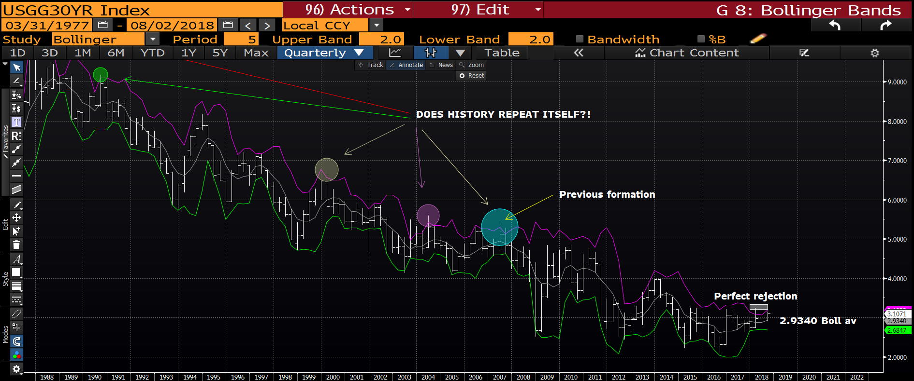
US 30yr yield quarterly : HISTORY IS ABOUT TO REPEAT ITSELF? ON ALL previous occasions yields have dropped and especially associated with DOUBLE UPSIDE PIERCES, as NOW! Any move sub the bollinger average 2.9246 will be very very negative.

Slide 4
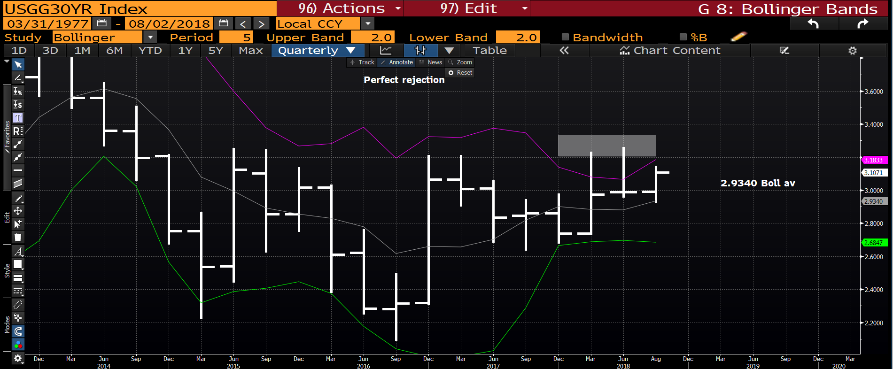
US 30yr yield quarterly : This “blow up” highlights 2 VERY nasty upside pierces which wont be eradicated unless we breach the highs, thus maintaining the YIELD LOWER call. I am hoping this is the extent of the rally and we head back toward the bollinger average 2.9340.

Slide 5
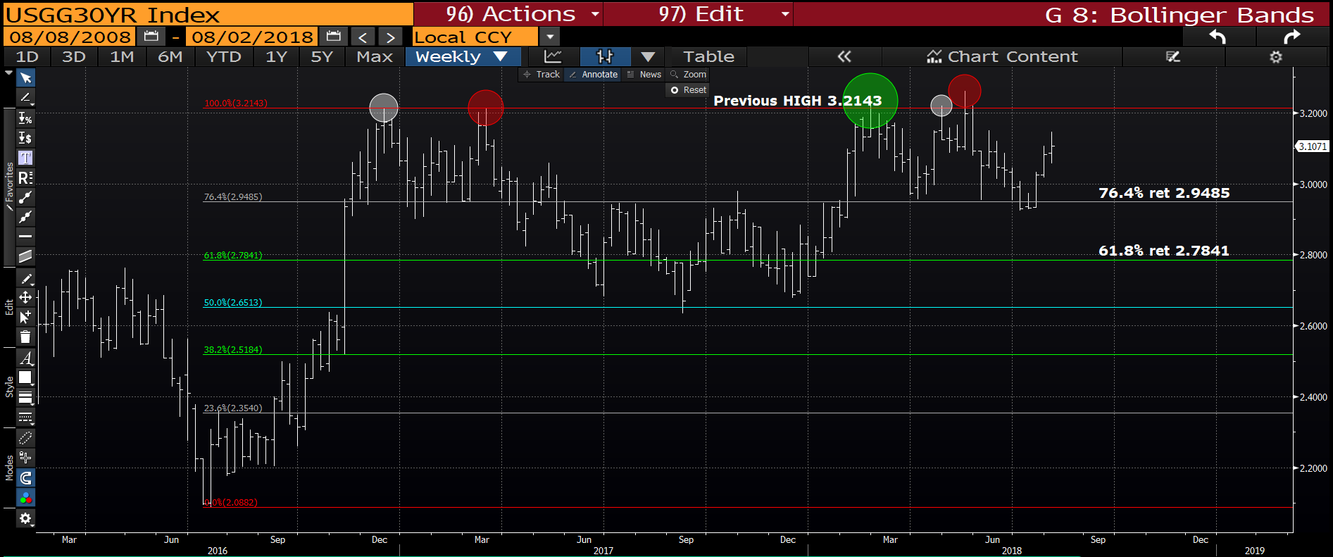
US 30yr yield weekly : Yesterdays HIGH needs to remain and we head LOWER in YIELD for the remainder of the week.

Slide 6
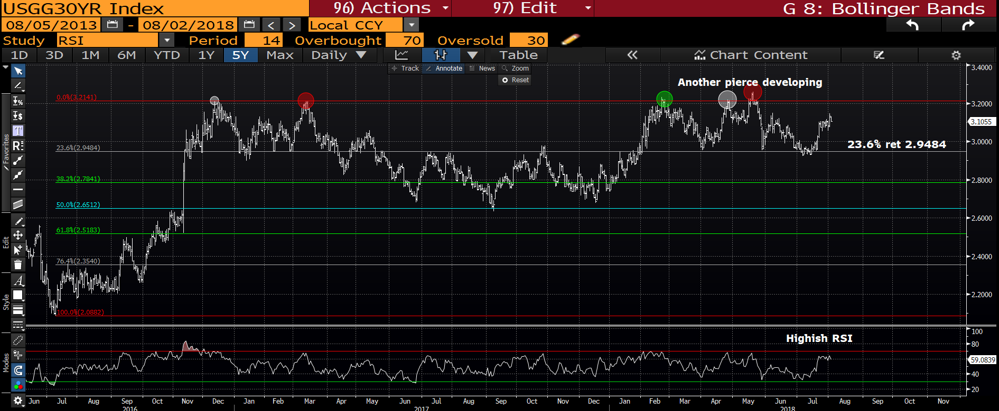
US 30yr yield daily : The RSI is lofty again and providing yesterdays yield high remains we should head lower.

Slide 7
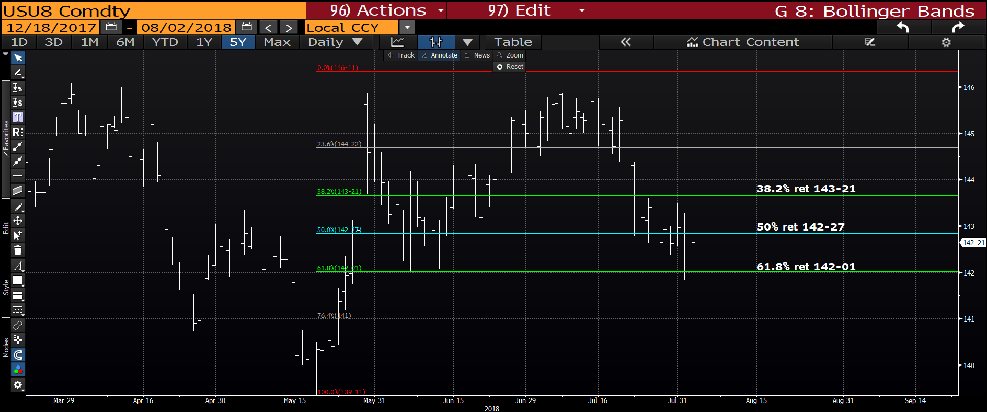
US 30yr futures daily : The dip has been significant SO hopefully this is the lowest we go.
All stops on new longs sub the 142-00 level, ADD above the 50% ret 142-27 and 143-21.

Slide 8
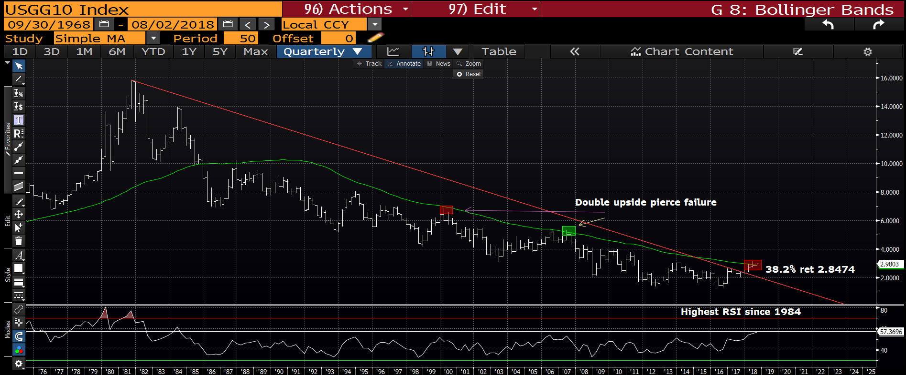
US 10yr yield quarterly : The RSI dating back to 1984 is not going to go away, thus the BIAS still remains for lower yields. We NEED to get back below the moving average 2.8474.

Slide 9
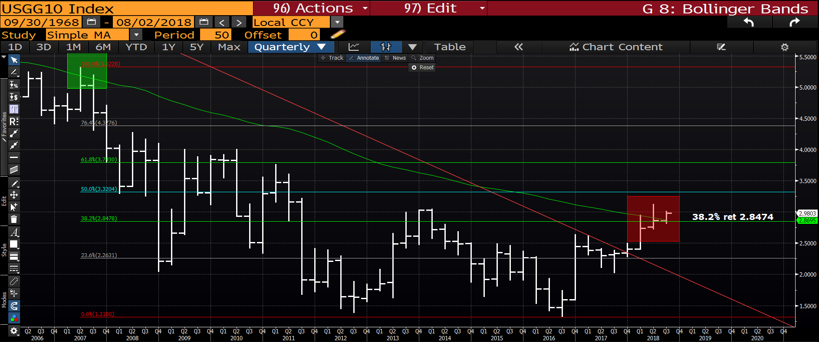
US 10yr yield quarterly : Could this be the PERFECT failure? We NEED to get BACK BELOW the 38.2% ret 2.8474. Another chart where if HISTORY REPEATS ITSELF, yields will be significantly lower.

Slide 10
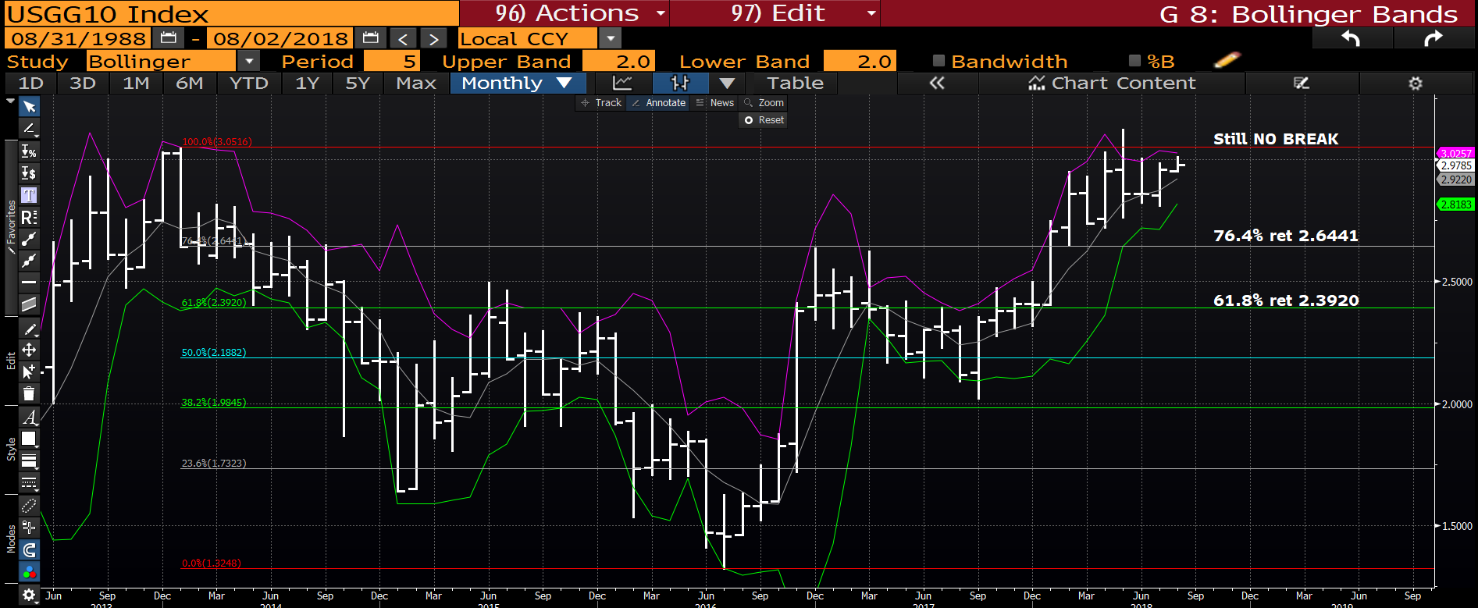
US 10yr monthly : The UPSIDE pierce remains AS does the recent HIGH. This is still a lower yield chart.

Slide 11
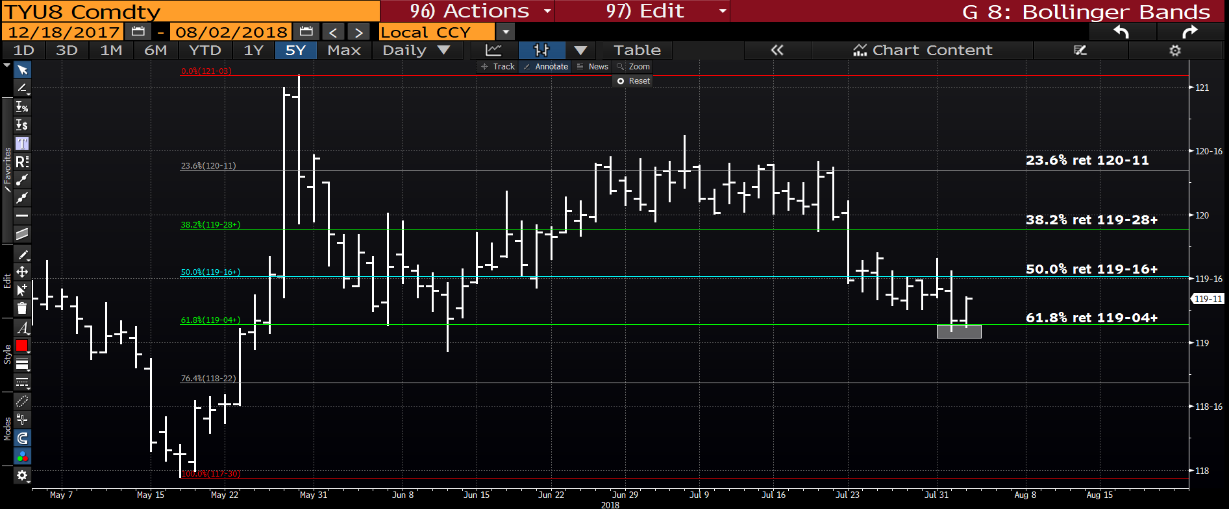
US 10yr daily futures : We have dropped back to sizeable support at t he 61.8% ret 119-04+ whilst creating 2 downside pierces. We should rally from here and place stops sub 119-00.

Slide 12
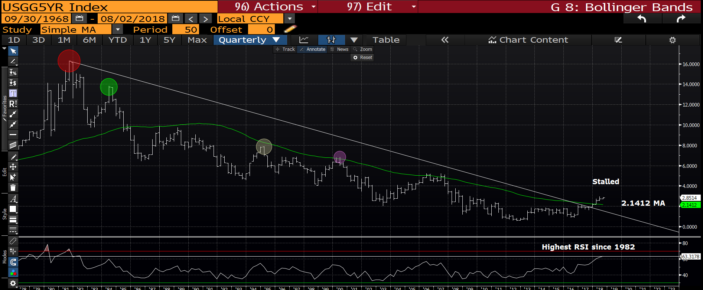
US 5yr quarterly : To many, this remains a positive chart i.e. above the moving average and trendline BUT the RSI will not diminish given it is of 1982 proportions. Also once we fail the moving average 2.1412, there are numerous example of what has happened before.

Slide 13
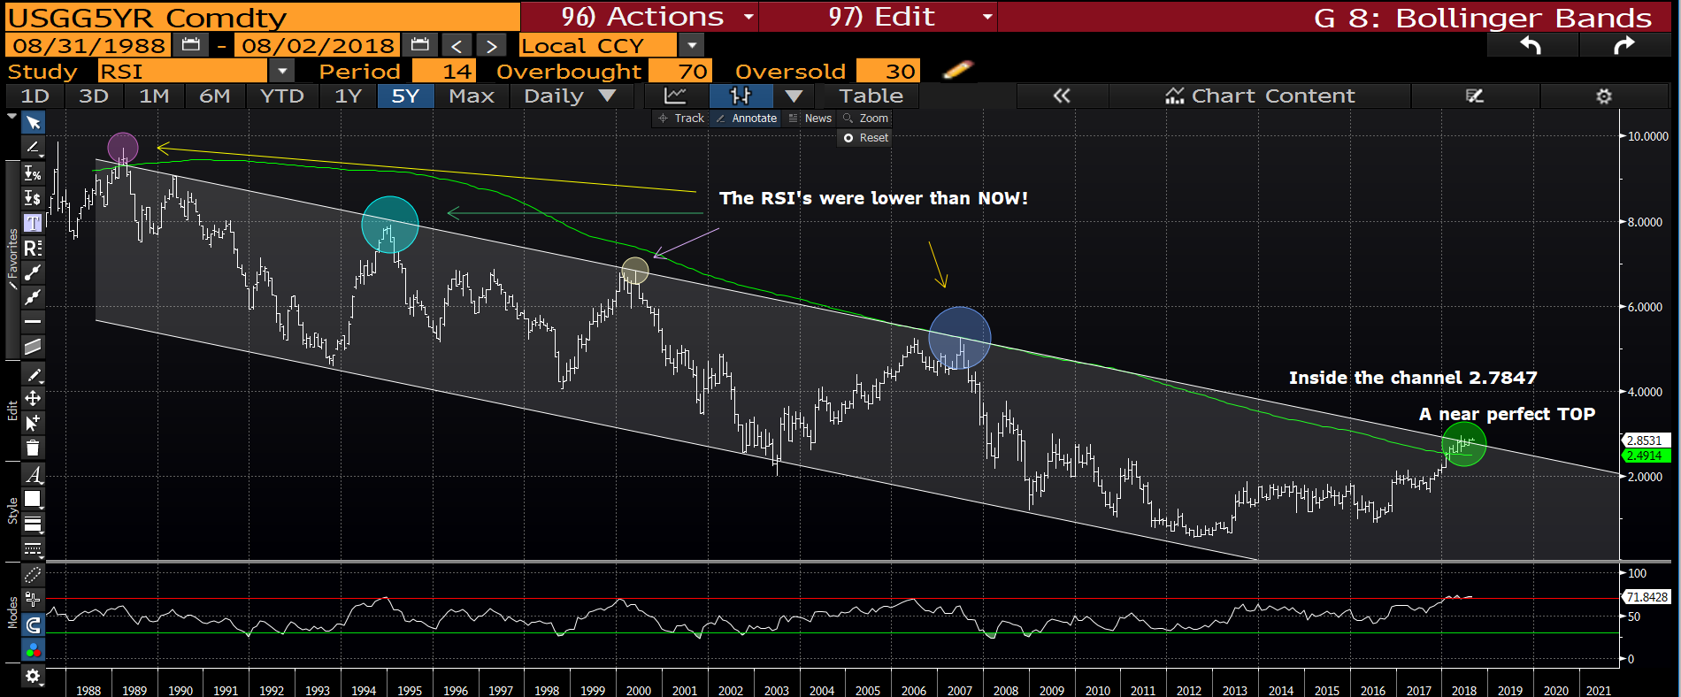
US 5yr monthly : We continue to TEASE around the LONGTERM trend channel (2.7847), the RSI has A LOT of unwind potential. Key break would be SUB the MOVING AVERAGE 2.4914.

Slide 14
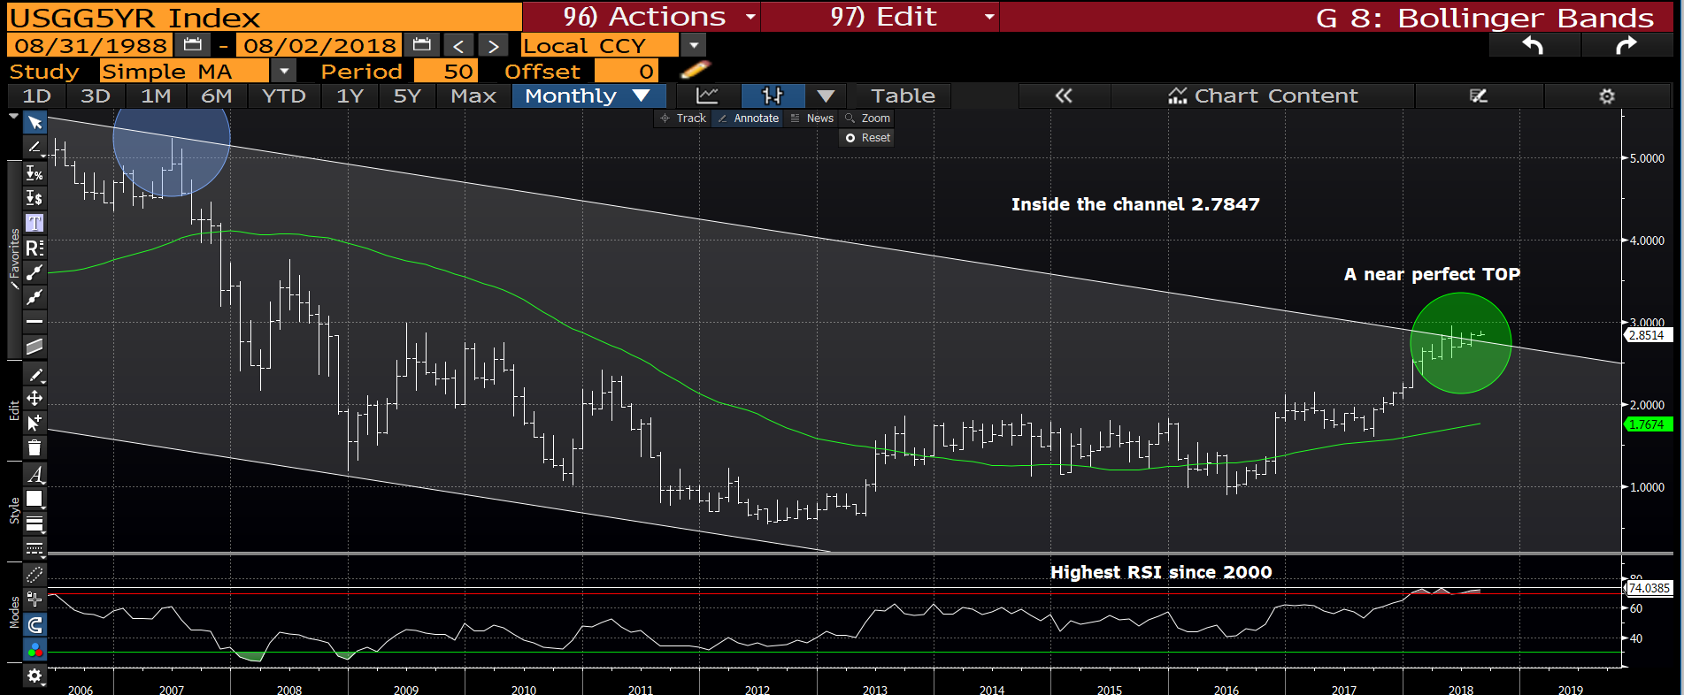
US 5yr monthly : Another perfect formation looming, we are teasing the trend channel with significant room to head lower. Sub the moving average 2.4985 will help, ALOT.
The RSI is not going to go away.

Slide 15
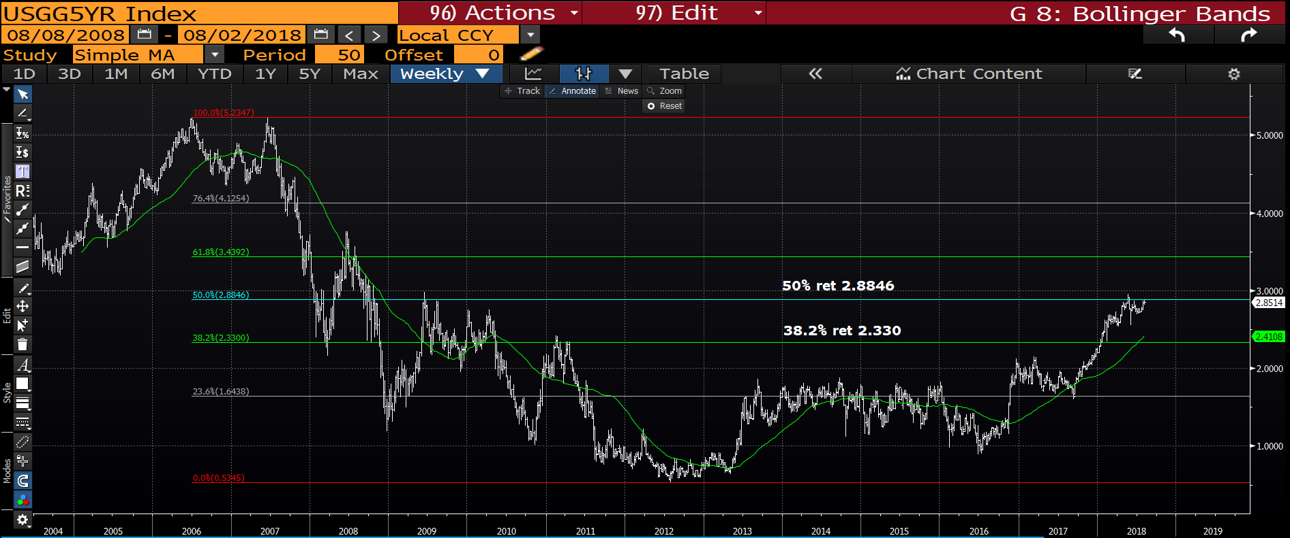
US 5yr weekly : We continue to fail the 50% ret 2.8846, targeting the 38.2% ret 2.330.

Slide 16
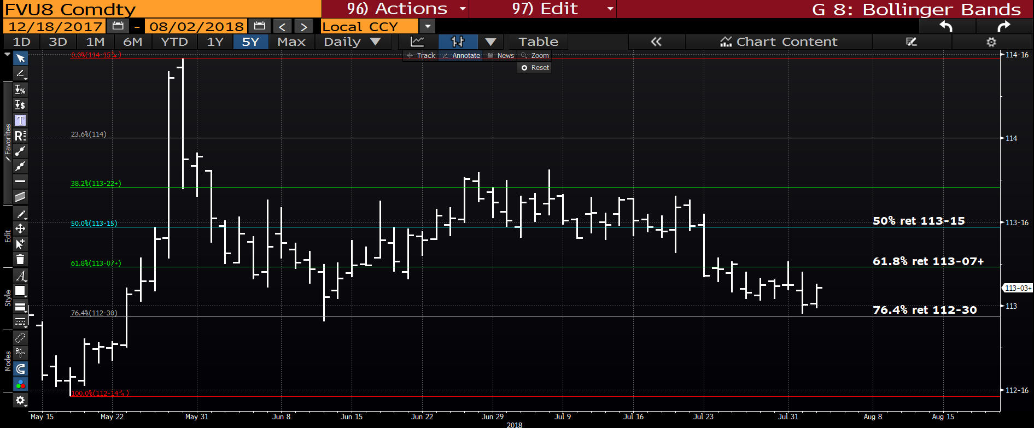
US 5yr futures daily : We have held the 76.4%ret 112-30 and ideally close the week above the 61.8% ret 113-07+.

Slide 17
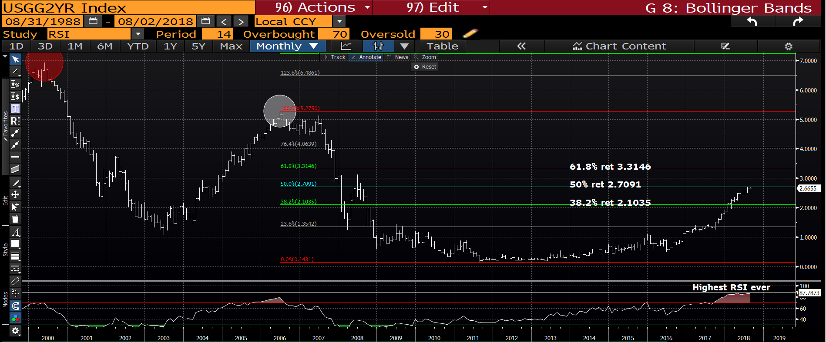
US 2yr monthly : The RSI speaks for itself and providing we remain sub the 50% ret 2.7091 then the TRADE ideas on the opening page will work.

Slide 18
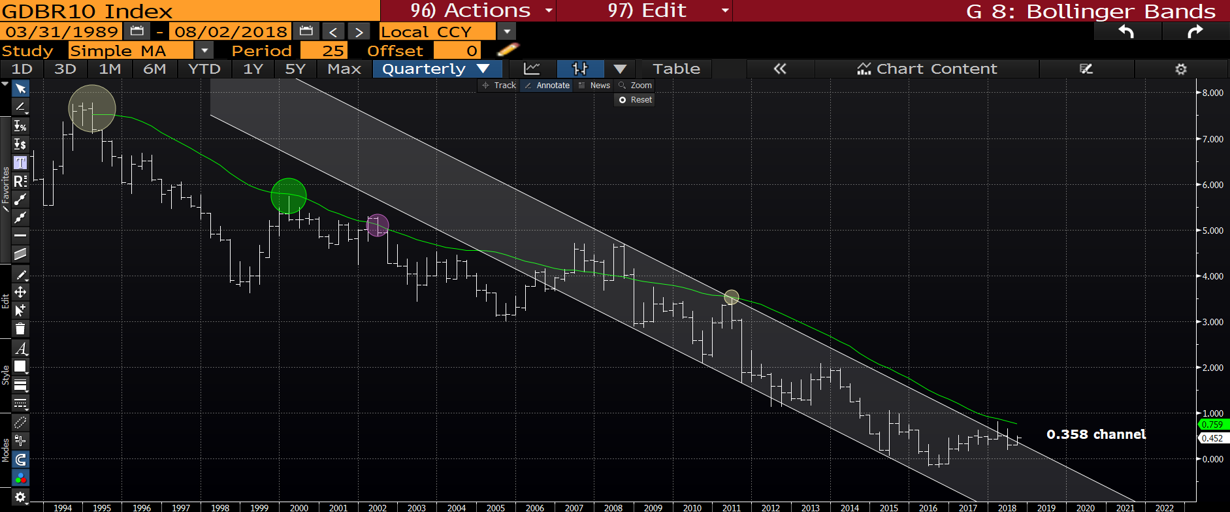
Generic German 10yr quarterly : We now have 2 SOLID UPSIDE PIRECES that are etched in history, this will form an explosive bearish tone for yields. Whilst teasing the multi year channel this is forming a very nice-tidy chart. COULD it be as simple as this?!

Slide 19
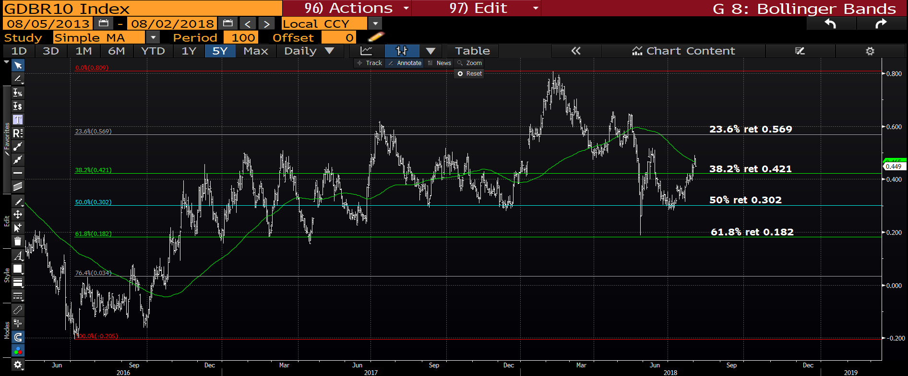
Generic German yield daily : This is the first of a few 100 day moving averages that have come in to play. A close sub the 38.2% ret 0.421 will be a BIG signal.

Slide 20
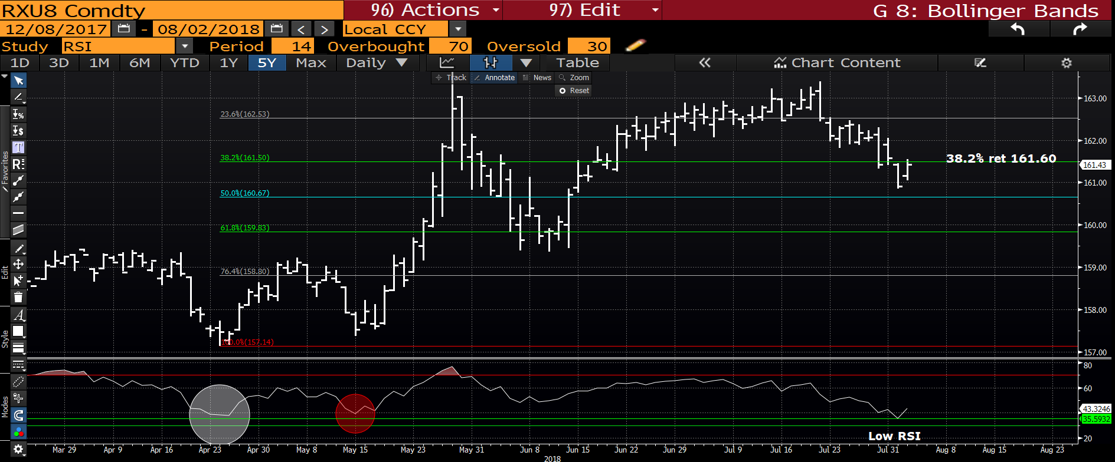
Bund futures daily : We have a LOW RSI and ideally close above the 38.2% ret 161.60.

Slide 21
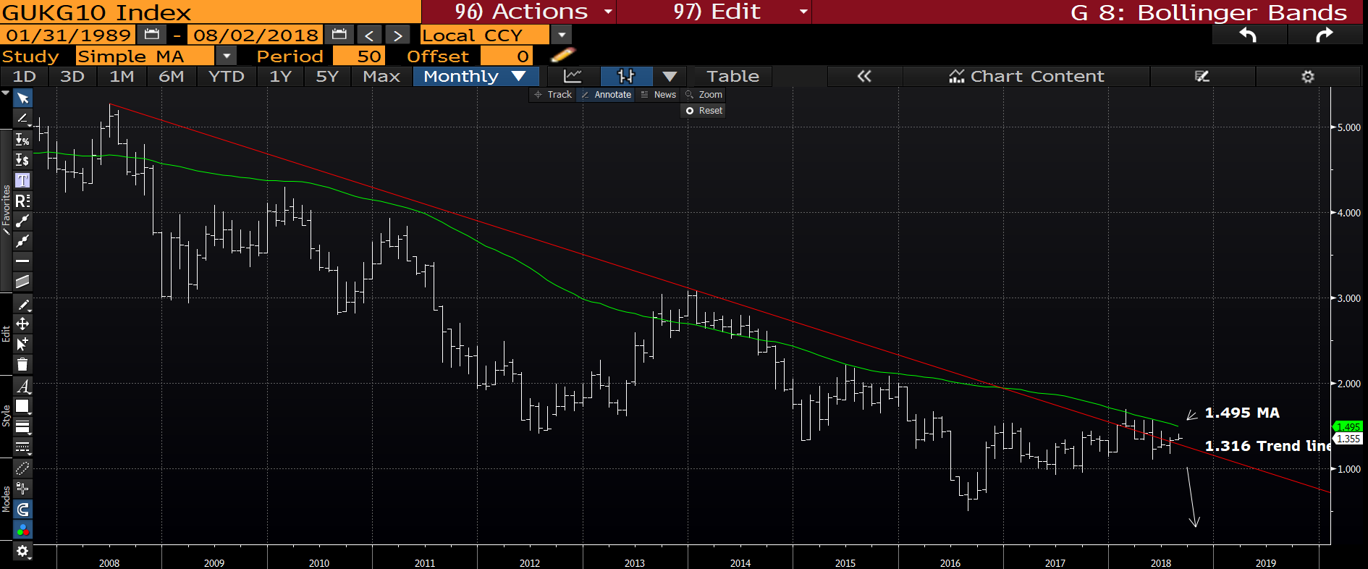
UK 10yr monthly : We are just above the 2008 trendline 1.316 and yields should STILL head lower.

Slide 22
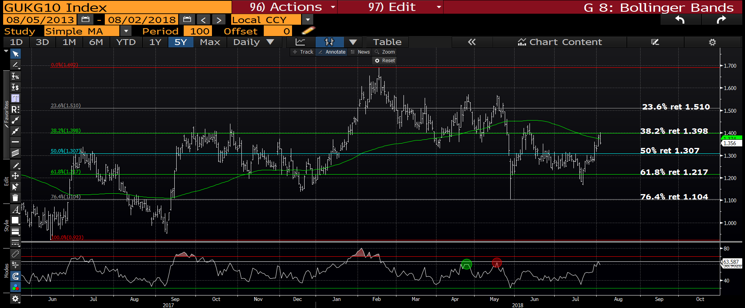
UK 10yr yield daily : We have failed the resistance at 1.398 38.2% ret and it is KEY to head lower from there, ideally back below the 50% ret 1.307. The RSI is now high.

Slide 23
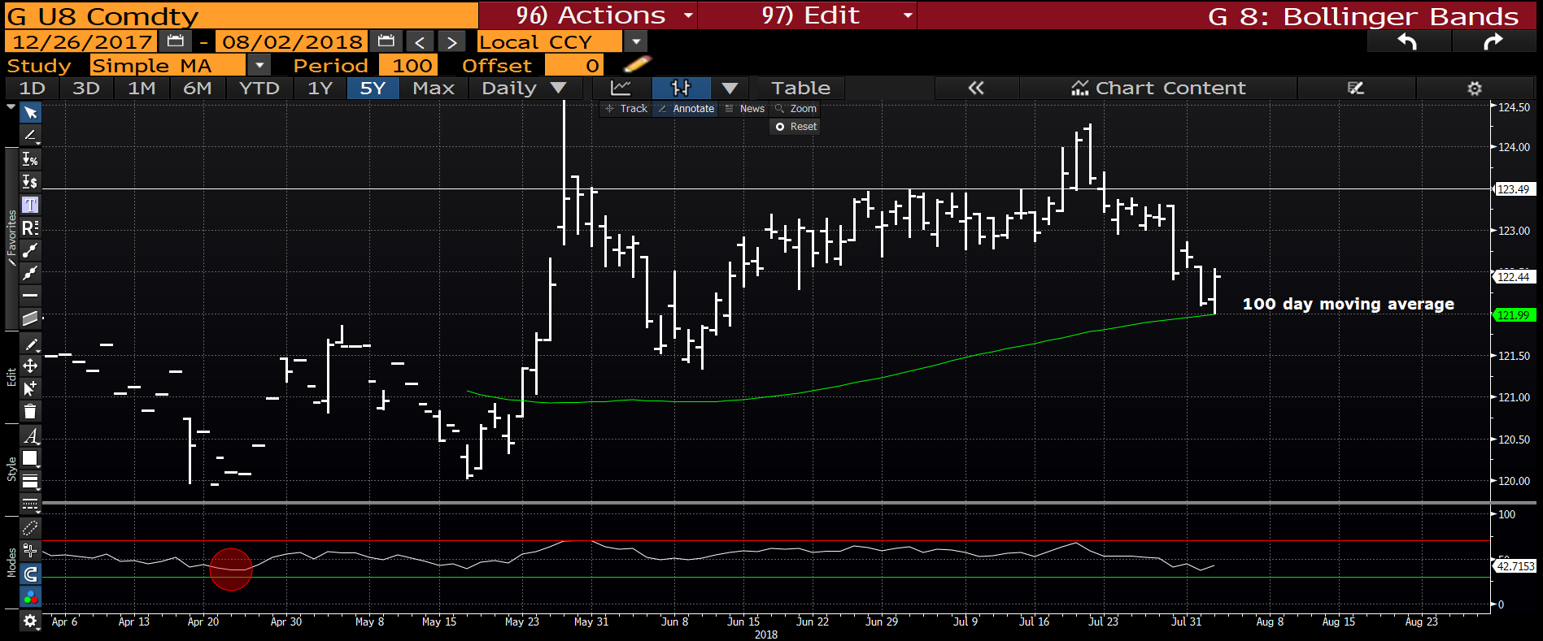
Gilt futures daily : We dipped back to the 100 day moving average 121.99 and the RSI is dislocated.

Slide 24
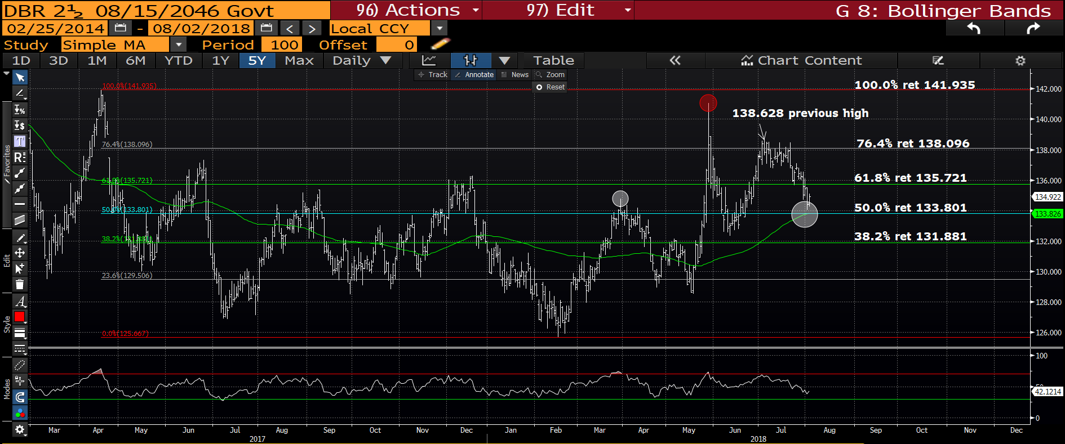
DBR 46 daily : Another 100 day moving average hit, also aligned with the 50% ret 133.801.

Slide 25
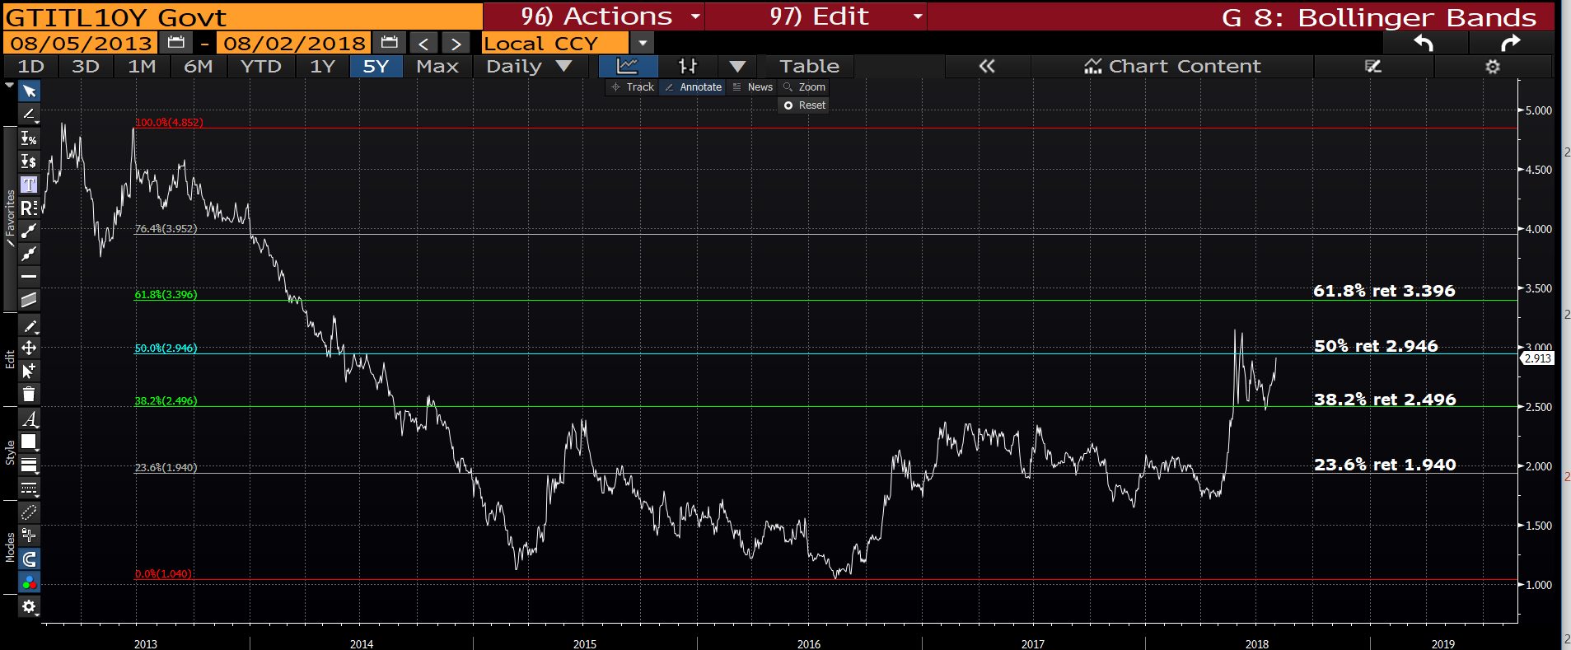
Italian generic 10yr daily : The next step here is very crucial, do we rebound off the 50% ret 2.946 or PASS through it. I think the later if the EURO breaks 1.1509.

Slide 26
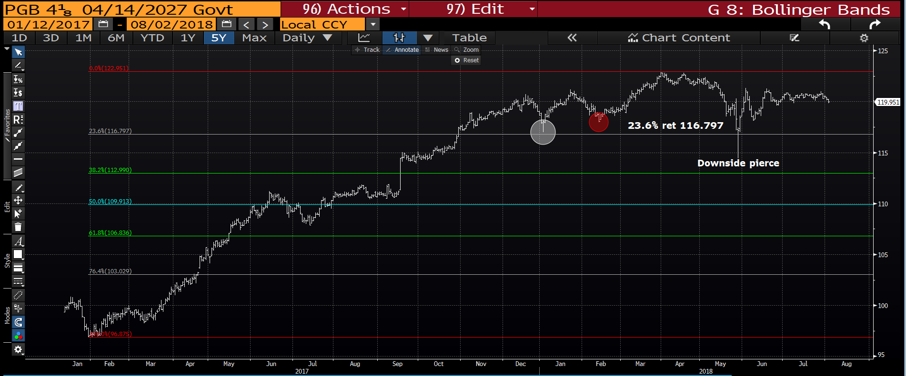
Portugal 27’s : A very sideways market but still holding.

Slide 27
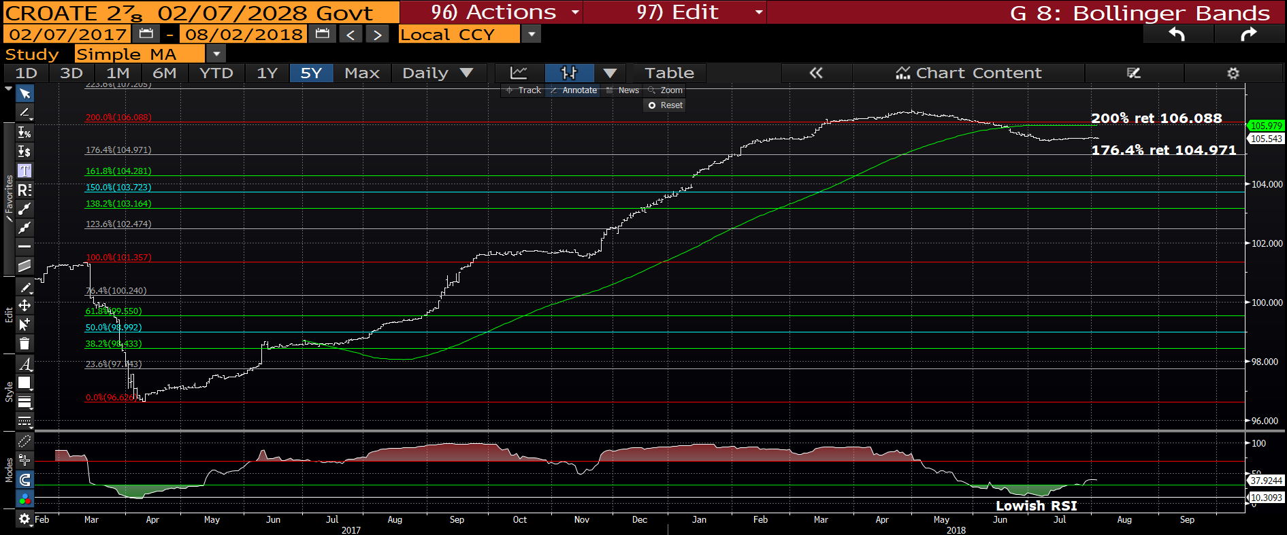
**Croatia 28’ daily : The RSI is now VERY low but we have dipped below the
200% ret 106.088. We should HOLD here given the RSI.

Slide 28
