Slide 1
MULTI ASSET UPDATE : PRE FED IT REMAINS YIELDS AND STOCKS LOWER, ACCOMPANIED BY A SHOCK FACTOR. The charts are lining up for a major FED night and could formulate a PIVOTAL turning point. Also a very prominent end to the quarter looming.
Bond yields : ALL long-term yield charts CONTINUE to endorse much lower yields so its really a case of WHEN, that could be this week if stocks fail from their current OPTOMISTIC levels here.
Equities : People have now become very CONTENT with the rally, SHOULD they fail here it will be terminal. If I am wrong then the BIGGEST DIP will have been missed. We continue the BATTLE with SO many overbought RSI’s and remain AROUND MANY CRUCIAL 200 day moving averages. The RUSSELL page 32 portrays a negative situation. Bloomberg news is full of underperformance and profit warnings to share holders not to mention the TECH sector under a HUGE SPOT LIGHT.
FX : Its not all about the USD, far from it given Brexit, Europe and EM. The EURO is testing KEY and previous resistance as we speak. DXY now looks poised to stall given the latest upside pierces.
RUB,INR and MXN now on the move aided by REAL MONEY longs.

Slide 2
FX UPDATE
Topics PAGES
BONDS 3 -13
US CURVES 14-20
EQUITIES 21-38
CORE FX 39-47
USD EM 48-56
Oil and GOLD 57-59

Slide 3
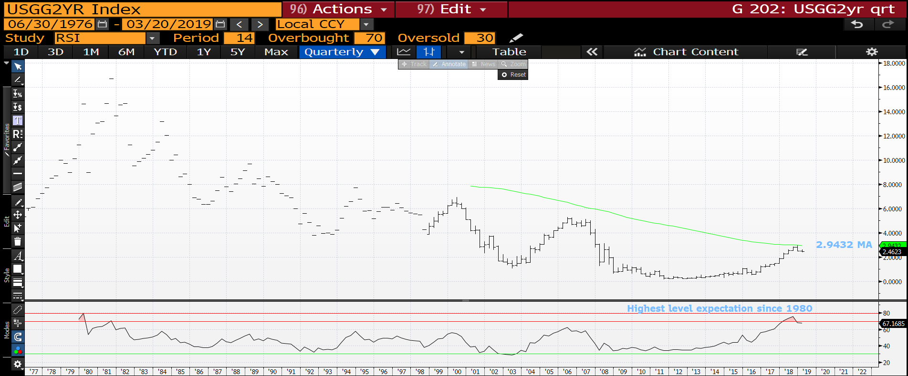
US 2yr yield quarterly : This chart highlights the HISTORICAL EXPECTATION is at 1980 proportions and thus expectation may have gotten ahead of reality. We could have a major top about to be confirmed by a re-breach of 2.4838. I have added a 100 period moving 2.9429 average highlighting last quarters high, a key failure. Its as if 2000 and 2007 were NON events.

Slide 4
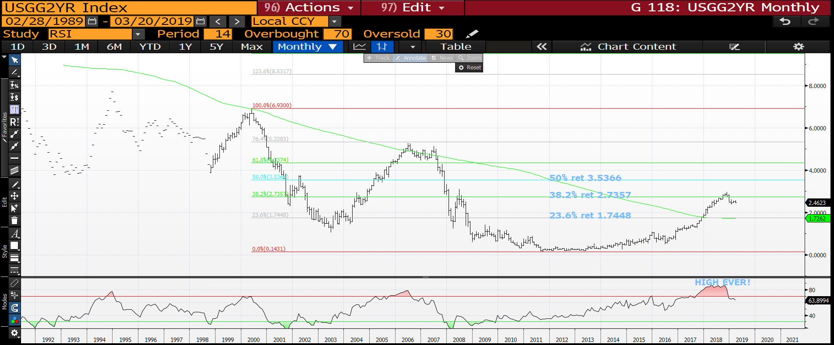
US 2yr yield monthly : The monthly RSI dislocation backs up the previous chart, it will be key if we remain sub the 38.2% ret 2.7357. Any reversal to the lows will be a major statement.

Slide 5
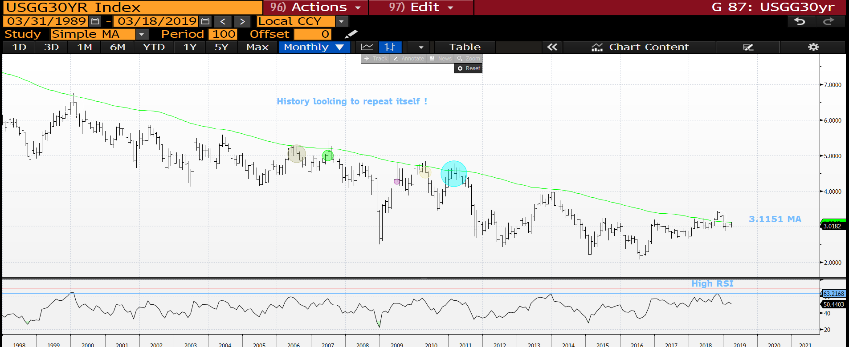
US 30yr yield monthly : The moving average 3.1151 is proving key resistance and thus must be noted. Previous failure is easily highlighted by the circles and the RSI remains high.

Slide 6
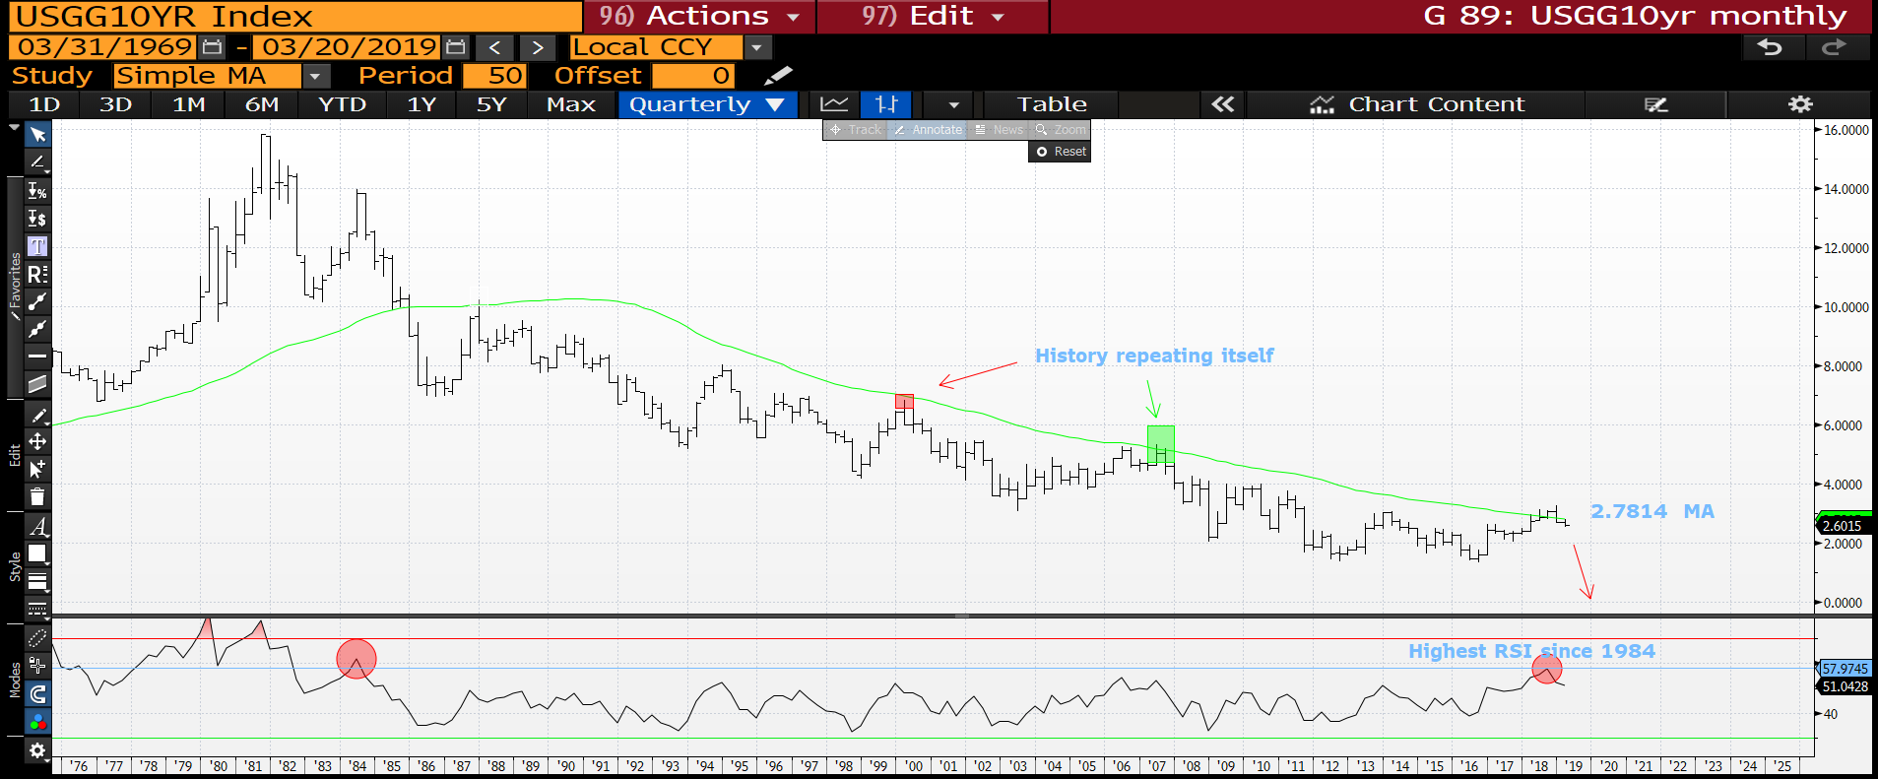
US 10yr yield quarterly : Another historical formation pointing toward lower yields as depicted in 2000 and 2007. The RSI has barely turned and we have failed to breach the 2.7814 moving average, thus far. We could DROP SHARLPY!

Slide 7
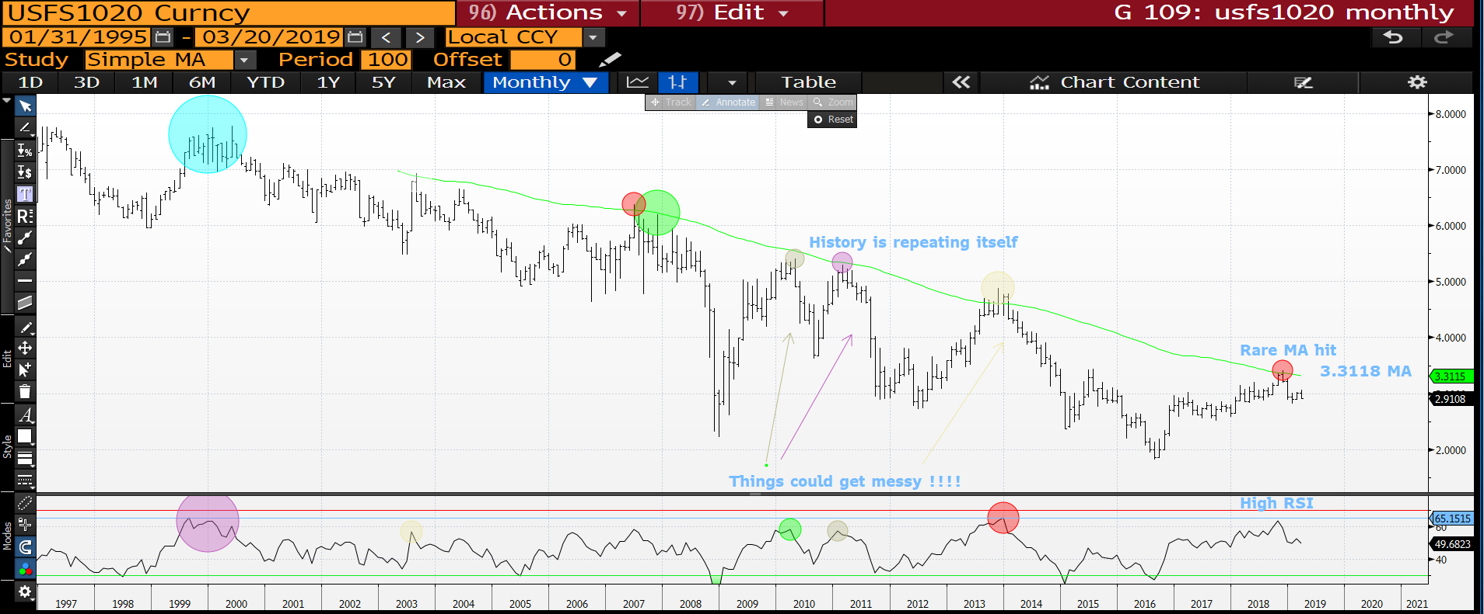
USFS10-20 monthly : This has been a great boost to the argument for lower yields going forward (assisted by our swaps expert David Sansom), as the chart shows we have a similar historical pattern of failure at this moving average. Lower we go.

Slide 8
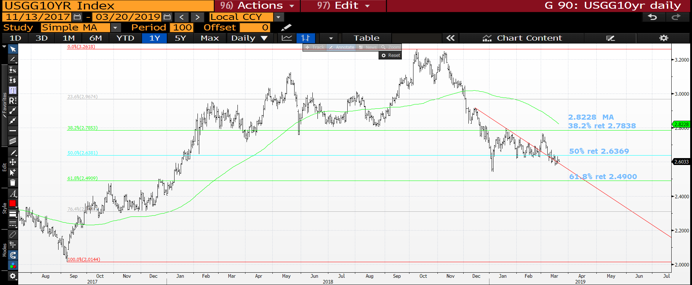
US 10yr yield daily : We remain sub the 50% ret 2.6369 thus remain weak.

Slide 9
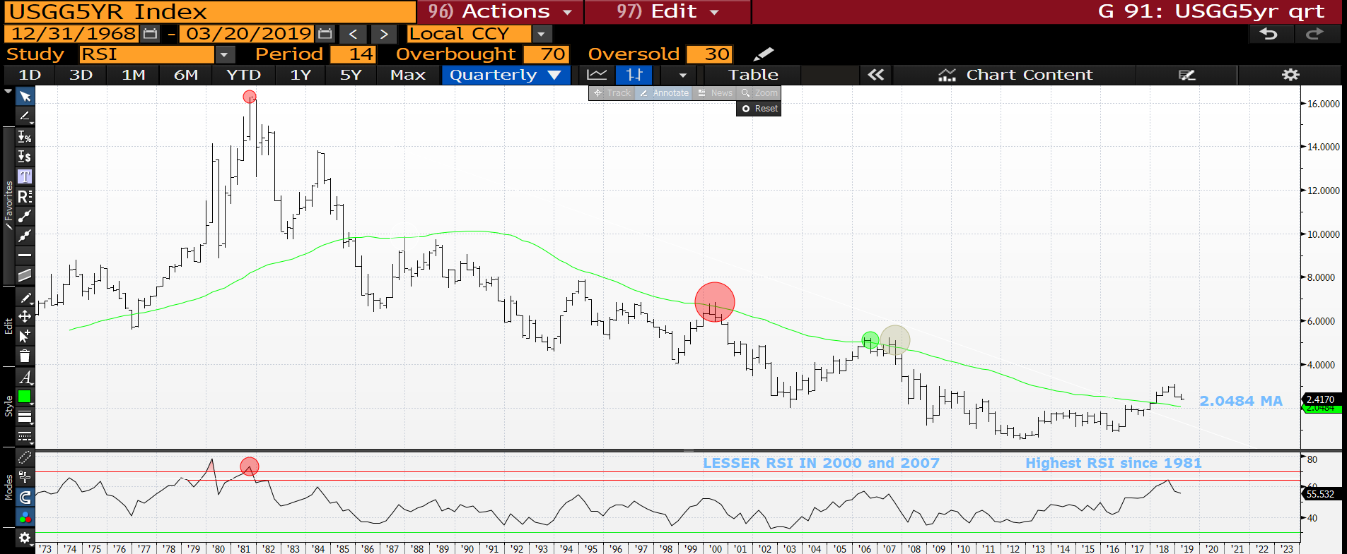
US 5yr quarterly : This time we are above the moving average BUT the RSI remains lofty, 1982 proportions! Again we have a new yield low and close to last quarters close. Where were 2000 and 2007 in this chart?

Slide 10
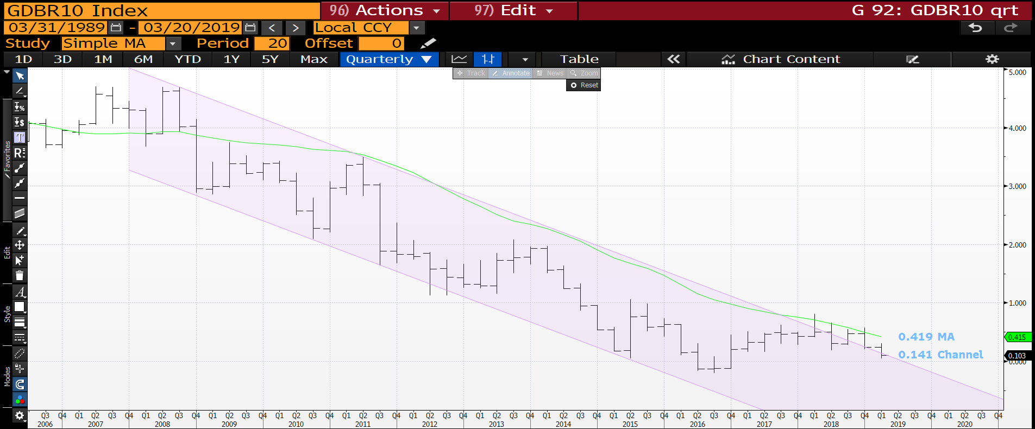
Generic German 10yr quarterly : Yields continue to grind lower now we are in the channel.

Slide 11
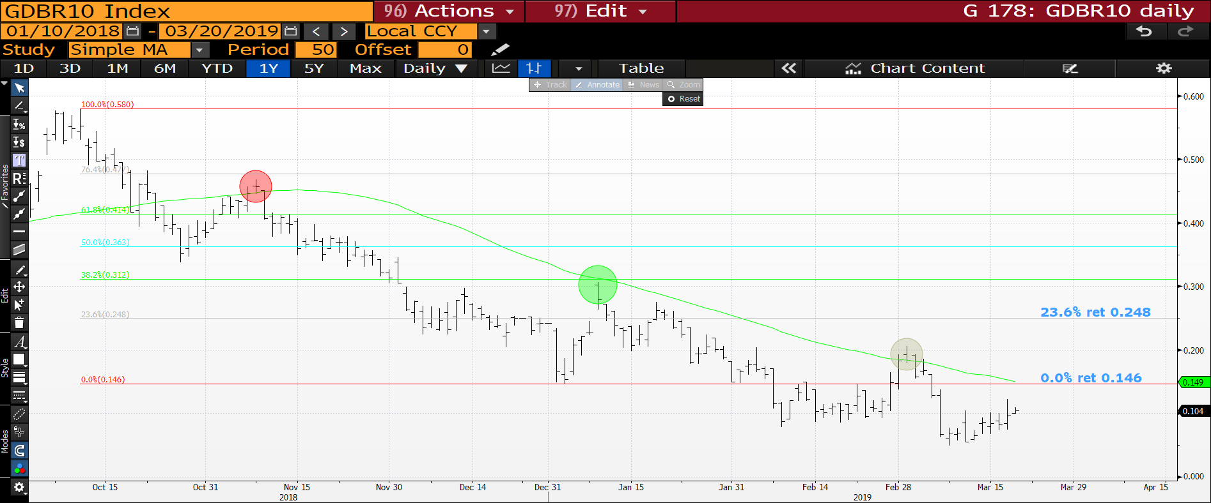
Generic German 10yr daily : We have continued to remain sub the 0.0% ret 0.146 so continues a very negative theme.

Slide 12
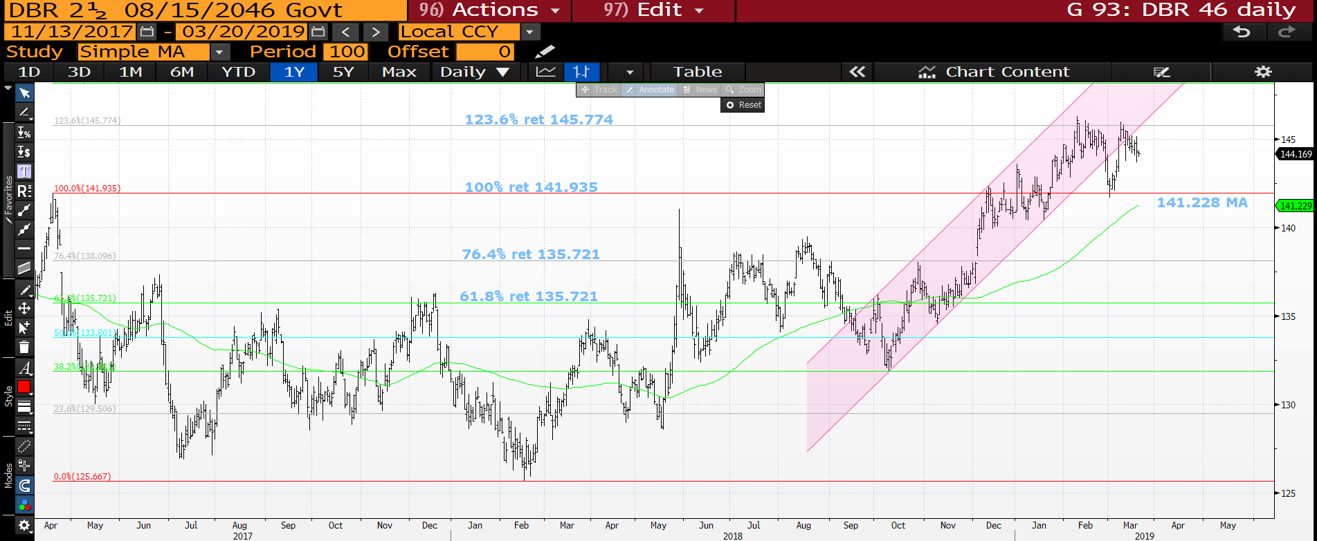
DBR 46 daily : This reliable bond does it again, we have held the previous high 100% ret 141.935 and should head higher from here.

Slide 13
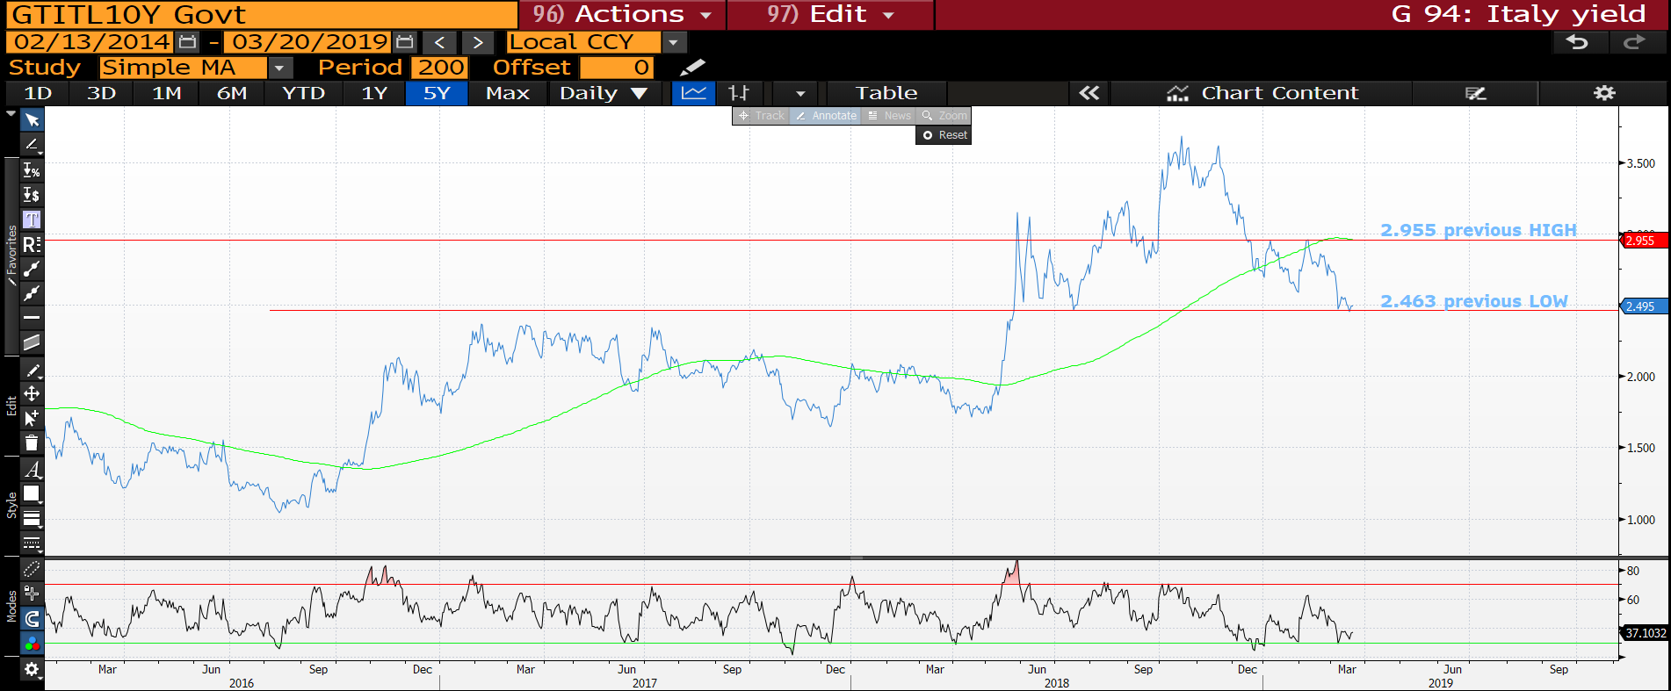
Italian generic 10yr daily : We are TEASING the 2.463 previous low so a MAJOR DROP if we close below it.

Slide 14
US curves a once in a lifetime opportunity?
Curves : Given yields should be heading lower again look to buy into steepeners in the back end. i.e 5-30 and 10-30.
** It seems the BACK END is where the TRADE is given the 2-30, 5-30 and 10-30 performance yesterday.
All generally have low RSI’s, MANY at 2006 levels.
It seems hard at the moment to pinpoint the OPTIMUM curve to go for but contenders already are 2-30, 5-30 and 10-30, that said most could do with quarter end confirmation.
REMEMBER ALL RSI’s ARE EXTENDED AND MANY HAVE HIT MULTI YEAR 76.4% RETRACEMENTS!

Slide 15
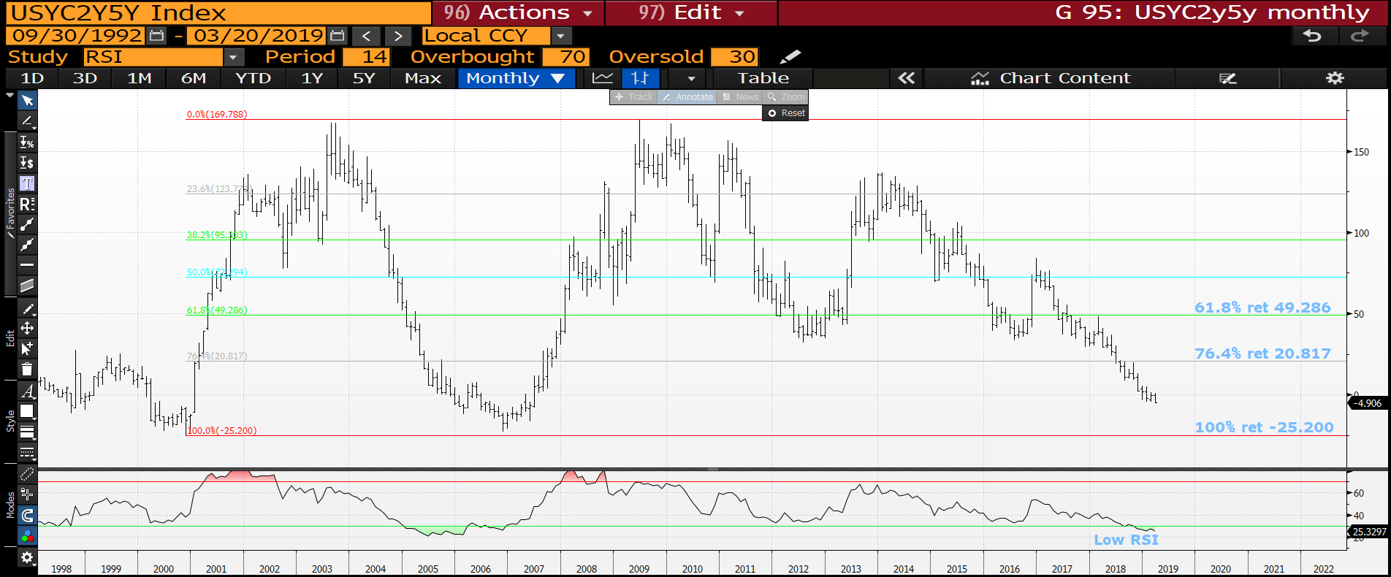
US 2-5 curve monthly : We have yet to reach an oversold RSI worth commenting on but the outright 2yr is poised to break lower in yield. Could be that a 2yr verses longer duration is better. Say 2-30.

Slide 16
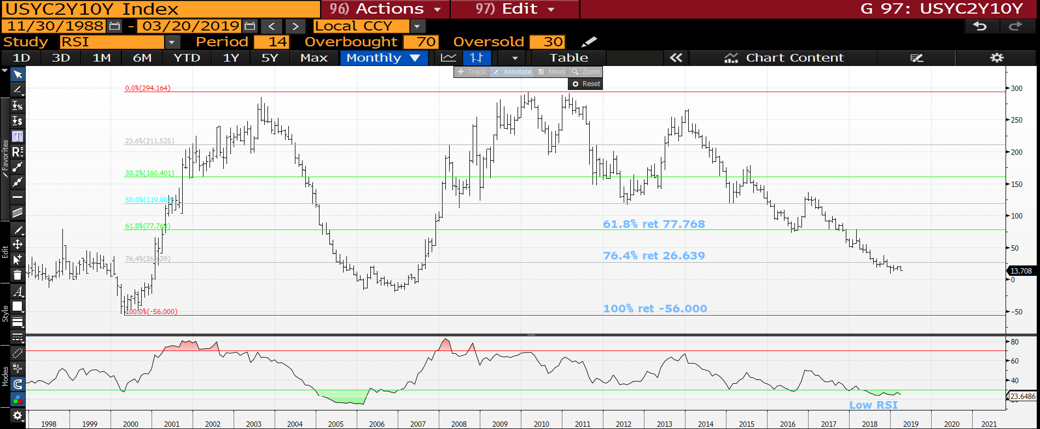
US 2-10 curve monthly : We might JUST have a base given we have a pierce! The RSI seems low enough, just need to get back above the 76.4% ret 26.639.

Slide 17
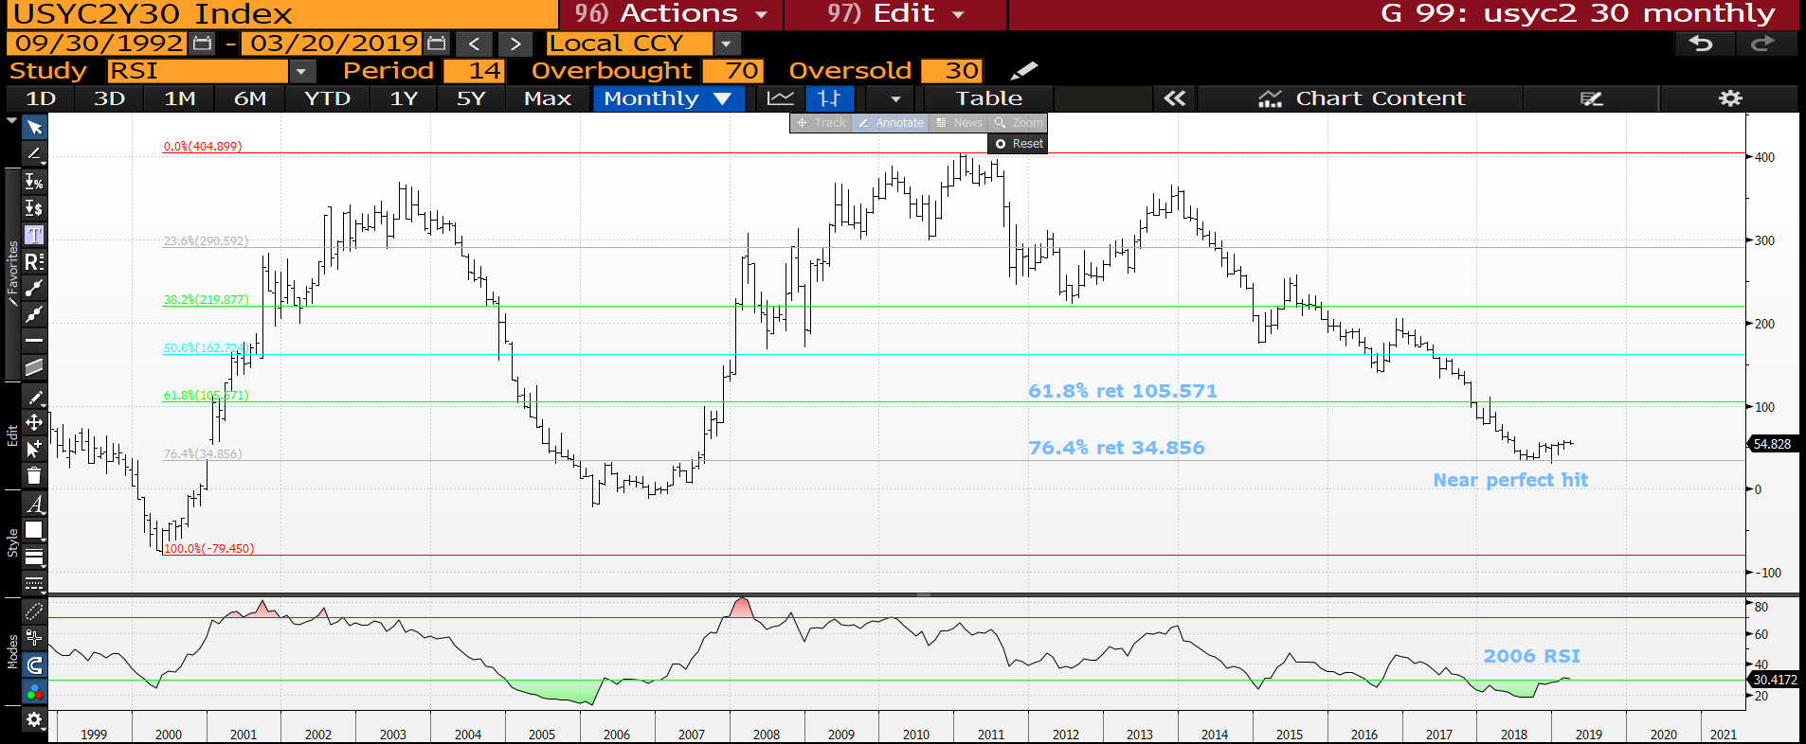
US 2-30 curve monthly : ANOTHER PERFECT hit and possible PERFECT BOTTOM to trade from. TO me this remains a VERY long-term trade and “what a great entry” knowing the LOW has been tested TWICE. We should start heading higher from here!

Slide 18
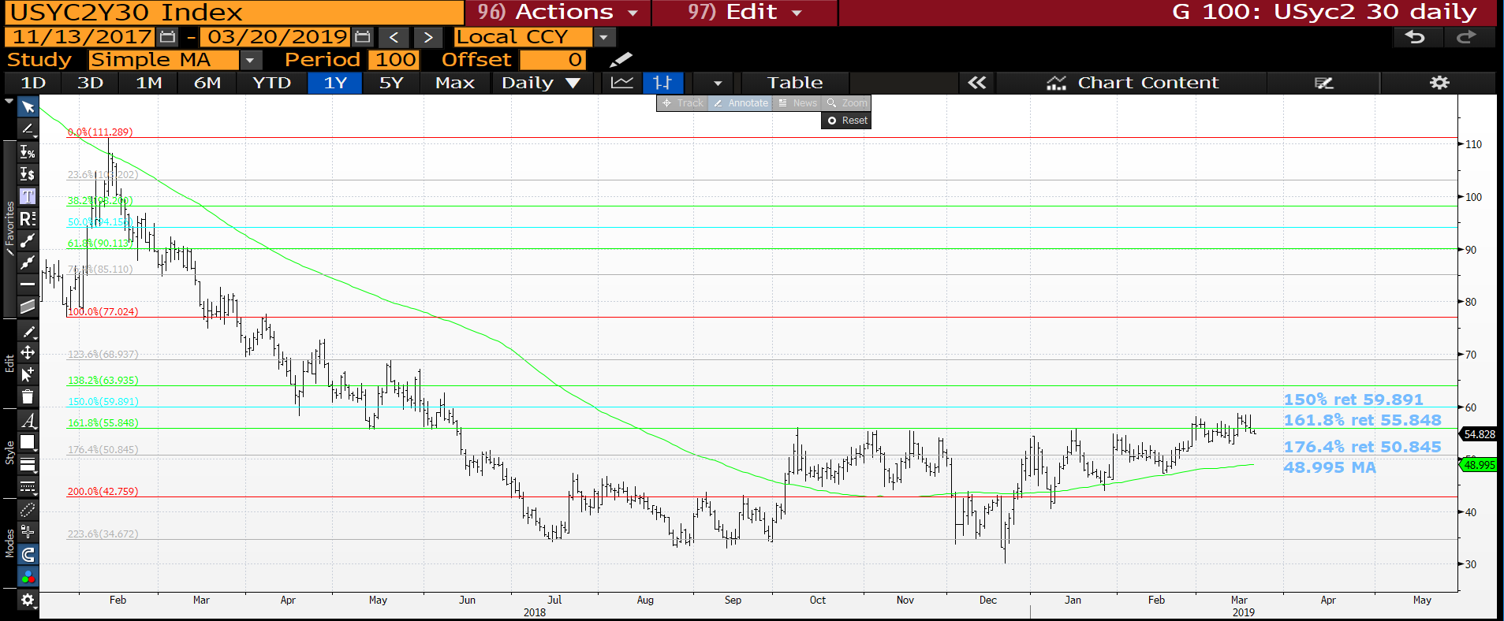
US 2-30 curve daily : We have re-breached the 161.8% ret 55.848 thus a short term stall.

Slide 19
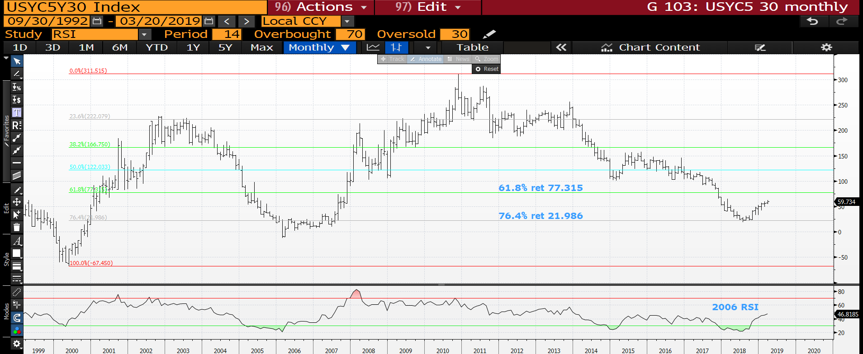
US 5-30 curve monthly : A VERY SOLID performance but watching the neutral RSI.

Slide 20
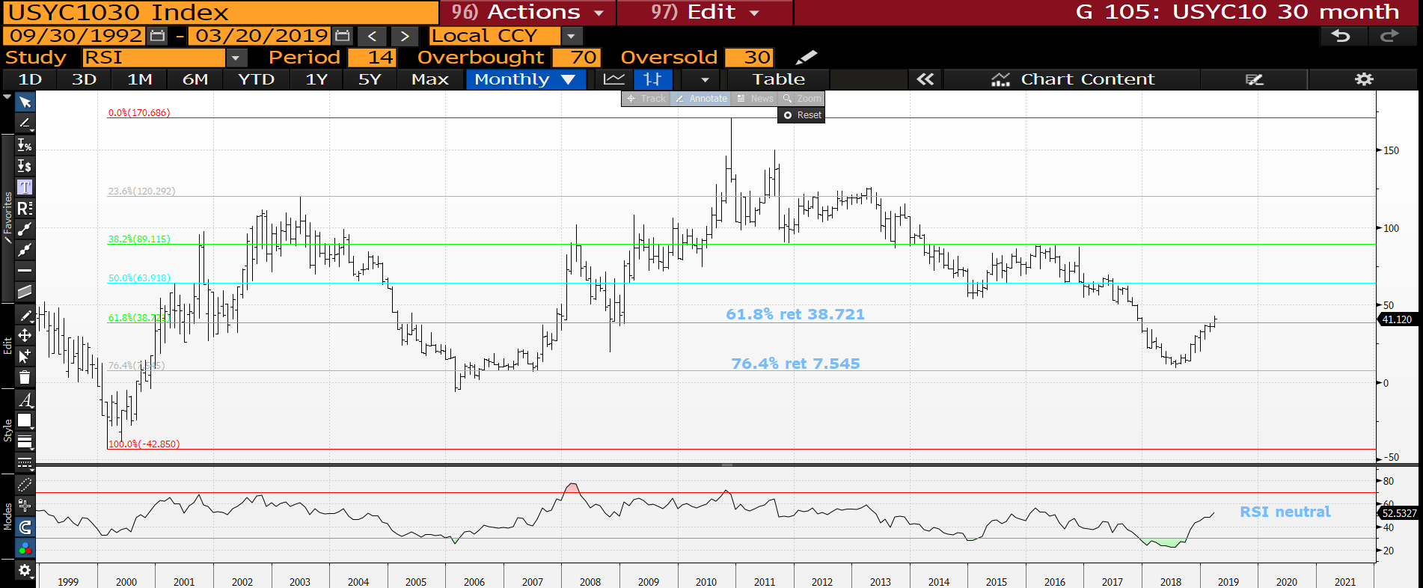
US 10-30 curve monthly : We have breached the multi-year 61.8% ret 38.721 thus a BIG statement.

Slide 21
EQUITIES
EQUITIES : Many will argue that stocks are FINE and a level of comfort is now built in. This has never been more of a critical location TO FAIL. Optimism is built in along with positions however MANY US markets remain sub key 200 day moving averages. If bond yields drop too it will be a double WHAMMY.
They continue to perform but further upside progress seems limited. We remain around numerous 200 day moving averages!
Although no NEW monthly lows we haven’t rallied MUCH. It’s a matter of TIME before stocks head lower AGAIN!
Europe is in a terminally bad way whilst the US is close to confirming the 10 year “RALLY” is over.
Both Nasdaq and Russell have 200 day moving average resistance.

Slide 22
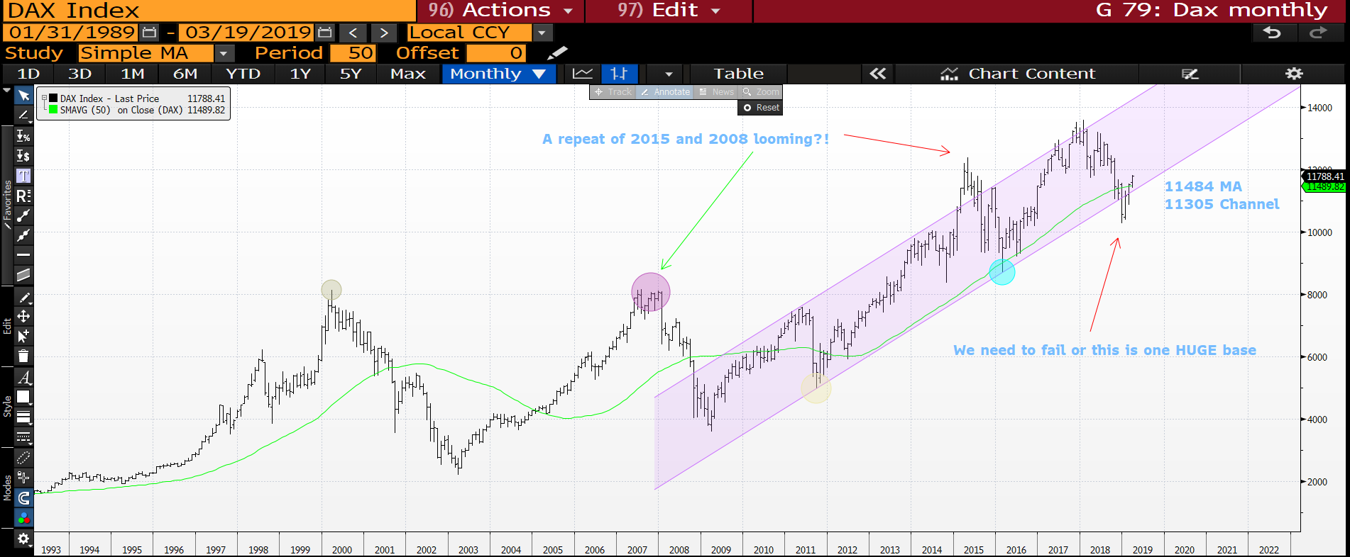
DAX monthly : We are now above all NEGATIVE levels BUT the daily REMAINS SUB key levels, admittedly JUST.

Slide 23
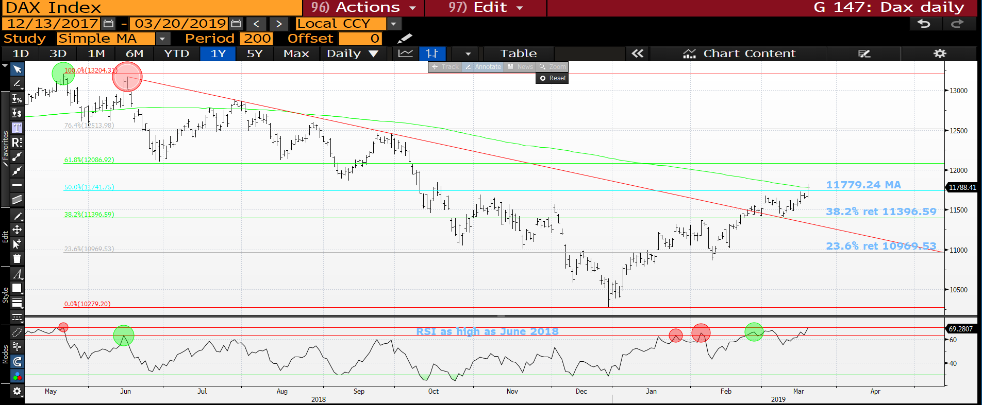
Dax daily : ITS NOW OR NEVER! We need to fail here and should given the RSI and 11779.24 moving average.

Slide 24
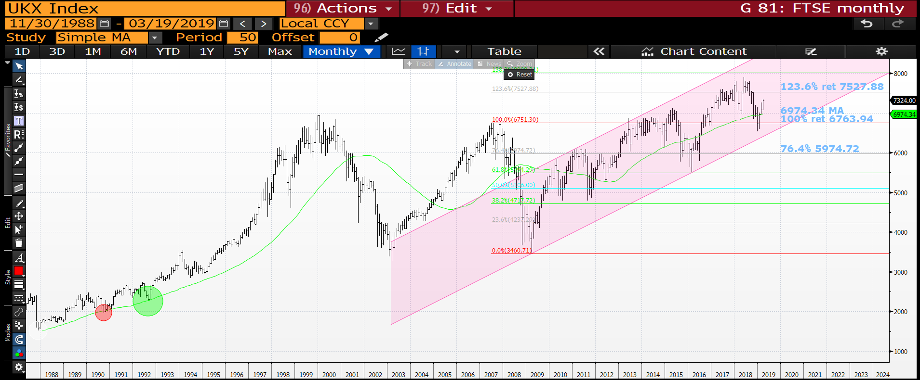
FTSE monthly : We are through last monthly high SO little negative about this chart.

Slide 25
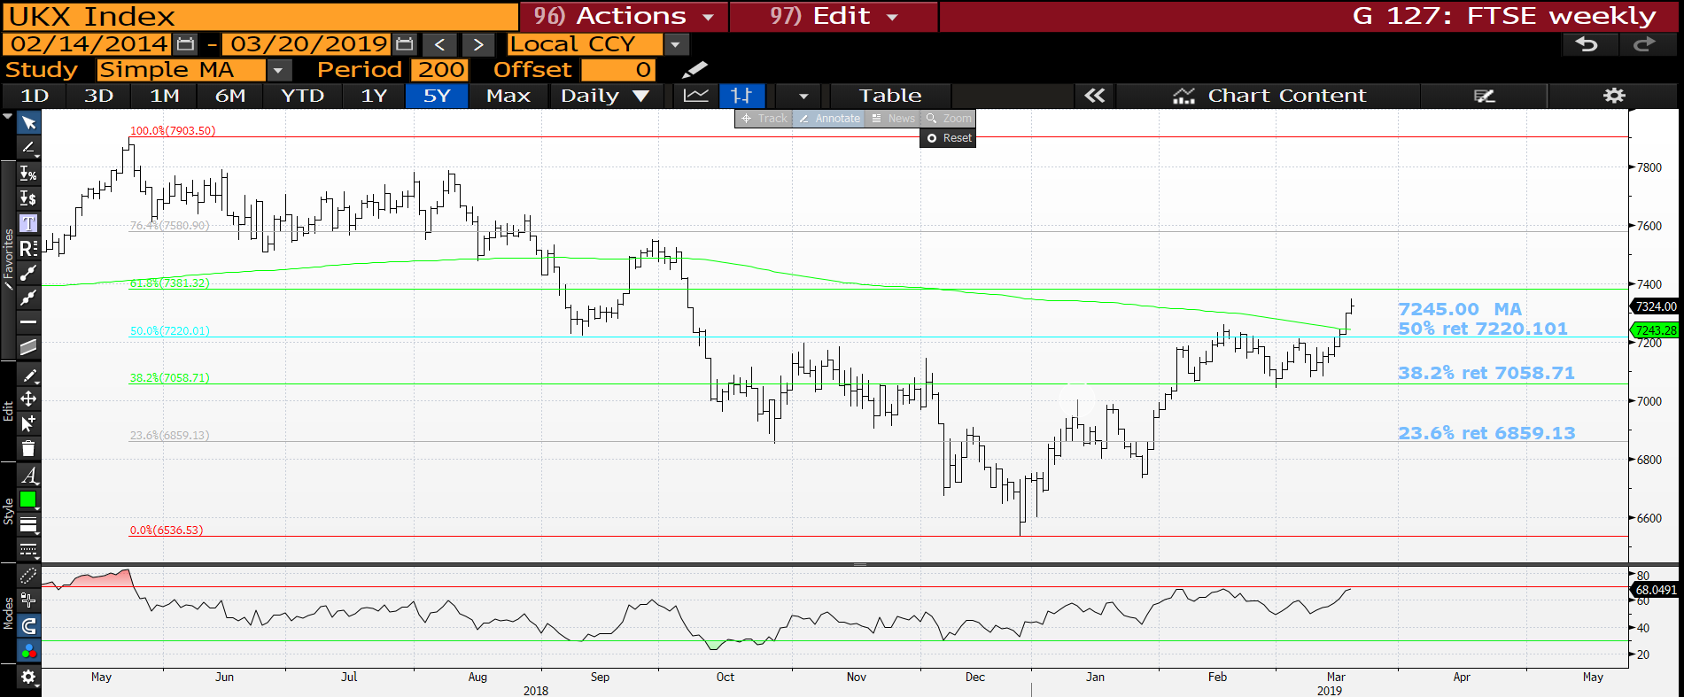
FTSE daily : We are through most levels of not and now relying on the OVERBOUGHT RSI to kick in.

Slide 26
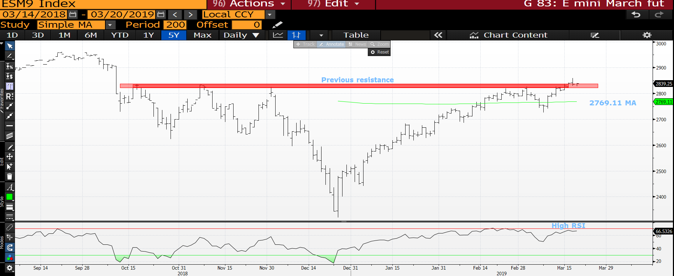
E mini S*P daily : Again NOW OR NEVER, we remain at solid previous resistance. The RSI is high. We shall see.

Slide 27
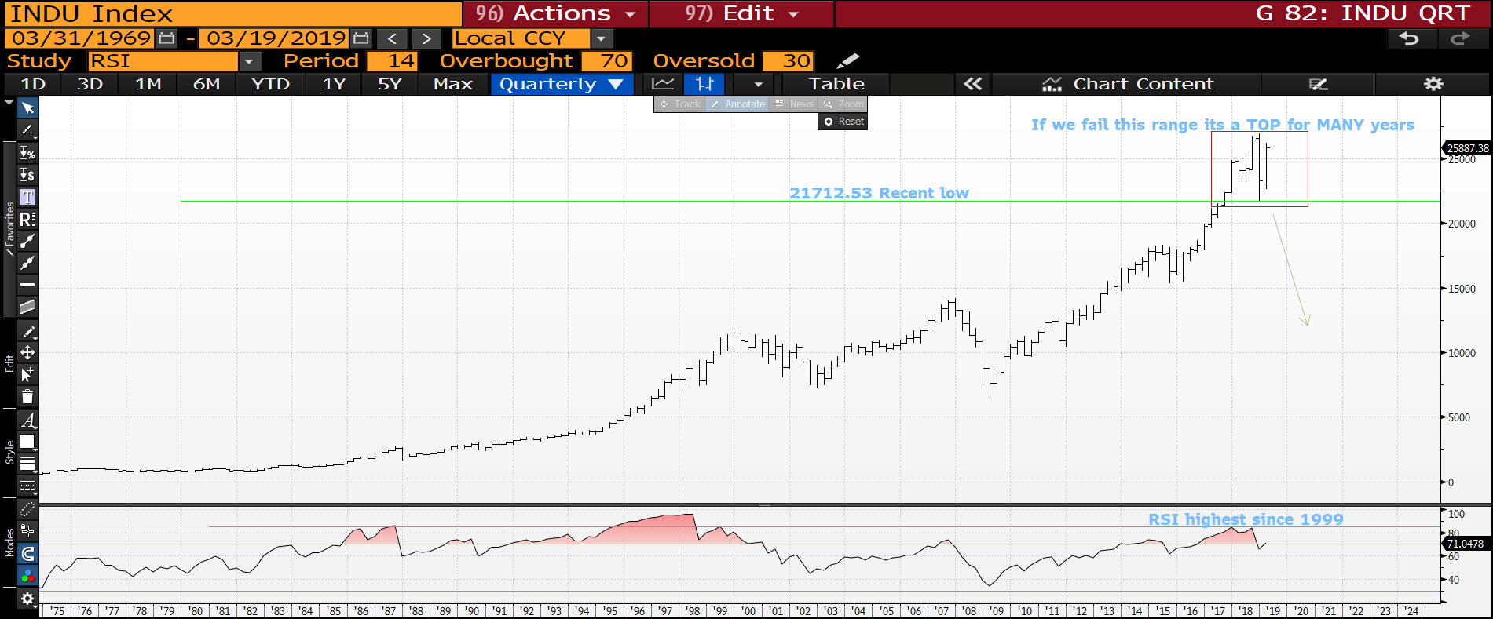
DOW quarterly : We have a “TOP” but need to capitalise on that with a move SUB the 23344.52 previous low.

Slide 28
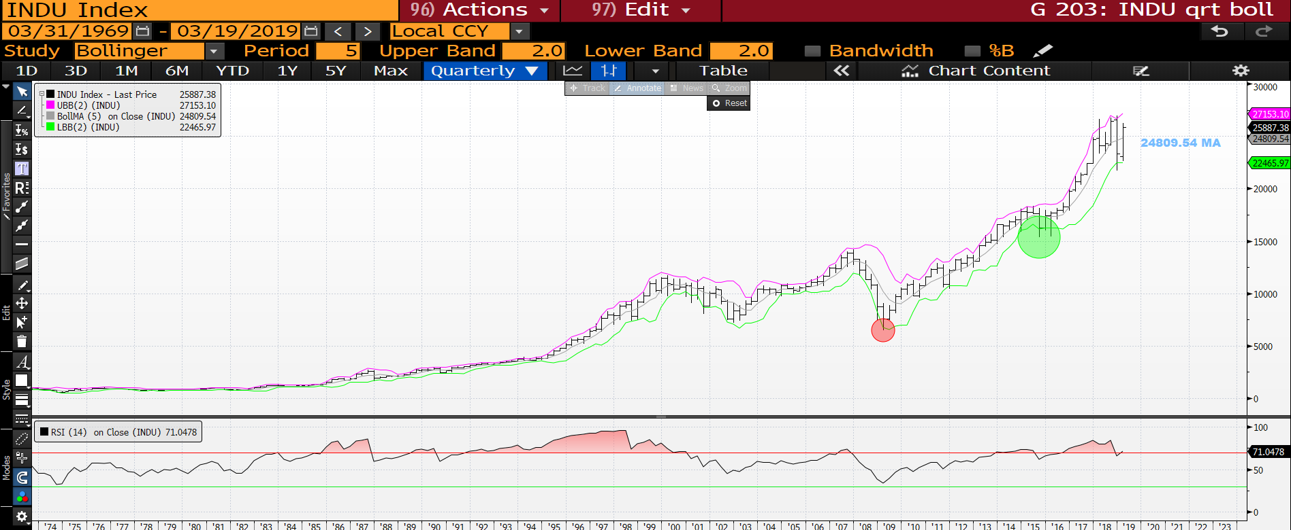
DOW quarterly : Last quarter generated pierces at either end of the range so IDEALLY to continue the bearish outlook we need to fail the 24809.54 moving average.

Slide 29
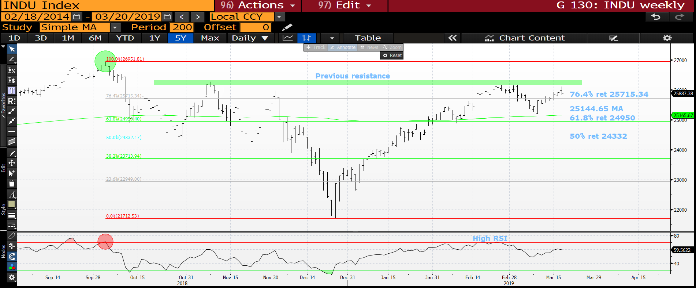
DOW daily : We are already failing the familiar resistance, sub the 76.4% ret 25715.34 will be helpful and sub the 25144.65 KEY.

Slide 30
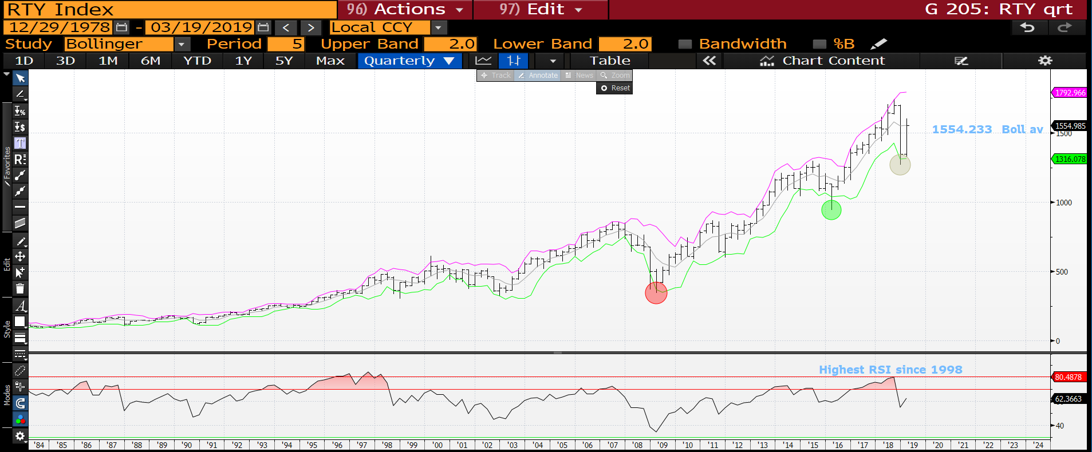
Russell quarterly : We have had a sizeable bounce but looks doubtful it will repair the terminal damage. Ideally we need to breach back below the 1554.233 bollinger average.

Slide 31
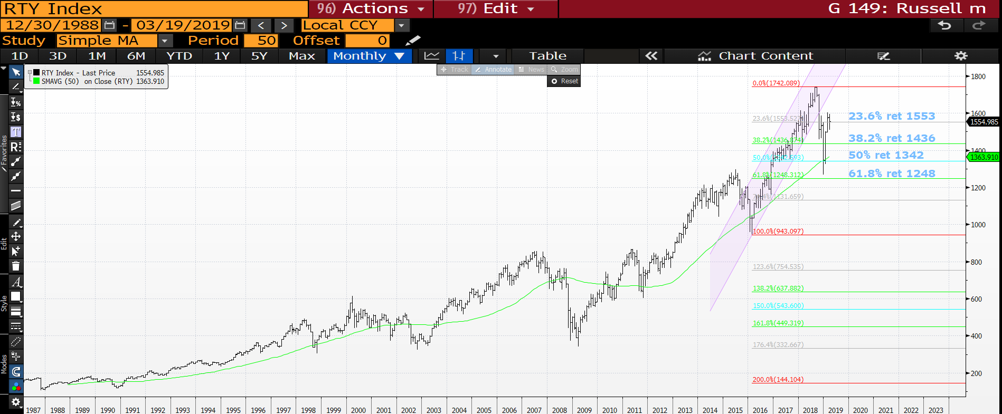
Russell monthly : We have had a sizeable bounce and ideally nip back below the
23.6% ret 1553.

Slide 32
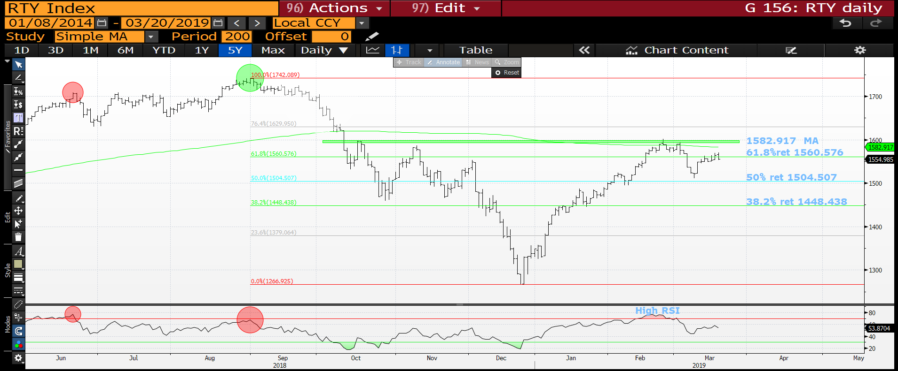
Russell daily : We are falling SHORT of the previous resistance so not as positive as people think. Remaining sub the 61.8% ret 1560.576 will help.

Slide 33
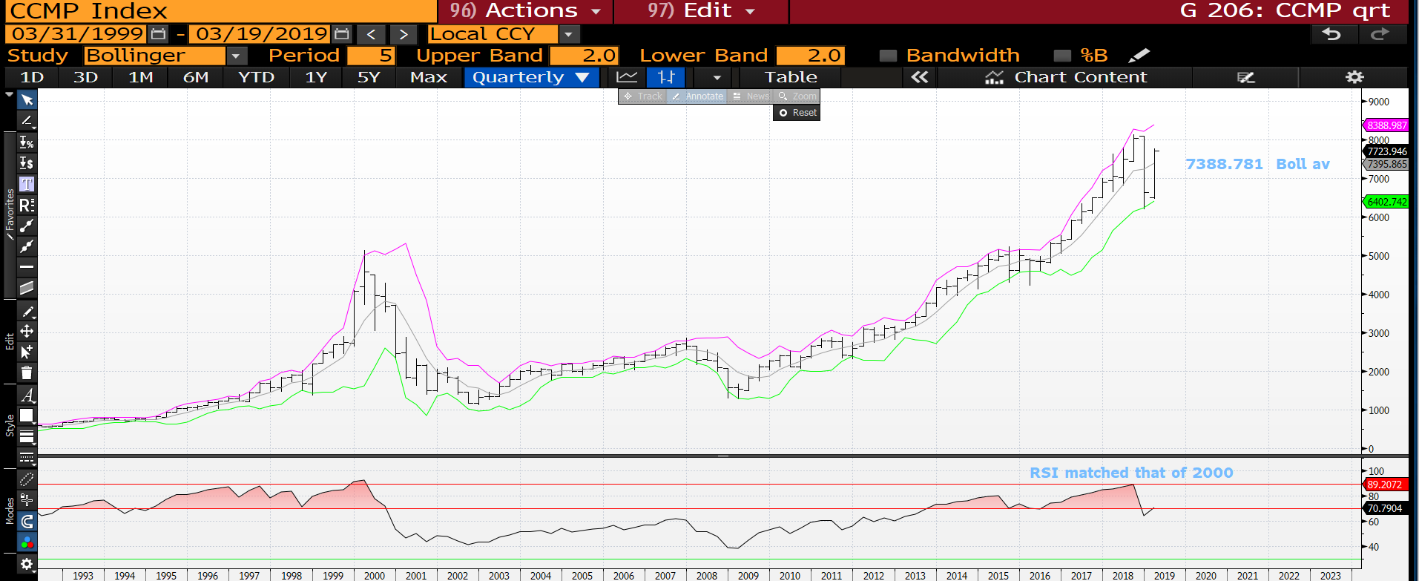
CCMP quarterly : A nasty bounce that minimally needs a close sub the 7388.781 moving average.

Slide 34
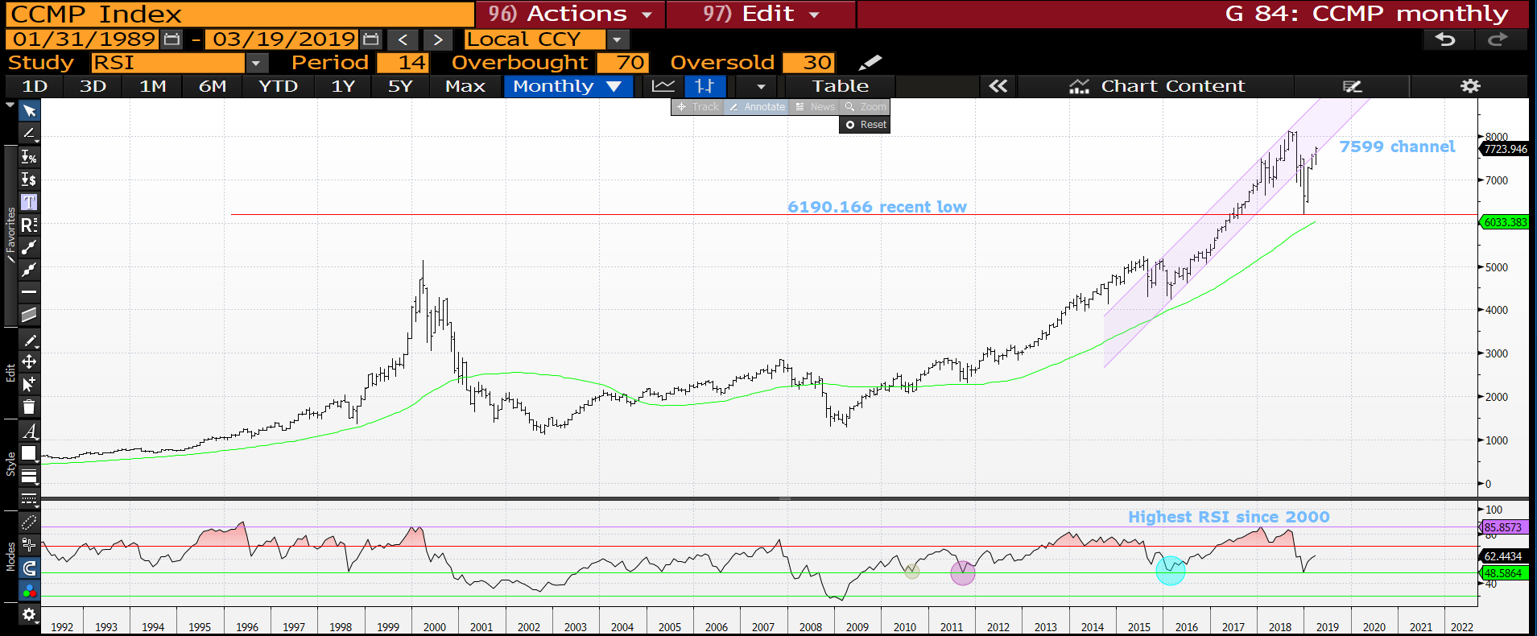
CCMP monthly : We have opened this month TESTING the channel resistance at 7599.

Slide 35
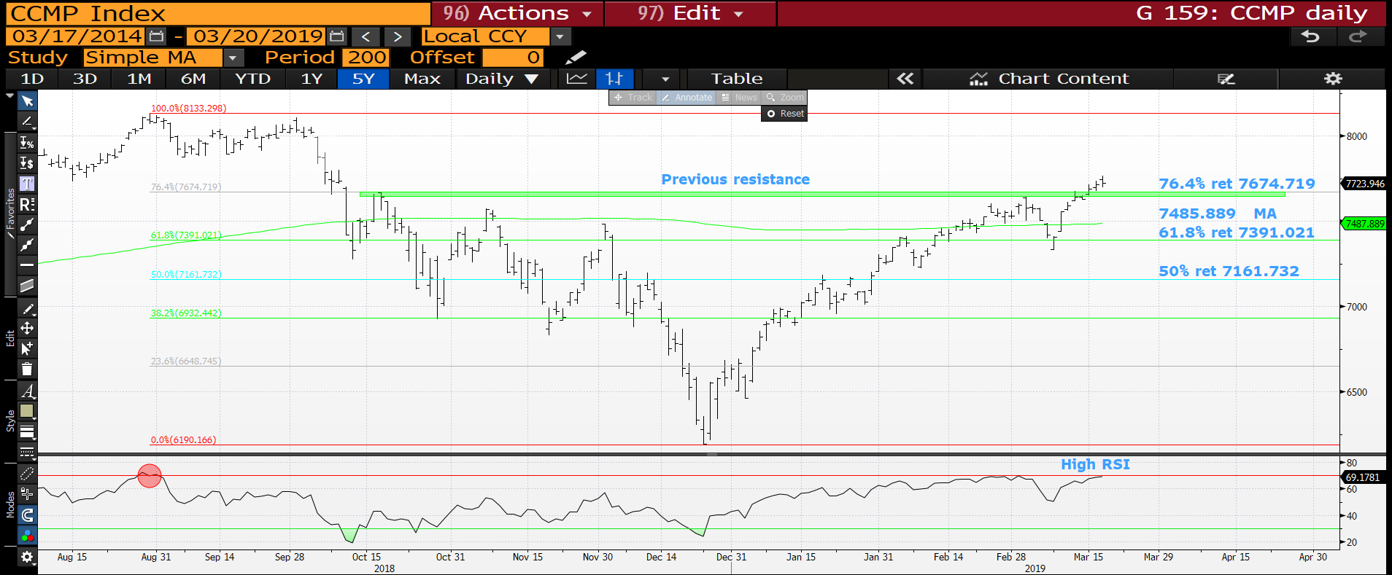
CCMP monthly : The last line of DEFENCE! We need to fail here and get back below the previous resistance-76.4% ret 7674.719, the RSI should help!

Slide 36
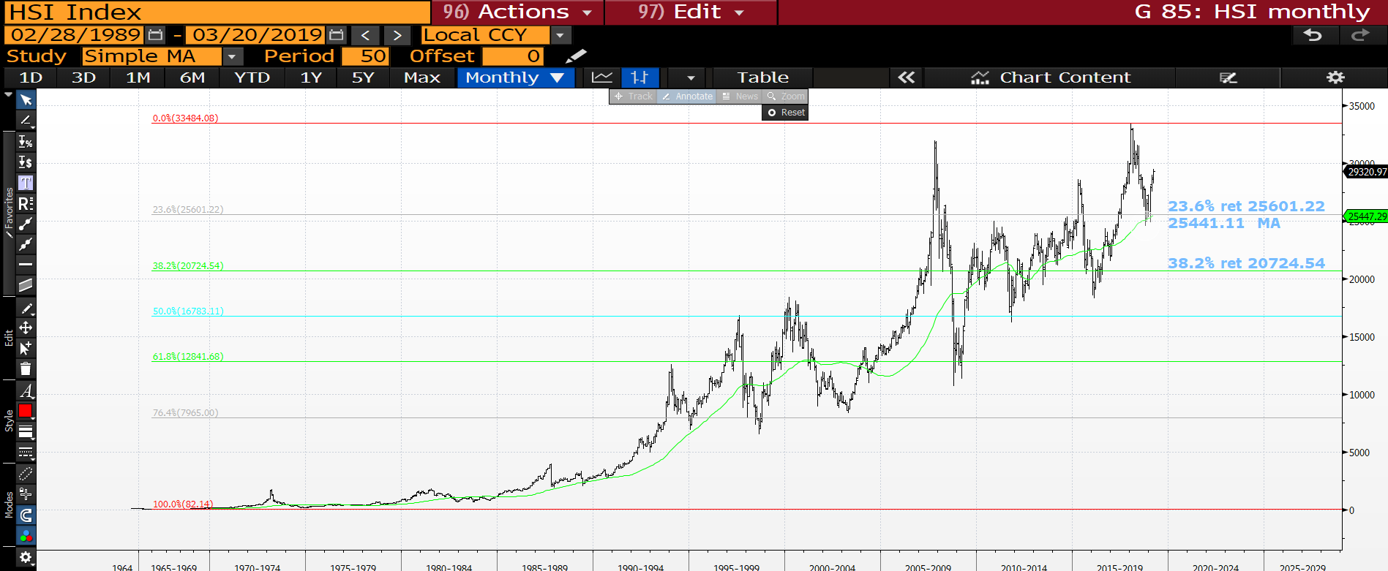
Hang Seng monthly : This is the biggest obstacle to a any short as this market formed a MAJOR base against its long-term moving average 25342.91.

Slide 37
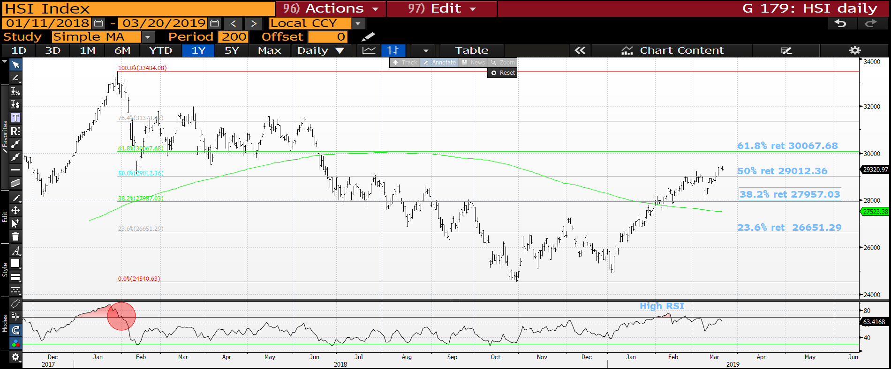
Hang Seng daily : FINALLY the RSI is HIGH but we need to close below the 50% ret 29012.36 soon.

Slide 38
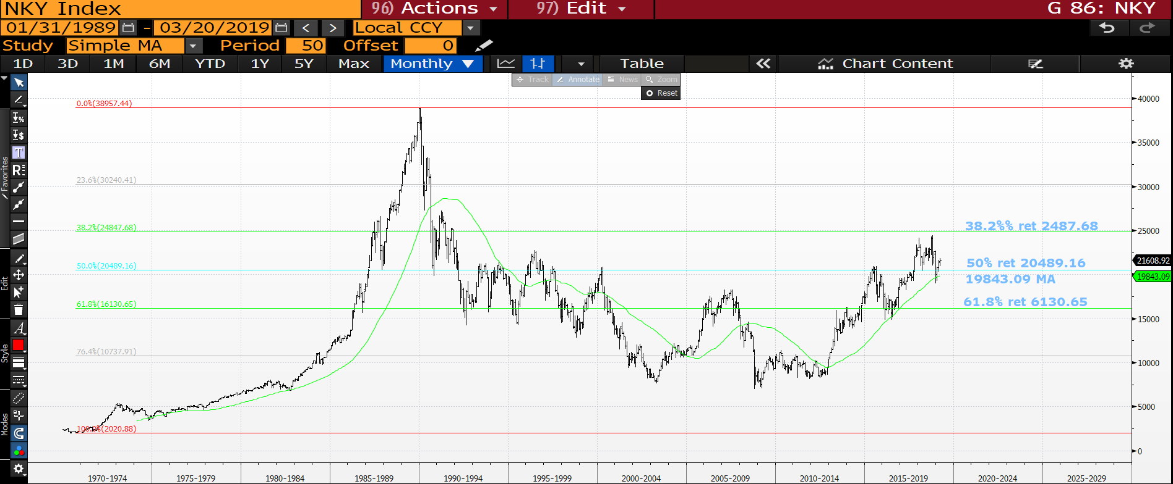
Nikkei monthly : A similar story to the Hang Seng in that we need to breach the 50% ret 20489.16.

Slide 39
FX UPDATE
FX UPDATE :
EURO : The EURO is “HOTTING UP” as we ease toward a Brexit conclusion. Sub 1.1241 will be catastrophic. If 1.1241 is ever breached then EUROPE-EU has a MAJOR CREDIBILITY ISSUE. We have a major test on right now as we TEASE constant moving average resistance 1.1358.
EUR GBP I have long favoured a short in this and the market looks poised to stretch its legs, am convinced this will come with the EURO breaching 1.1241. This could be the STAR trade for 2019.
The DXY index is teasing the 50% ret 95.859 with little RSI drive.
EM now steeping forward as MANY multi year tops are close to being confirmed. EM is a firm favourite with REAL MONEY.

Slide 40
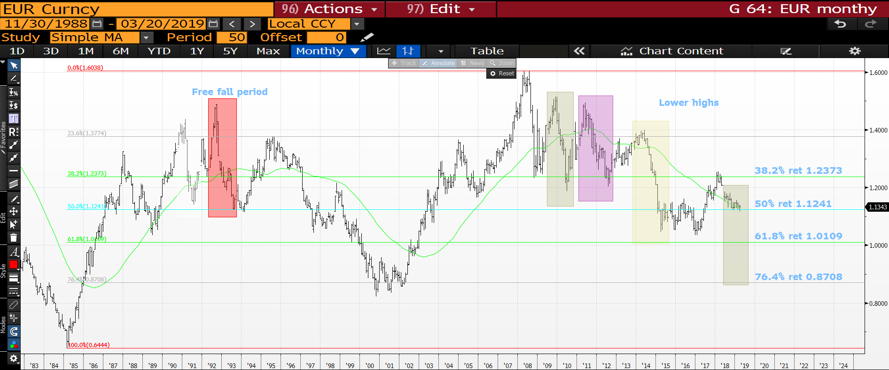
EUR USD monthly : The niggle here is we have HELD the 50% ret 1.1241 but continue to trade sideways with little bounce. Sub 1.1241 we freefall, there are previous range extensions highlighted.

Slide 41
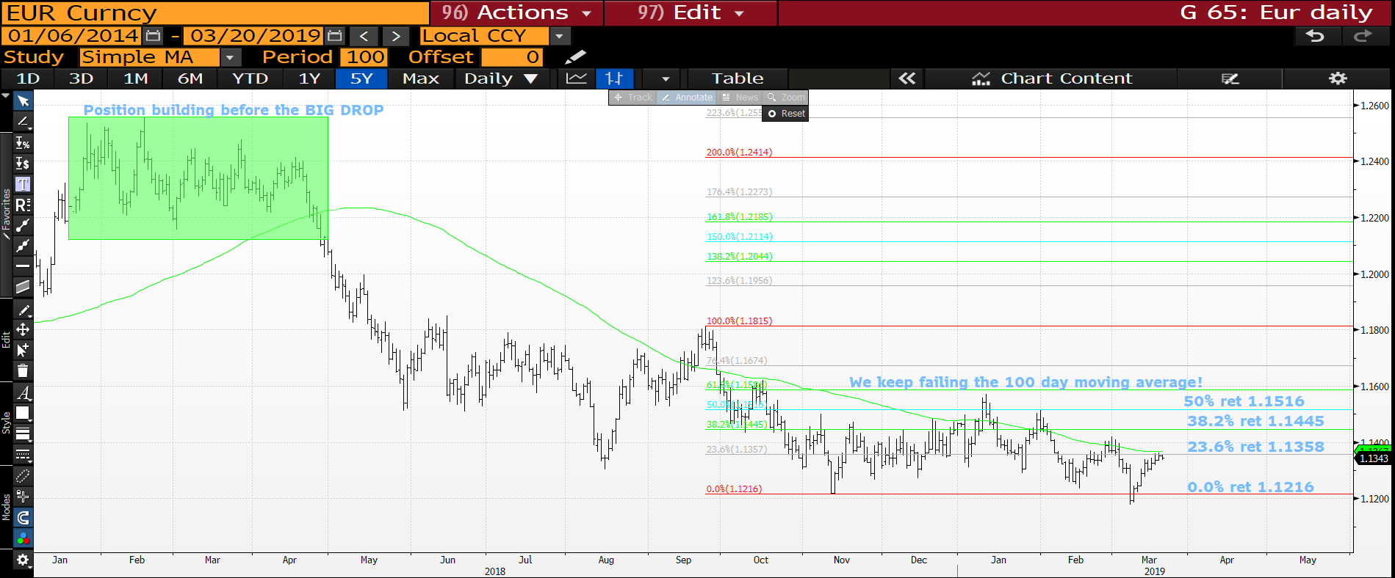
EUR USD daily : A MAJOR TEST HERE as we hit the VERY RELIABLE 100 day moving average 1.1358.

Slide 42
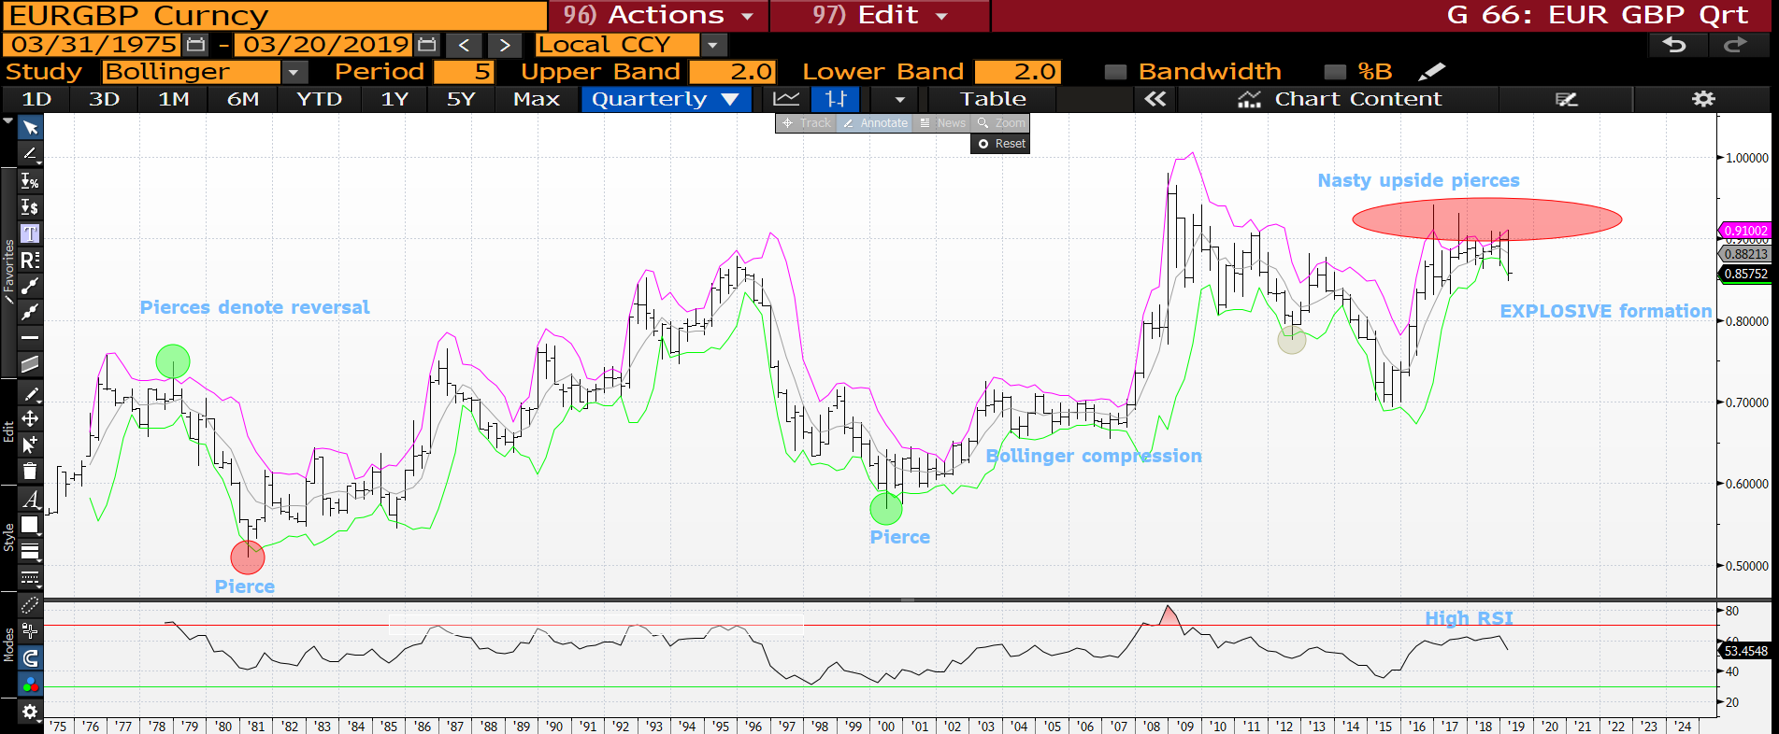
EUR GBP quarterly : This is a VERY RARE formation and a MEGA bearish one for the EURO over the POUND. We have SEVERAL upside pierces and coiling formation! For obvious reasons the one to watch but the speed of the move will be the killer blow!

Slide 43
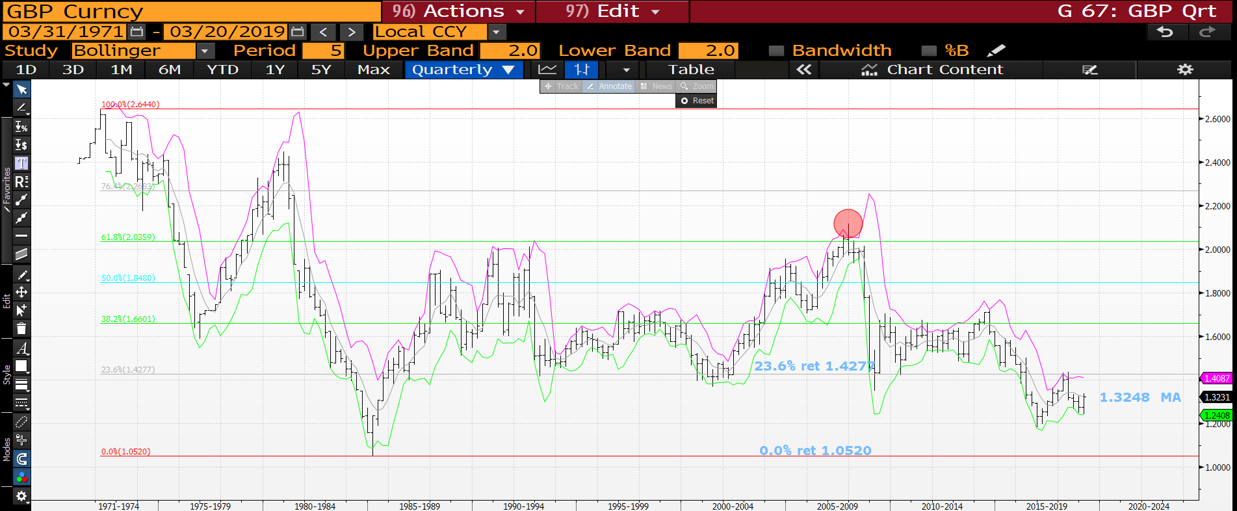
Cable quarterly : A reasonable recovery with in the bollinger bands, a BIGGER statement has been made above the 1.3248 moving average.

Slide 44
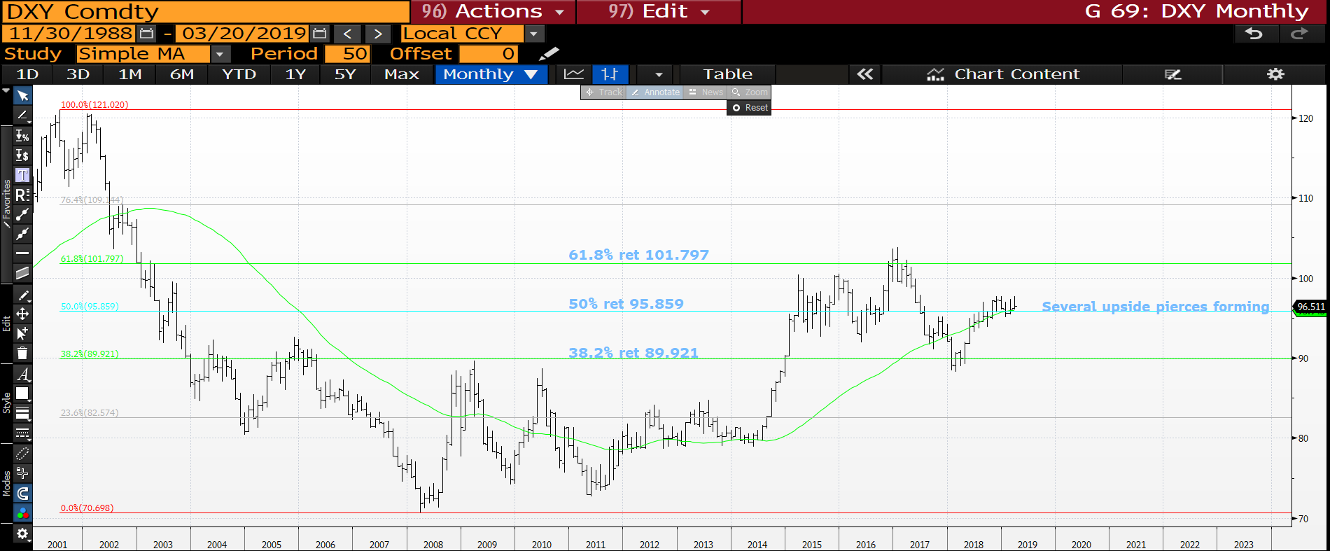
DXY monthly : A tricky location and rather a neutral one being at a 50% ret 95.859 of the last 18 years. Issue here though is that the recent upside pierces are forecasting a BEARISH move lower soon.

Slide 45
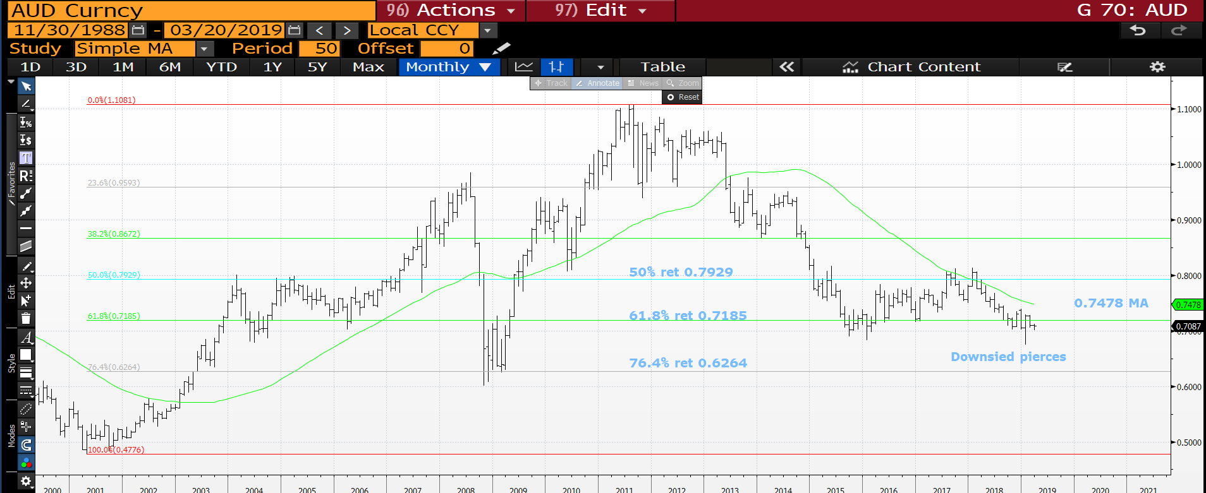
AUD USD monthly : AUD low in place and now ready for a decent move higher. The latest pierces are very positive. Above the 61.8% ret 0.7185 will help ALOT.

Slide 46
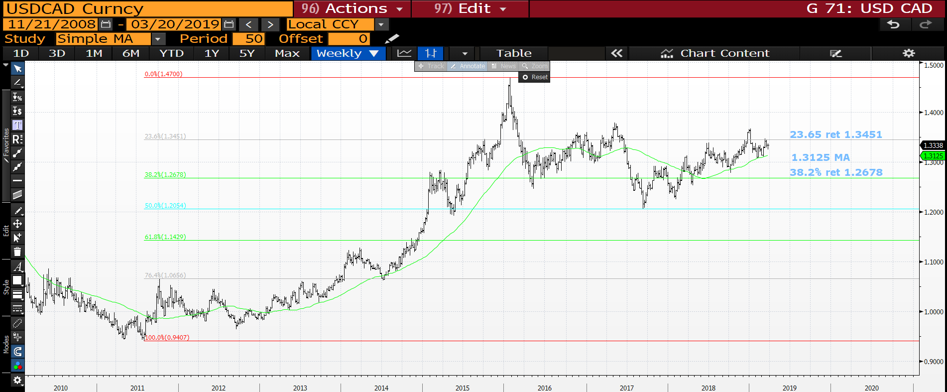
USD CAD weekly : The moving average continues to be the solid support on any dip, next step is to breach the 23.6% ret 1.3451.

Slide 47
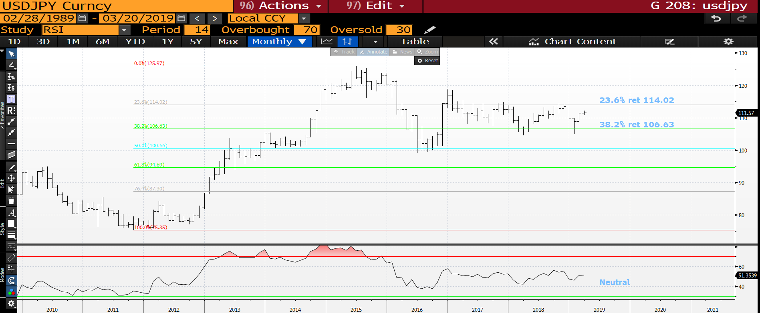
USD JPY monthly : I had to include this but the RSI and market is very neutral.

Slide 48
EM UPDATE
EM : A significant proportion of the EM crosses have created multi year tops and should see EM continue to perform regardless of USD direction.
MANY USD-EM crosses now have SIZEABLE long-term tops formed. I think it is a combination of EM relief that the Turkey-Argentina situation is improving and the DXY losing momentum, more bias on the former for influence.
USD MXN continues to reject decent trend resistance at 20.6155 AND poised to break lower!

Slide 49
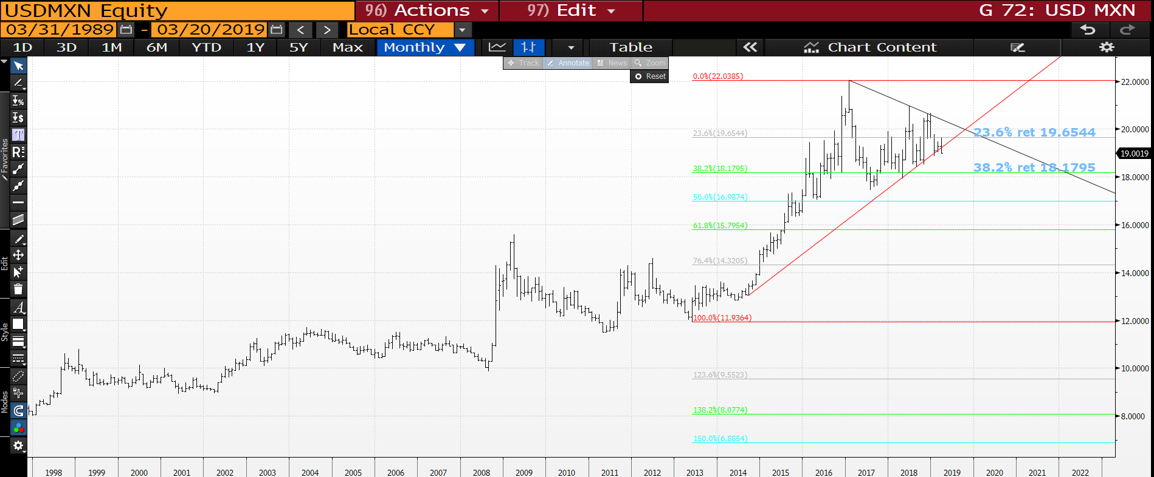
USD MXN monthly : We have broken the out of the VERY TEDIOUS triangle so the next target is the 38.2% ret 18.1795.

Slide 50
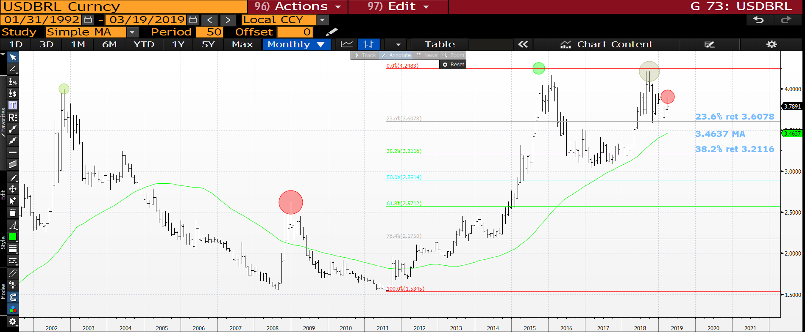
USD BRL monthly : We now have a very sizeable volume top and any breach of the 23.6% ret 3.6078 will be HUGE.

Slide 51
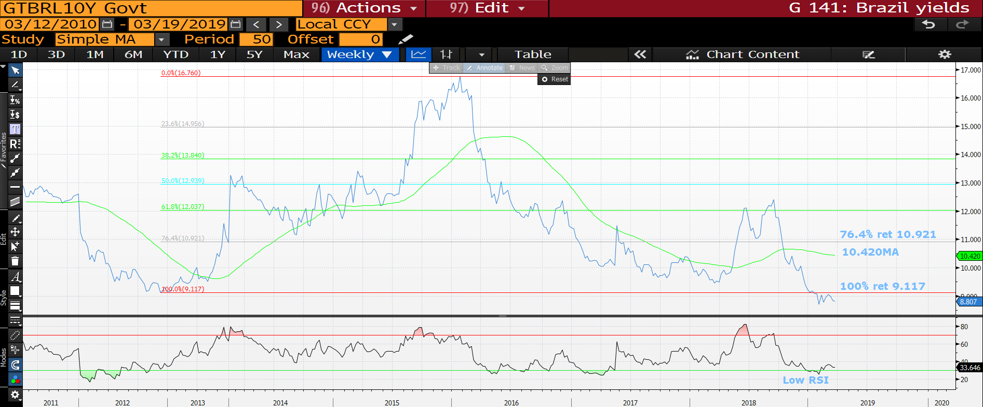
GTBRL10Y weekly : Yields have to continued to remain sub the 100% ret 9.117.

Slide 52
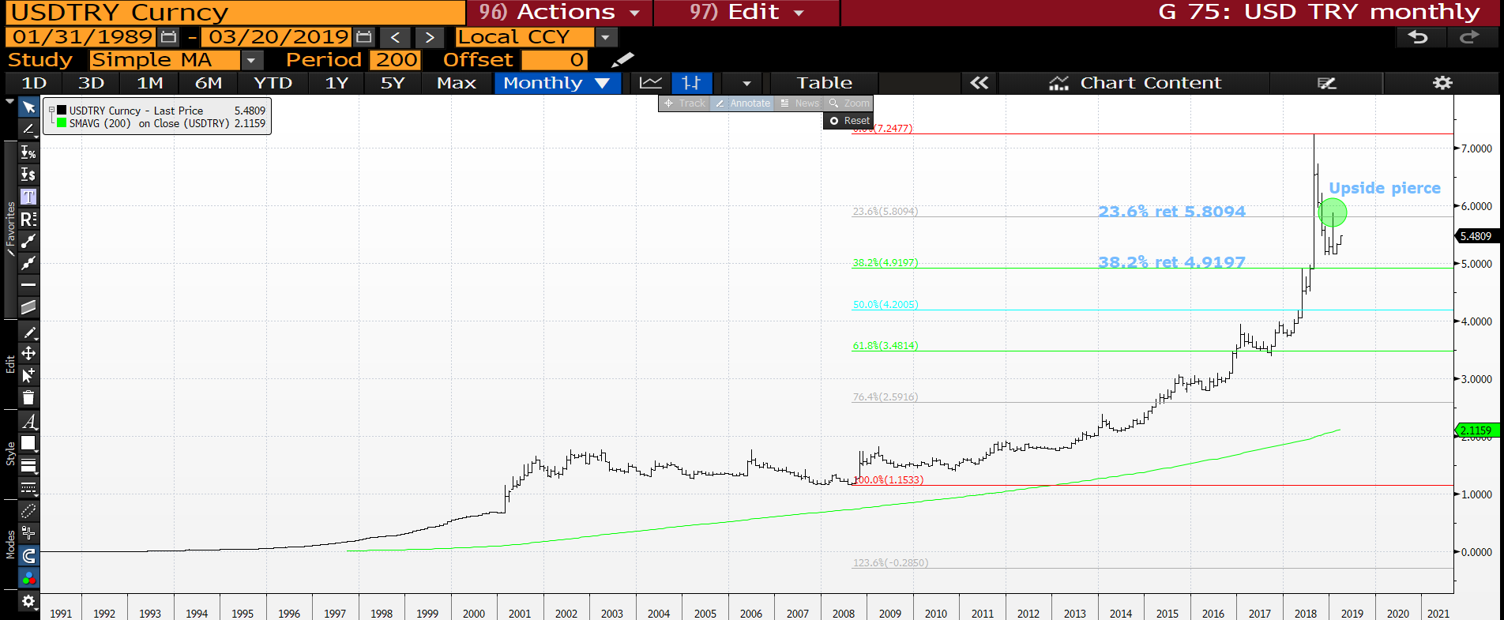
USD TRY monthly : We have opened above last months high so this has tempered the bearish view.

Slide 53
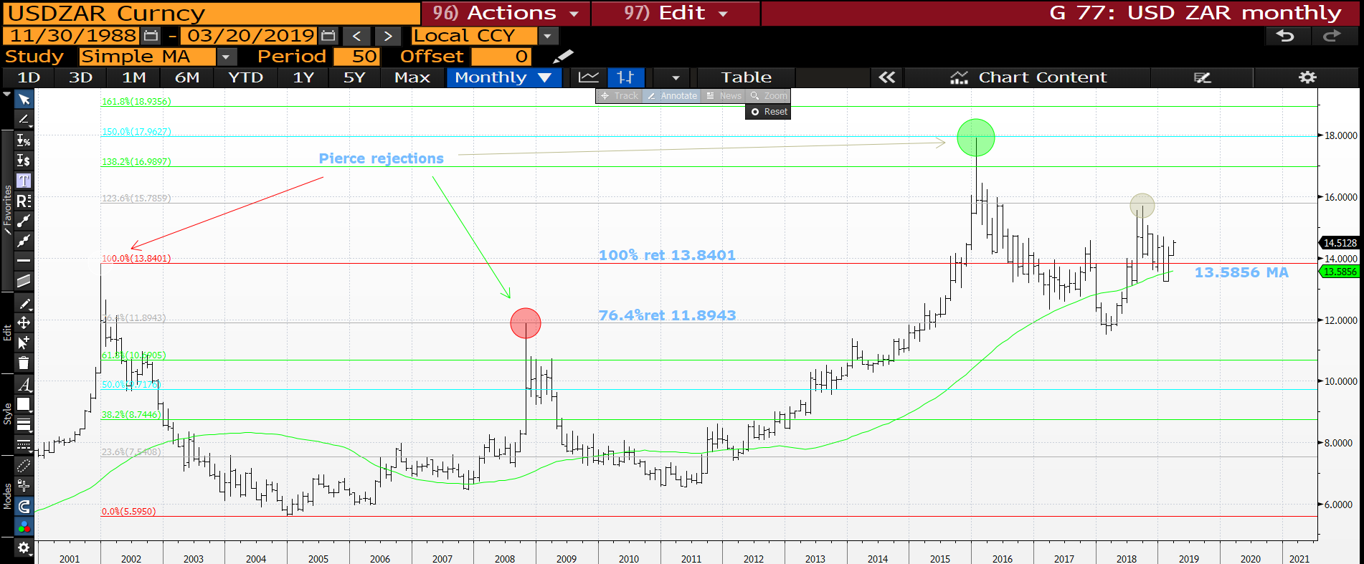
USD ZAR monthly : We need to fail here and head back below the 100% ret 13.8401.

Slide 54
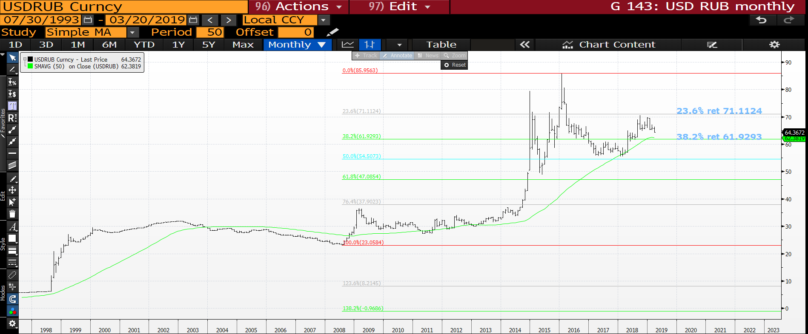
USD RUB monthly : A nice break of the recent low and the next big test the 38.2% ret 61.9293.

Slide 55
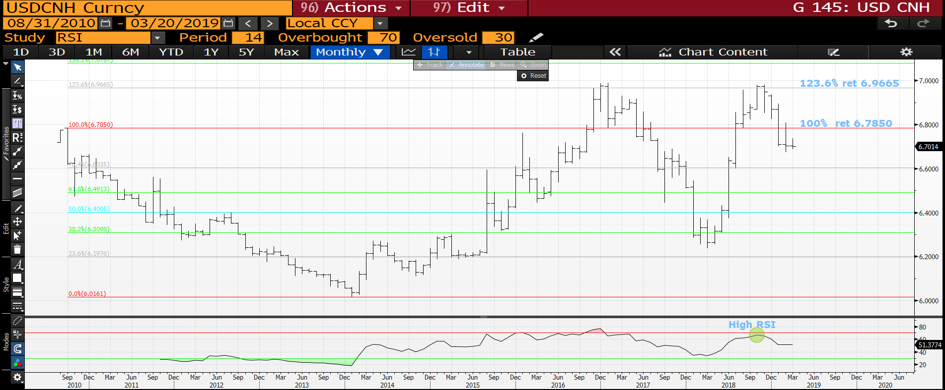
USD CNH monthly : Certainly one to note going forward given its TECHNICAL HIT! We have failed the multi year 100% ret 6.7850 and heading toward 6.6000.

Slide 56
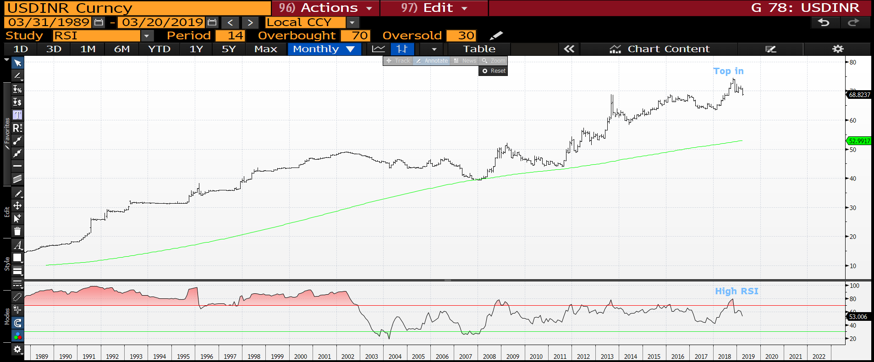
USD INR monthly : The RSI is as HIGH as September 2013 and we APPEAR to be forming a TOP. The TOP is in and PLENTY of downside possibility.

Slide 57

CL1 monthly : A nice chart given we have hit and held the 76.4% ret 42.72 first time down. It seems we need to see the 61.8% ret 62.75 first, before the next drop.

Slide 58

CL1 weekly : We appear to be struggling at the 50% ret 59.47 looms.

Slide 59

GOLD monthly : This has lacked any REAL momentum since 2013 but does look to be benefiting from the usual SAFE HAVEN view. Whilst above the 38.2% ret 1283.53 it carries a positive tone and an AUD bounce may help.

Slide 60


