Slide 1
MULTI ASSET UPDATE : ALL ABOUT THE US YIELDS FAILING CRITICAL 50 DAY MOVING AVERAGES!
WHATS CHANGED :
BOND YIELDS HAVE POPPED AND MANY TODAY ARE TESTING 50 DAY MOVING AVERAGES SO KEY FOR THE LONGERTERM VIEW, THEY FAIL.
US CURVES CONTINUE TO SEE THE PERFORMANCE SHIFT MORE TO THE FRONT END AND THE us 2-5 HAS A NICE BASE.
FX WATCH THE EURO AS A SUSTAINTED TIME AROUND THE MULTI YEAR 1.1241 RETRACEMENT IS “NOT HEALTHY”. DXY CONTINUESTO PUT IN A LAME PERFORMANCE.
EM FX, THIS CONTINUES TO ENDORSE FURTHER EM STRENGTH CONTINUING, WITH THE EXCEPTION OF TURKEY.
EQUITIES, THESE ARE THE BIGGEST PAIN! THEY CONTINUE TO GRIND HIGHER WHICH IS AT ODDS WITH THE MORE LONGTERM CHARTS. GIVEN EARNINGS SEASON IS UPON US I STILL REMAIN VERY SCEPTICAL ABOUT RESULTS AND FORWARD PROJECTIONS, ITS GOING TO BE A TOUGH YEAR FOR MANY.
***THEY REMAINA NIGGLE AND STILL BELIEVE THERE IS A NEGATIVE SURPRISE LOOMING.***
OIL IS POISED TO STALL AS GOLD HOLDS A MAJOR RETRACEMENT.

Slide 2
FX UPDATE
Topics PAGES
BONDS 3 -18
US CURVES 19-27
EQUITIES 28-44
CORE FX 45-53
USD EM 54-62
Oil and GOLD 63-65

Slide 3
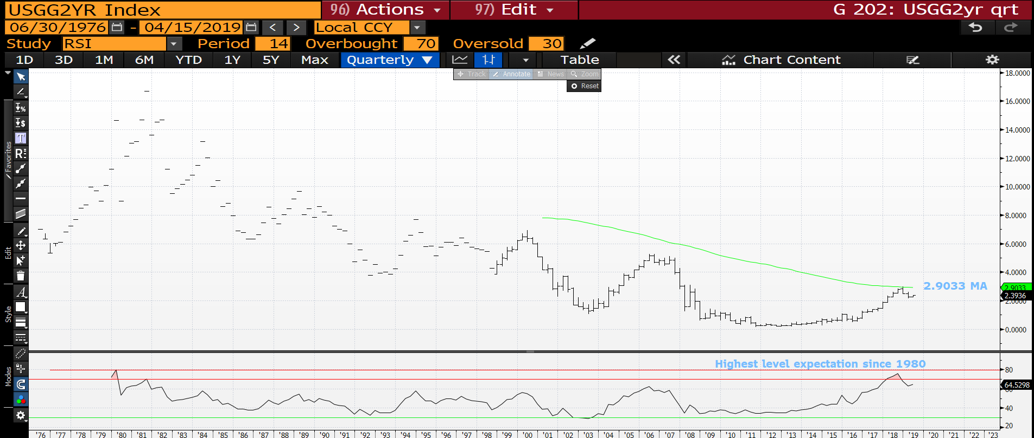
US 2yr yield quarterly : The TOP has now been formed against the 2.9033 moving average and the RSI indicates plenty of yield downside. Its as if 2000 and 2007 were NON events.

Slide 4
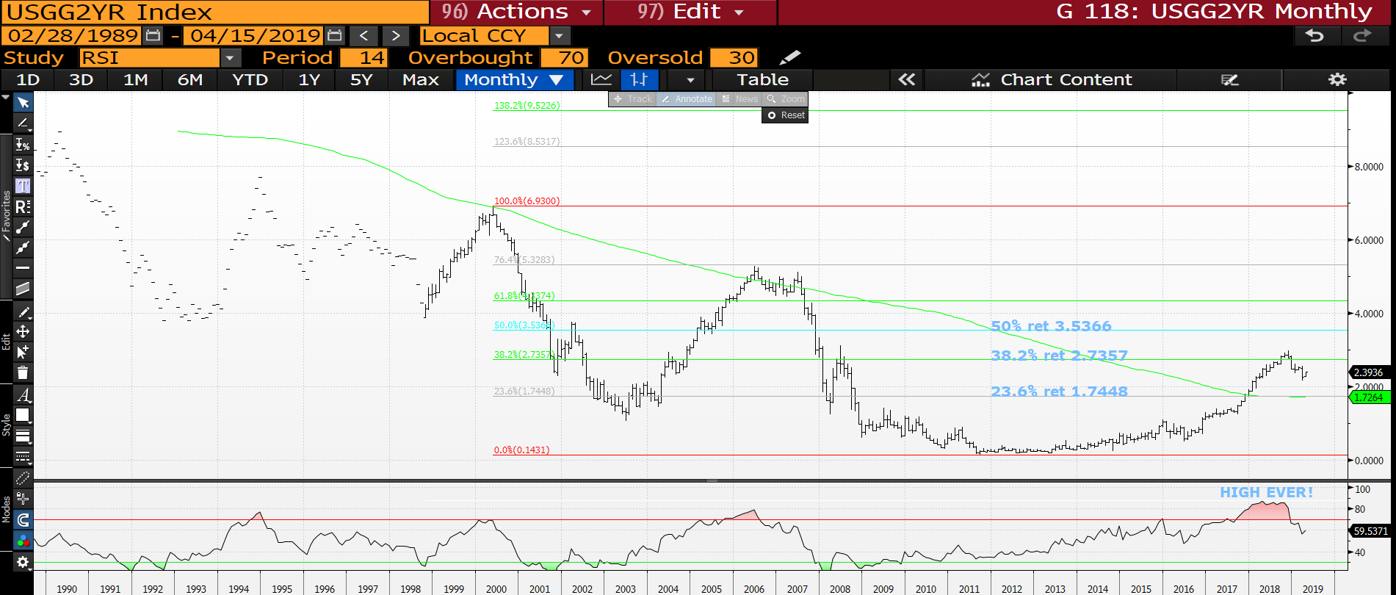
US 2yr yield monthly : A decent bounce this month and hoping we fail soon.

Slide 5
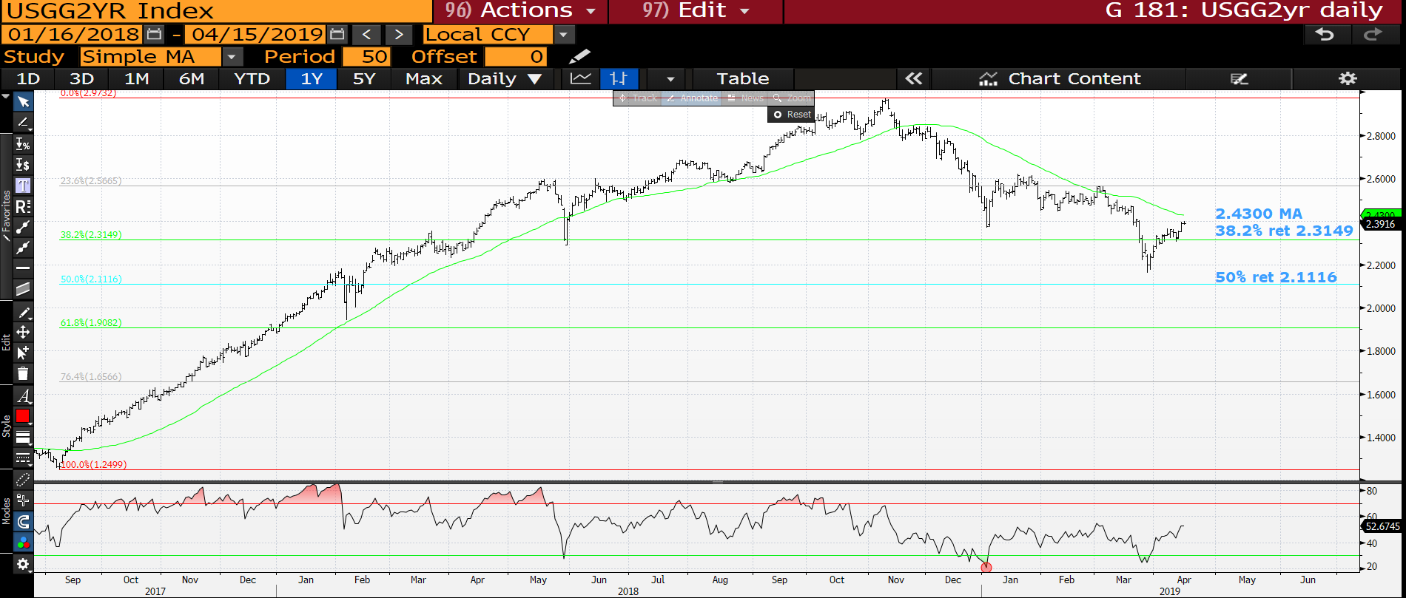
US 2yr yield daily : We have popped the 38.2% ret 2.3149 but running into the 50 day moving average resistance at 2.4300. A need to fail here to substantiate the longer-term view.

Slide 6
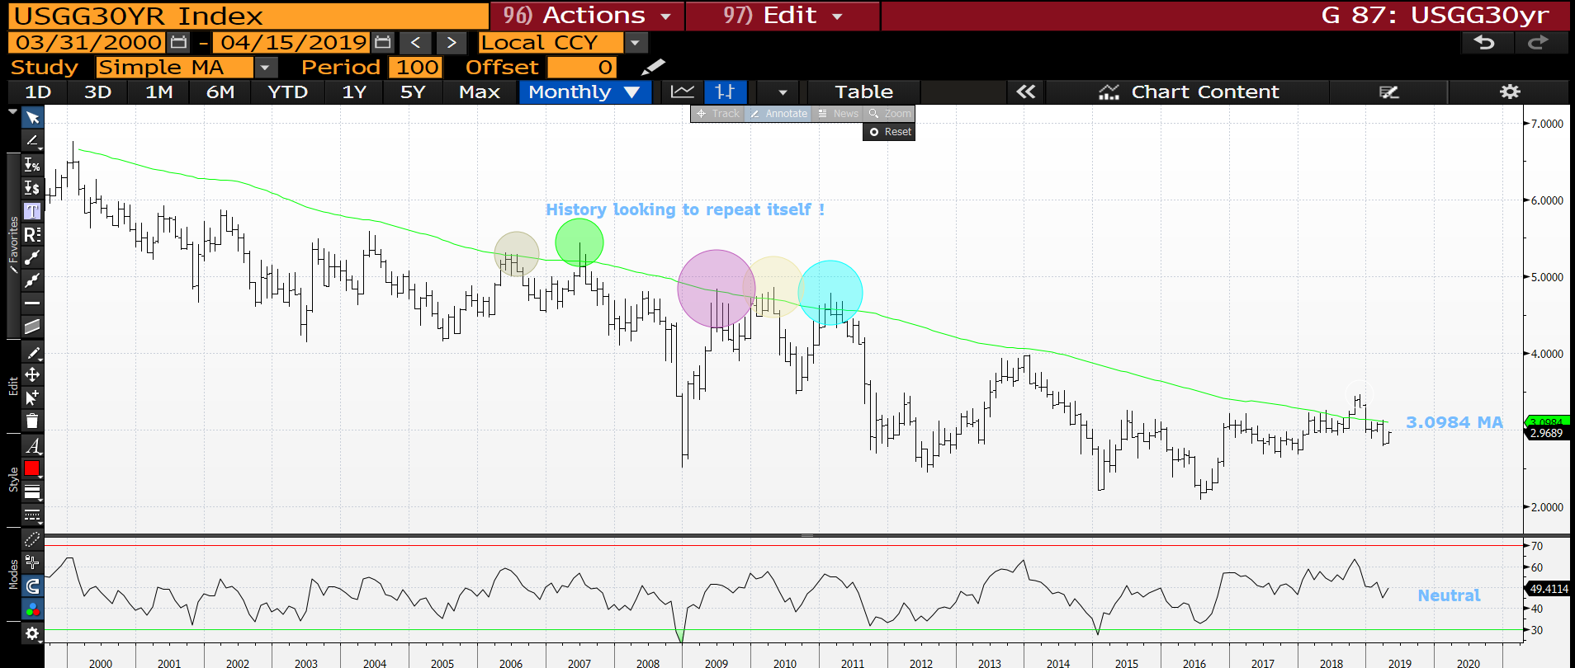
USGG30yr monthly : History repeating itself. The path of least resistance is definitely lower. We have backed up last months range a lot but do need to fail here.

Slide 7
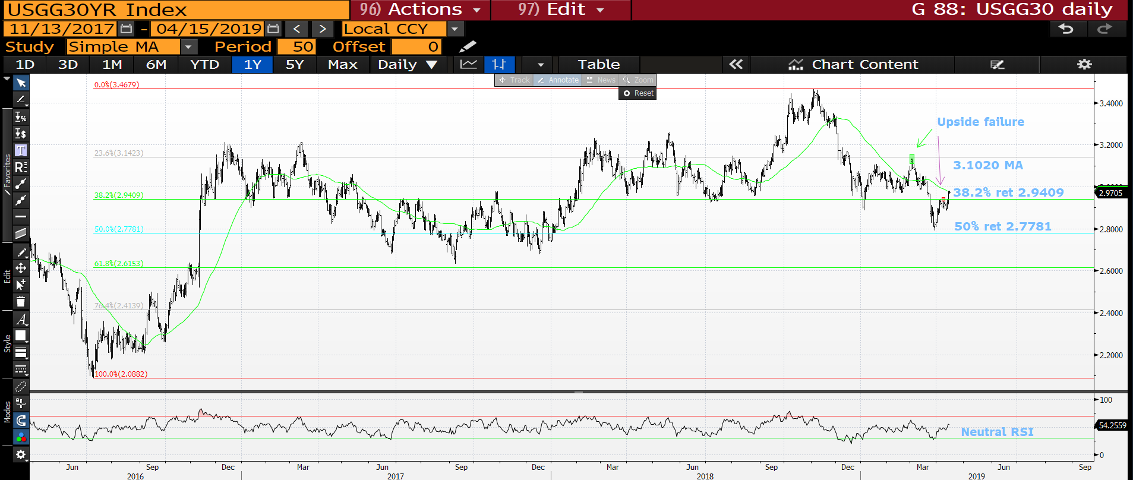
US 30yr yield daily : Another KEY failure day, we are hitting the 3.1020 so ideally need to stall here to continue the lower yield theme.

Slide 8
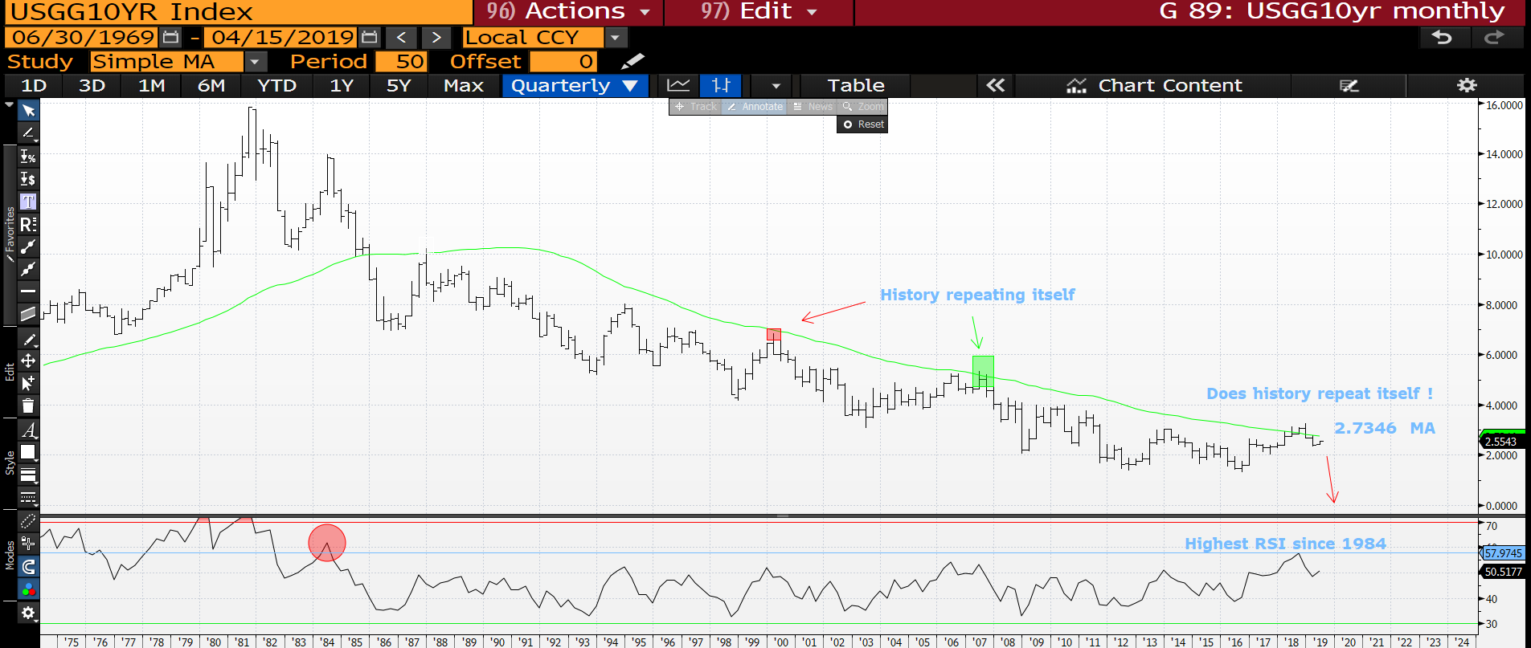
US 10yr yield quarterly : Another historical formation pointing toward lower yields as depicted in 2000 and 2007. The RSI still has room so hopefully we see a new low shortly.

Slide 9
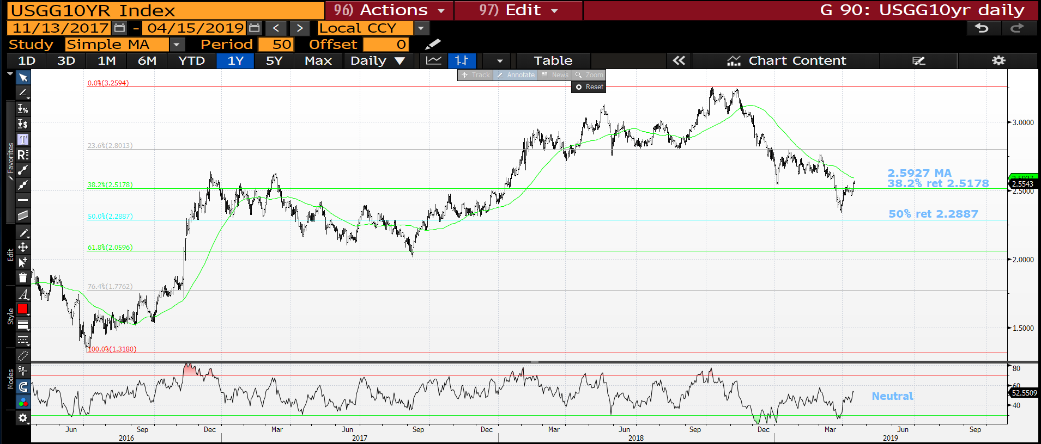
US 10yr yield daily : We have popped the 38.2% ret 2.5178 but the 50 day moving average 2.5927 looms as sizeable resistance. Need to fail.

Slide 10
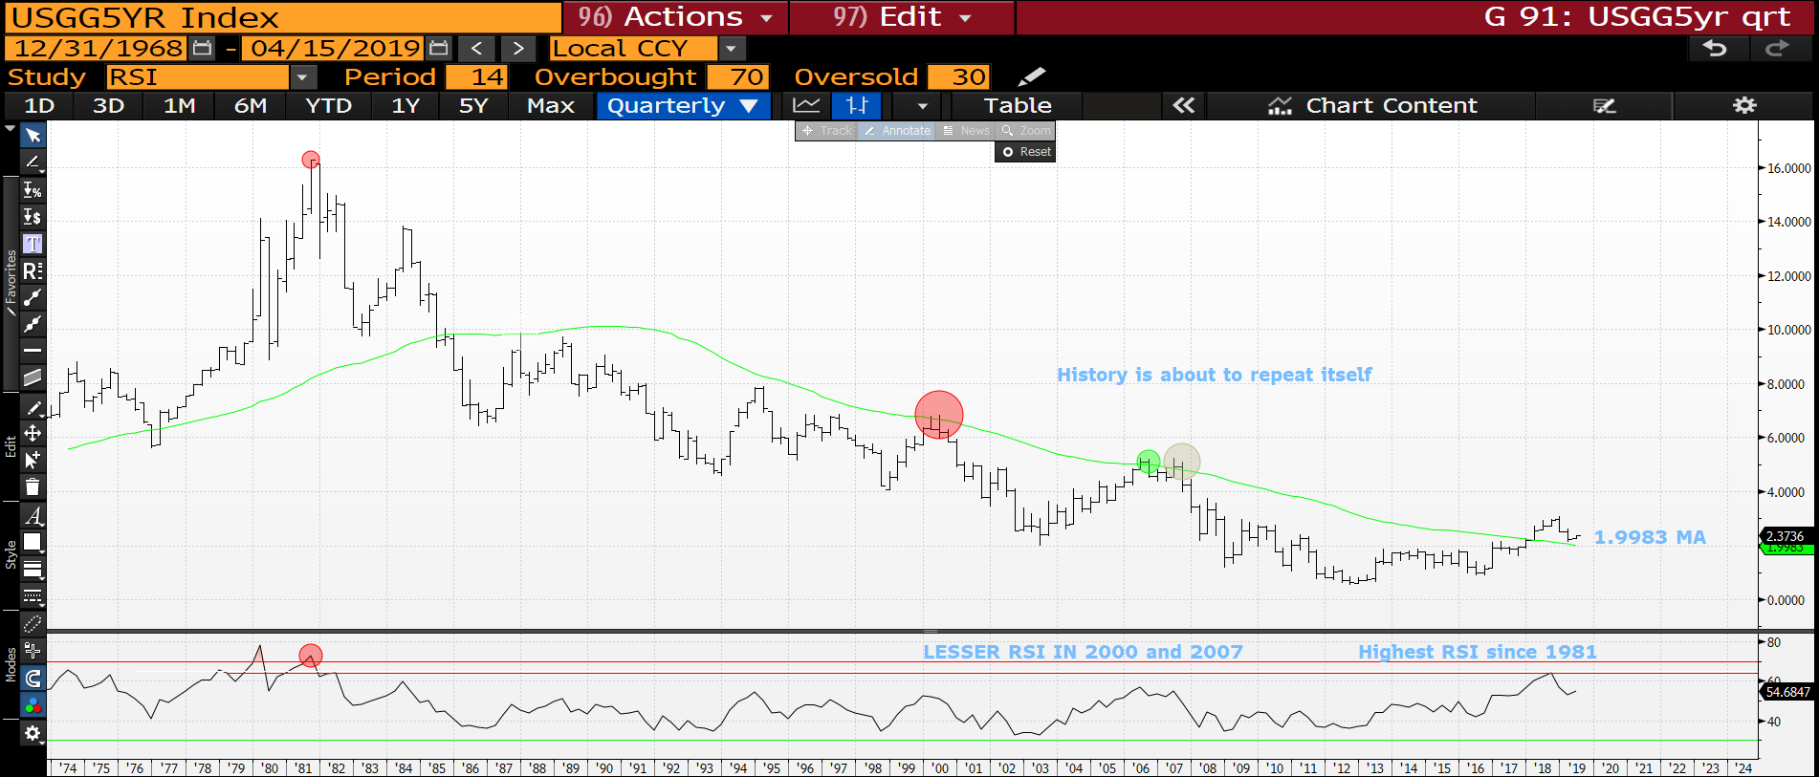
US 5yr quarterly : We are now targeting the 1.9983 moving average as the RSI unwinds SOME of its 1981 tension. Where were 2000 and 2007 in this chart?

Slide 11
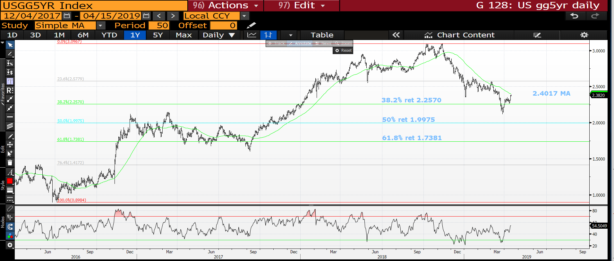
US 5yr daily : Another IMPORTANT test in the form of the 2.4017 50 day moving average.

Slide 12
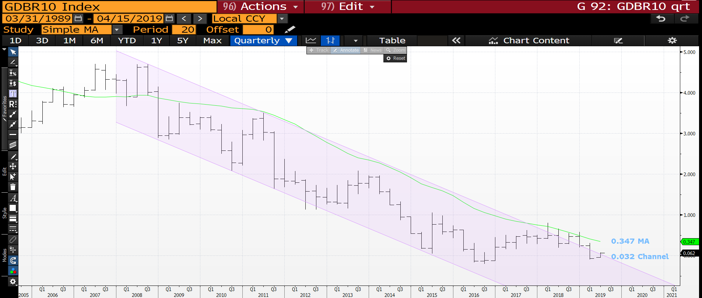
Generic German 10yr quarterly : We have popped outside the long-term trend channel but the daily chart is similar to the US in terms of 50 day moving average resistance.

Slide 13
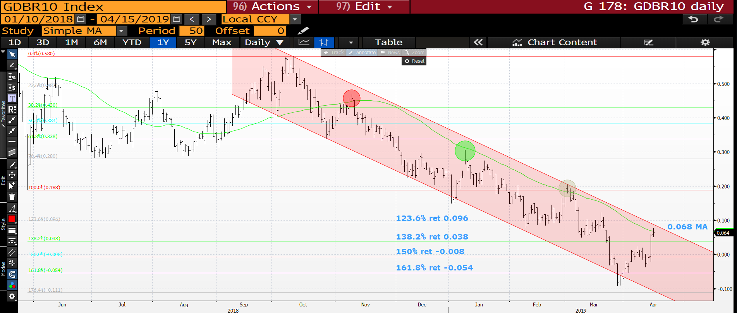
Generic German 10yr daily : We are back up at the historical 50 day moving average 0.068 so KEY we replicate the previous failures.

Slide 14
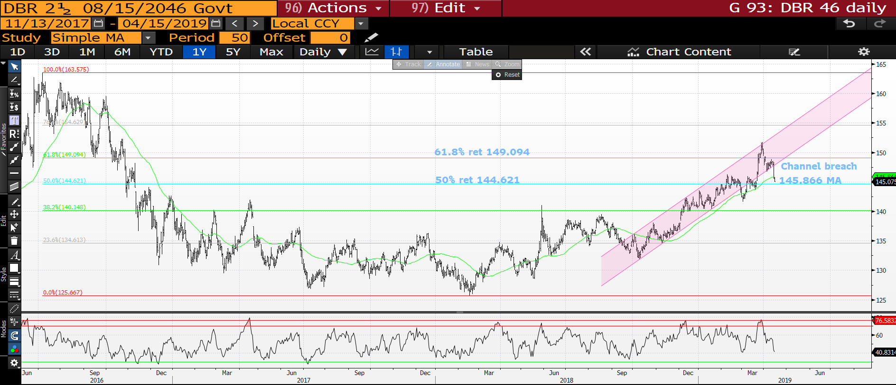
DBR 46 daily : A MAJOR breach of the channel and TEST of the 50 day moving average.

Slide 15
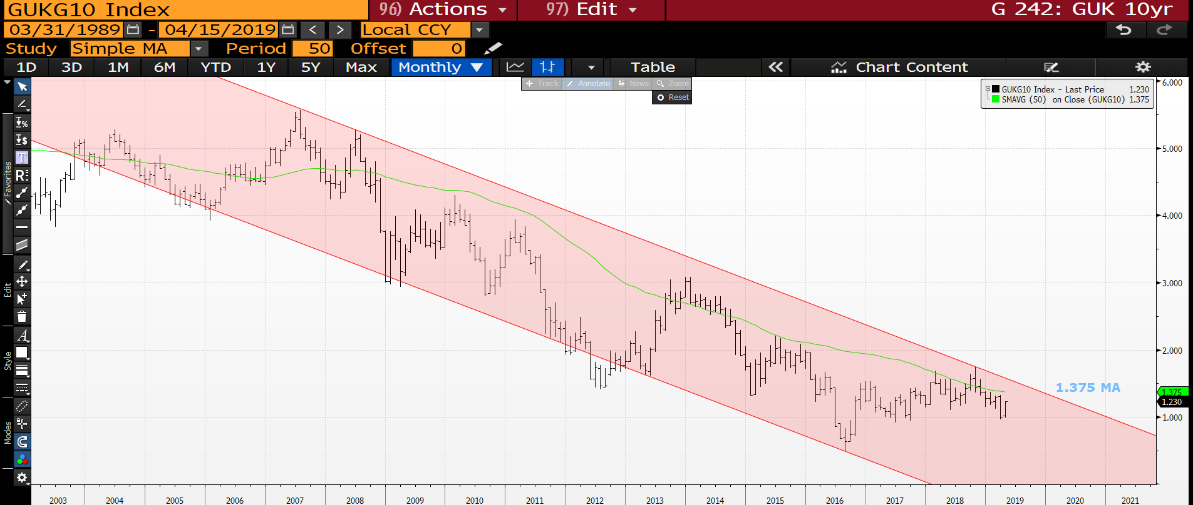
UK 10yr yield monthly : A savage about turn as the 50 period moving average resistance looms at 1.375.

Slide 16
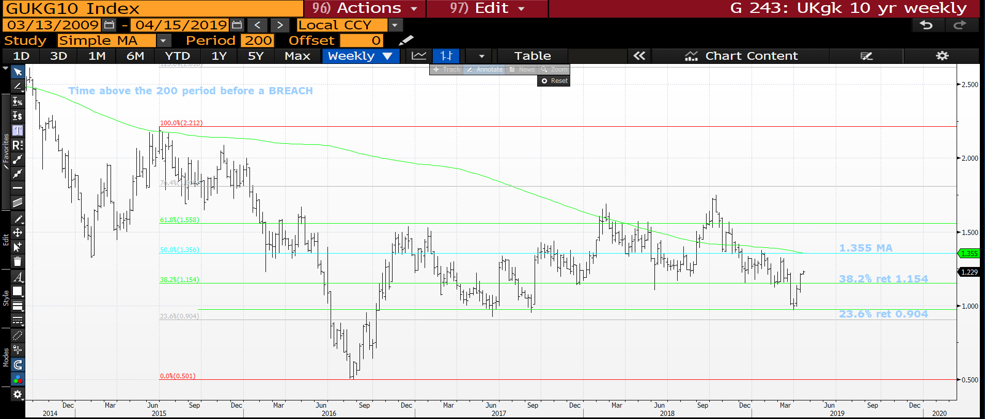
UK 10yr yield weekly : We have bounced through most major moving averages and only major one left is the 1.355 200 period.

Slide 17
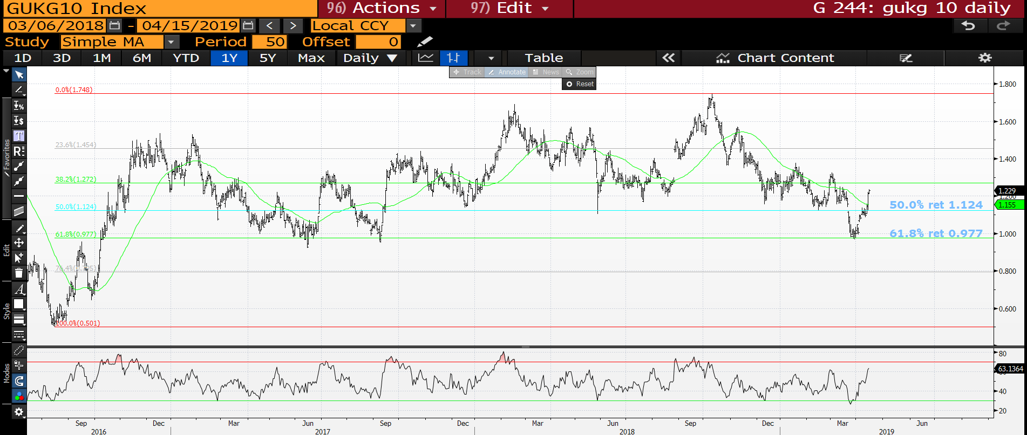
UK 10yr yield daily : A very SHARP reversal leaving minimal levels and NO RSI extension.

Slide 18
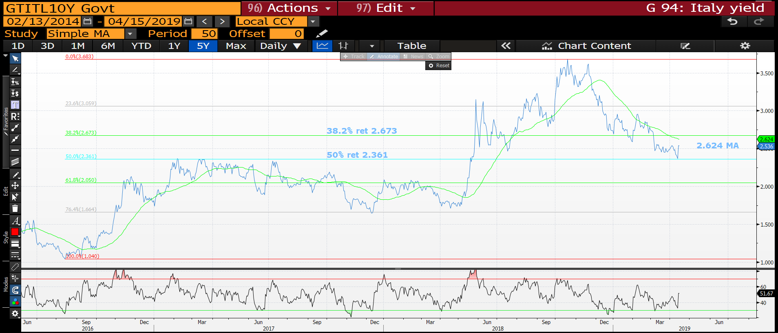
Italian generic 10yr daily : We have hit and very much recognised the 50 % ret 2.361 so all a bit neutral here along with the RSI.

Slide 19
US curves a once in a lifetime opportunity?
Curves : The frontend curves now look like a PERFORMER given the strong steepening closes last quarter. Certainly looks like the BASES are in.
** The BACK END ideas have had a good run so maybe time to get long US 2-5 and 2-10 steepener. It seems the BACK END is where the TRADE is given the 2-30, 5-30 and 10-30 performance yesterday.
All generally have low RSI’s, MANY at 2006 levels.
It seems hard at the moment to pinpoint the OPTIMUM curve to go for but contenders already are 2-30, 5-30 and 10-30, that said most could do with quarter end confirmation.
REMEMBER ALL RSI’s ARE EXTENDED AND MANY HAVE HIT MULTI YEAR 76.4% RETRACEMENTS!

Slide 20
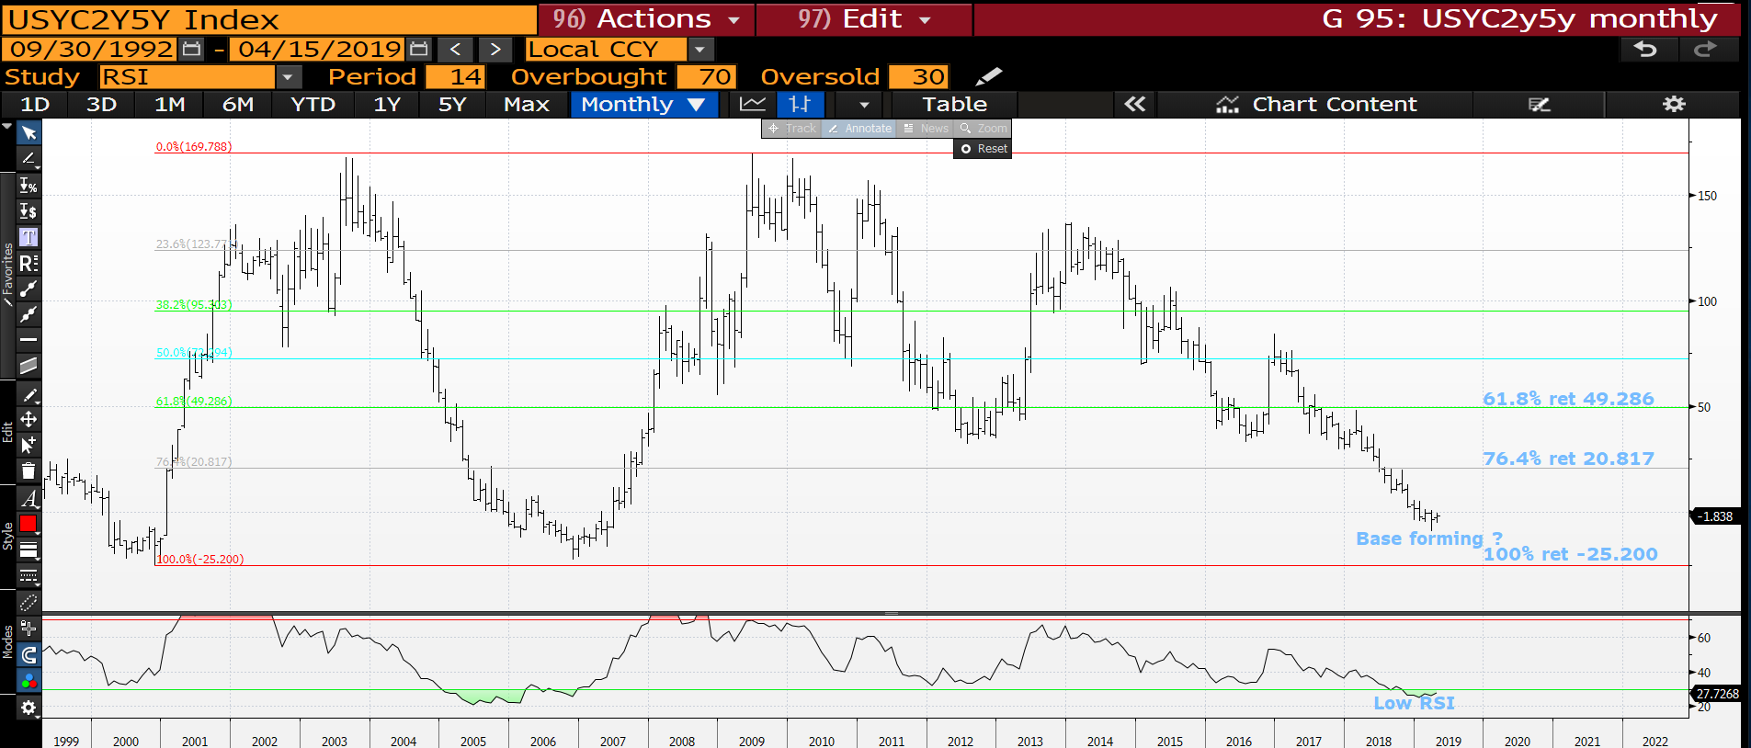
US 2-5 curve monthly : We do seem to be forming a DECENT BASE thus could be a cheap stop on a curve steepener. Yet to decide if this reflects a yield direction change?

Slide 21
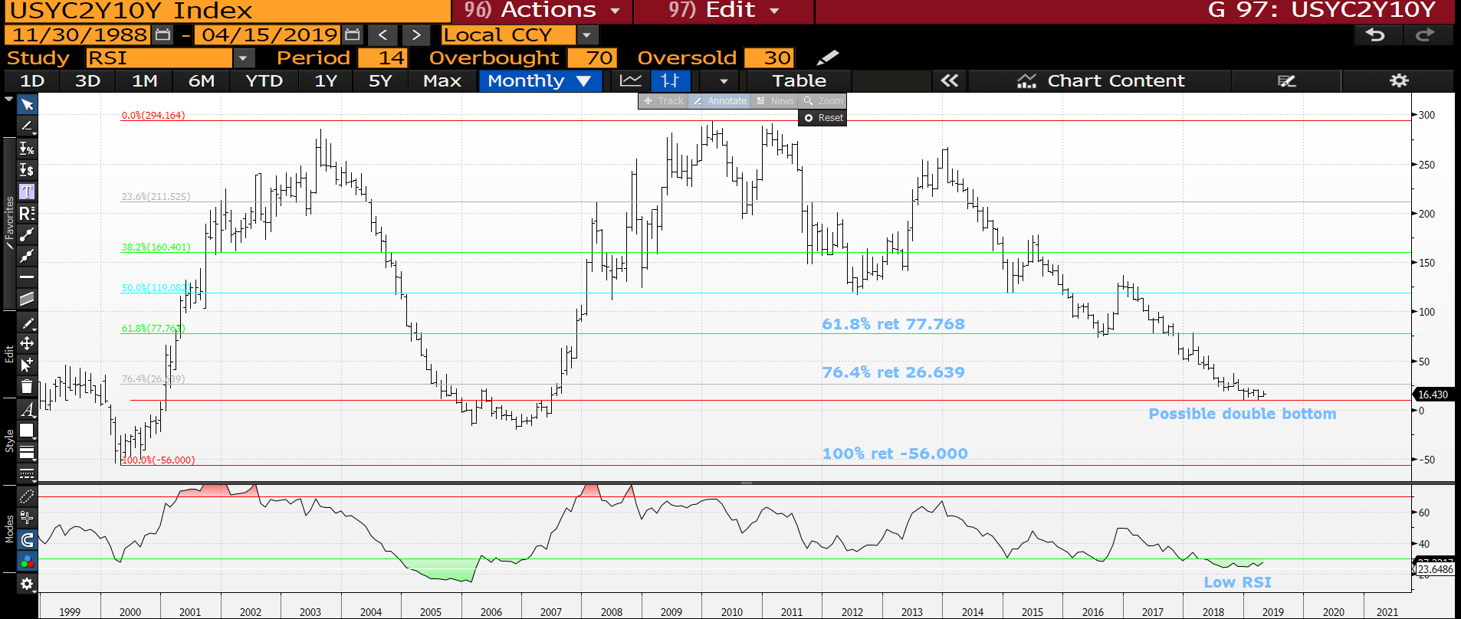
US 2-10 curve monthly : We have now formed a DECENT base over the last few months, a good time to get involved in a steepener. Add on a breach of the 76.4% ret 26.639.

Slide 22
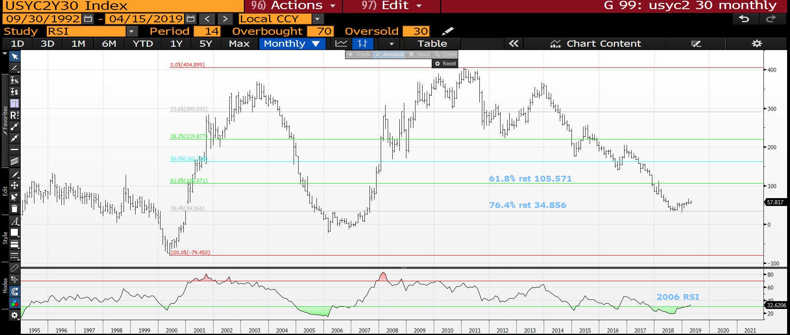
US 2-30 curve monthly : This curve seems to have had its run and now trading sideways.

Slide 23
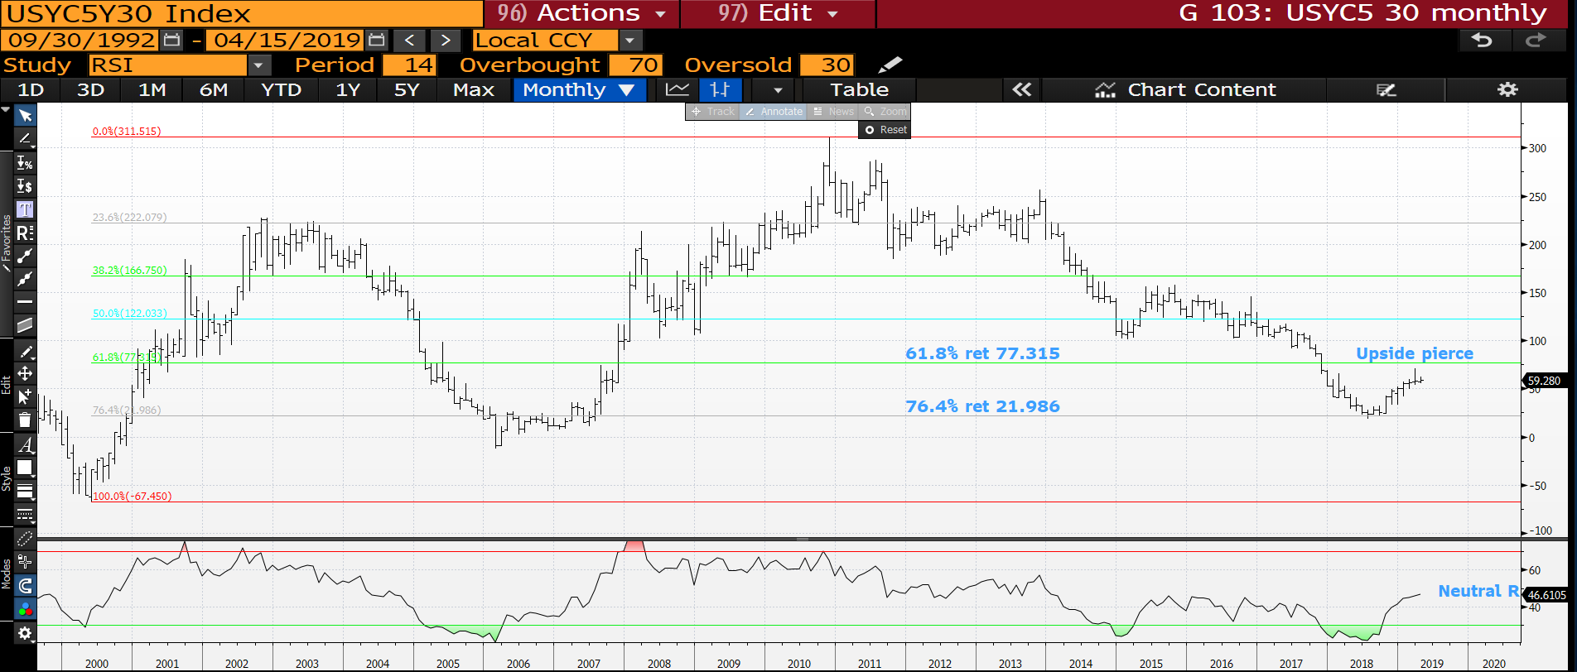
US 5-30 curve monthly : As mentioned previously we stalled last month thus should flatten from here.

Slide 24
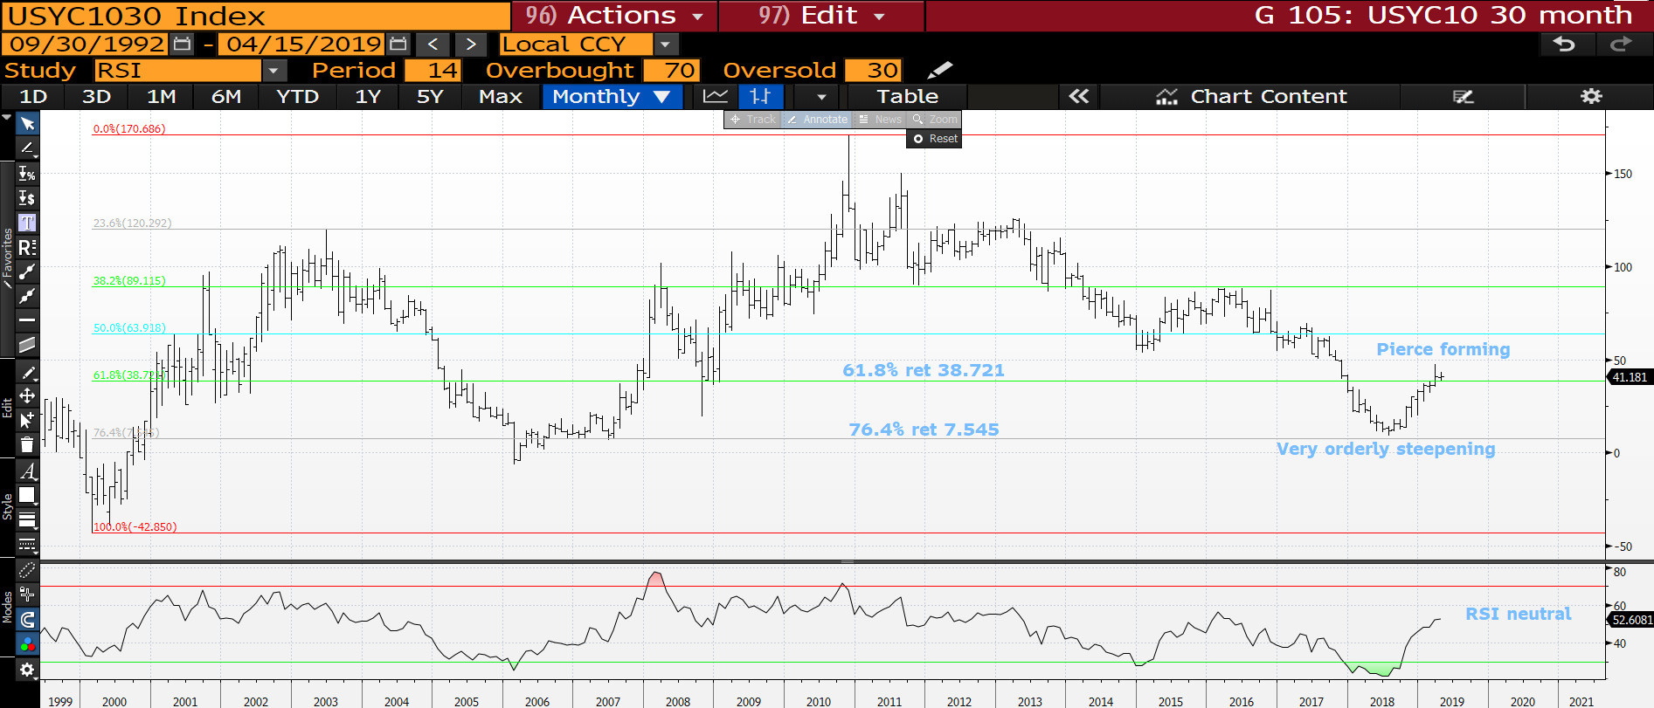
US 10-30 curve monthly : We have a pretty major upside pierce so likely to dip below the 61.8% ret 38.721 soon.

Slide 25
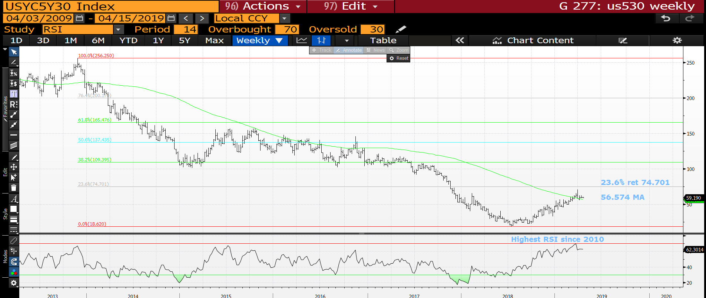
US 10-30 curve monthly : We have a pretty major upside pierce so likely to dip below the 61.8% ret 38.721 soon.

Slide 26
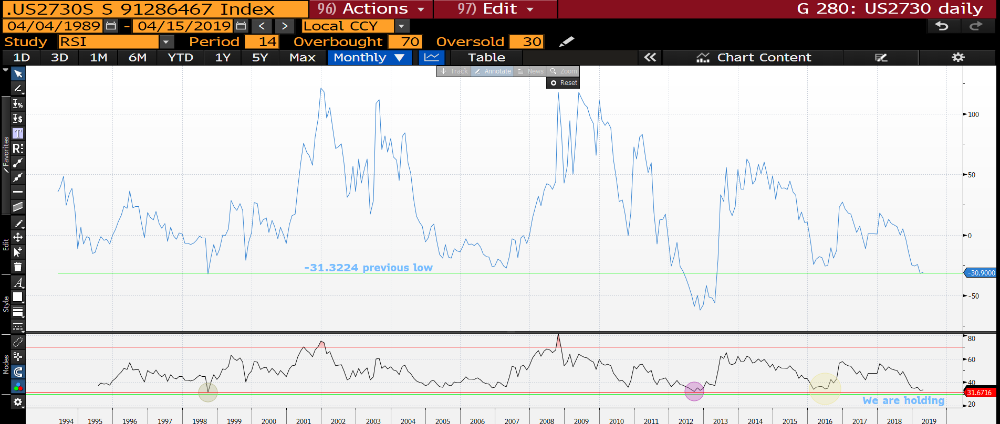
US 2-7-30 fly monthly : We are now HOLDING the previous low -31.3224.

Slide 27
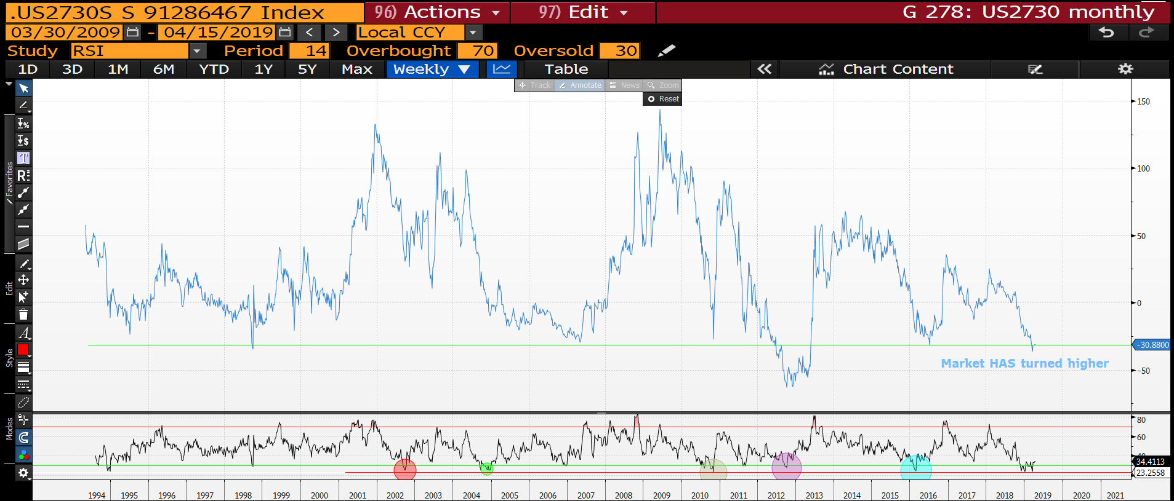
US 2-7-30 fly weekly : We have now based and poised to head higher!

Slide 28
EQUITIES
EQUITIES : One area that remains a SIZEABLE frustration!
Many will argue that stocks are FINE and a level of comfort is now built in. This has never been more of a critical location TO FAIL. Optimism is built in along with positions however MANY EARNINGS SEASON is upon us and personally I don’t think it will go well.
They continue to perform but further upside progress seems limited.

Slide 29
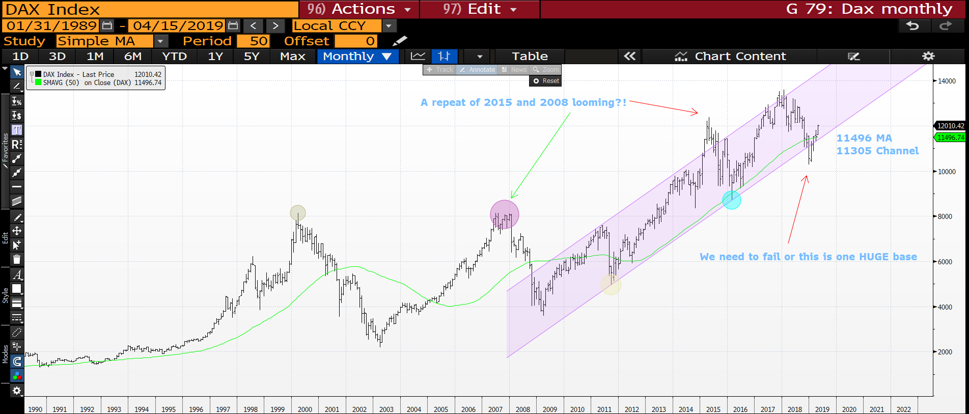
DAX monthly : Do now have that sinking feeling that the latest BASE is in!

Slide 30
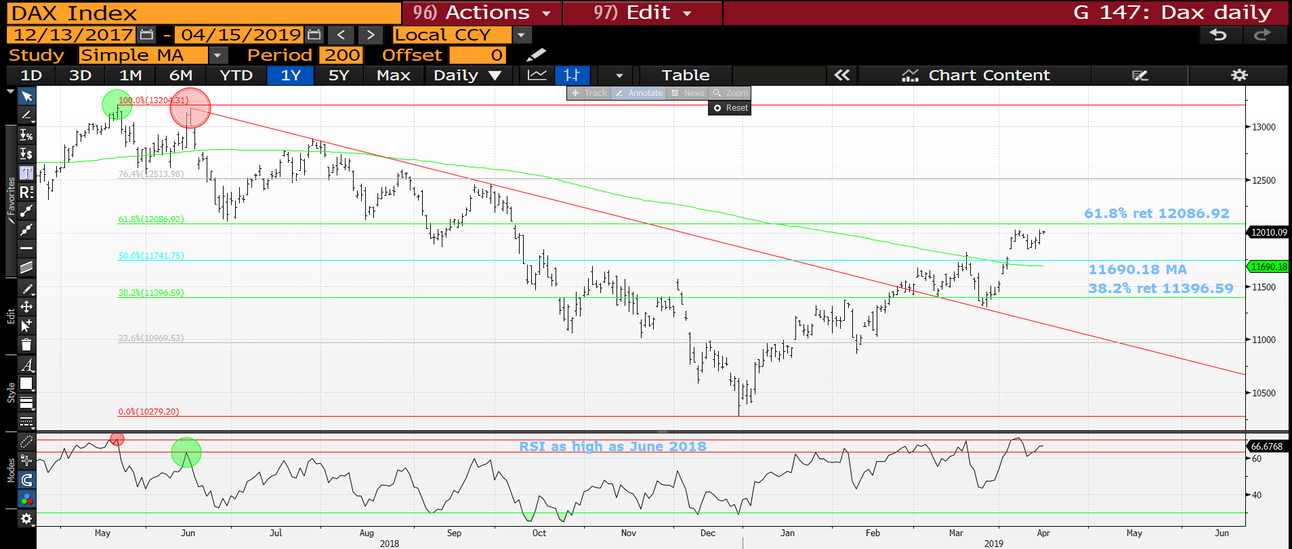
Dax daily : We need to remain sub the 61.8% ret 12086.92 or else all bearish calls are over.

Slide 31
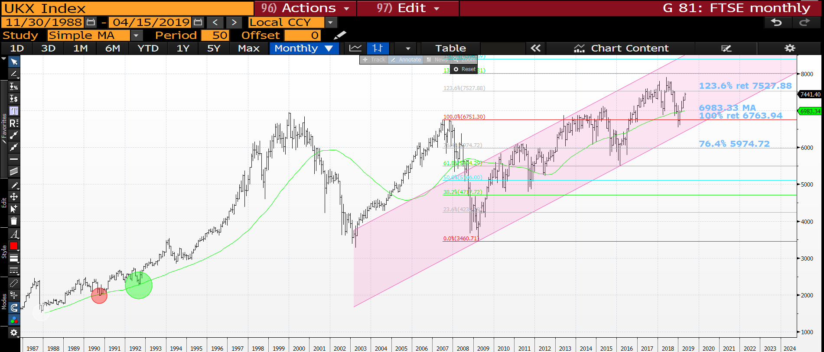
FTSE monthly : We have had a sizeable bounce but lets see if we have the momentum to breach the 123.6% ret 7527.88.

Slide 32
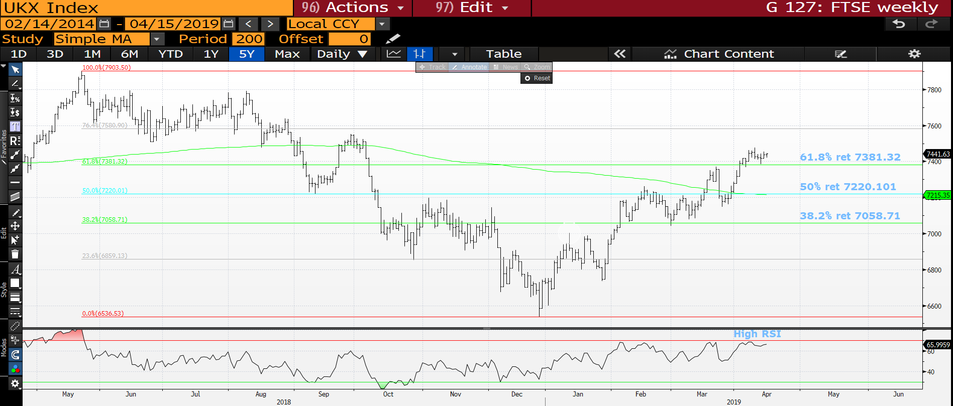
FTSE daily : Progress is limited but we are positive now above the 61.8% ret 7381.32.

Slide 33
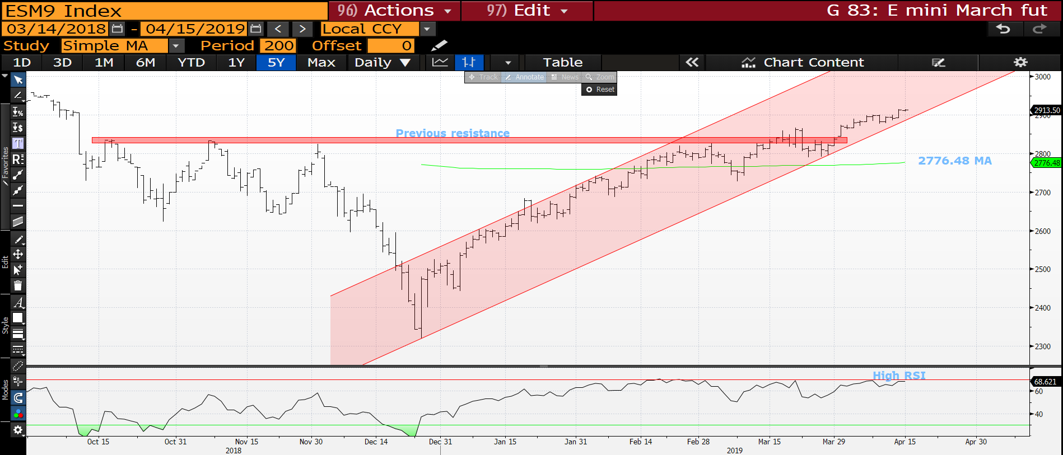
E mini S*P daily : We have popped the previous resistance but this HAS taken the RSI to lofty levels, we shall see but should fail.

Slide 34
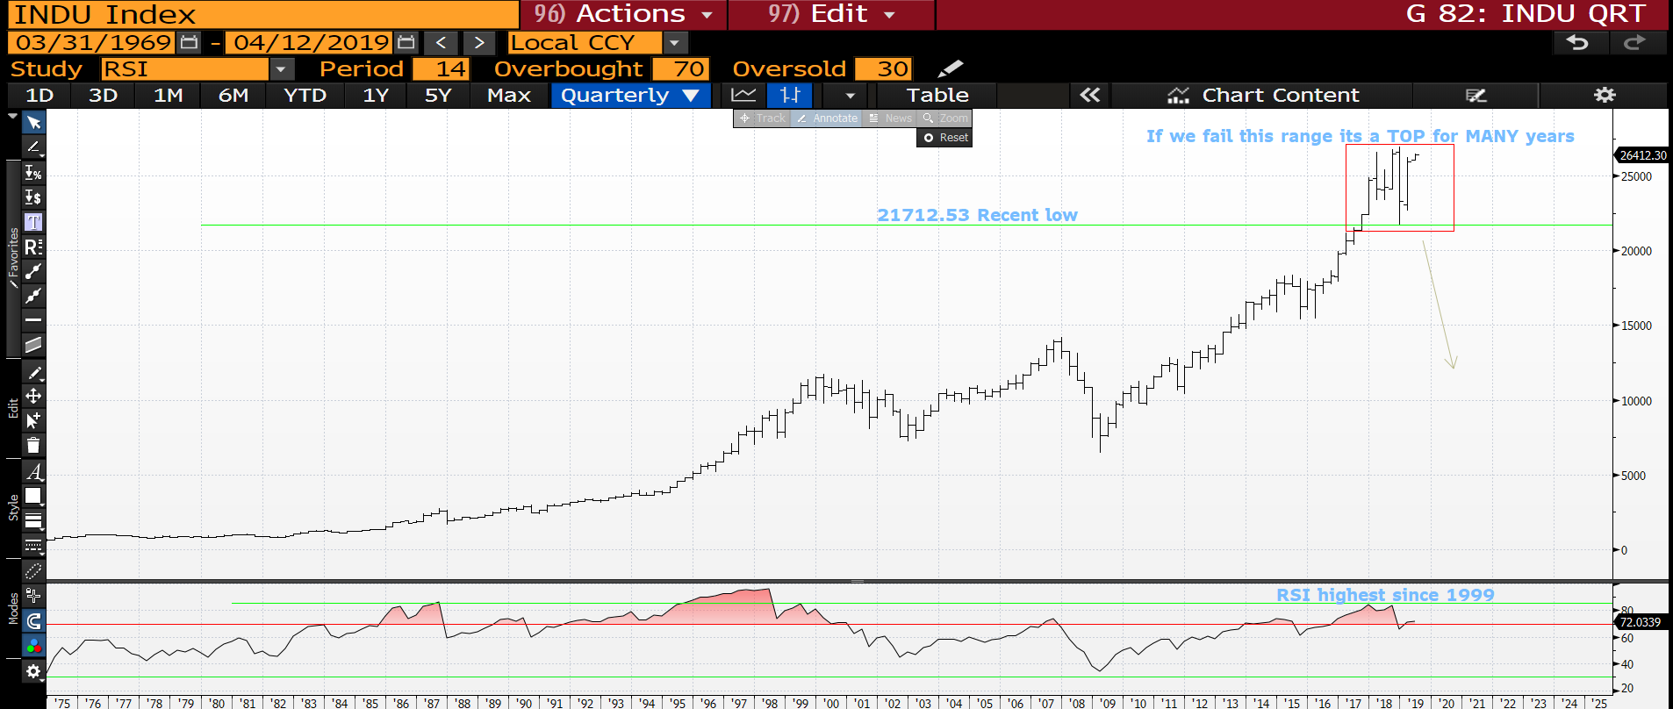
DOW quarterly : We have breached the last quarters highs.

Slide 35
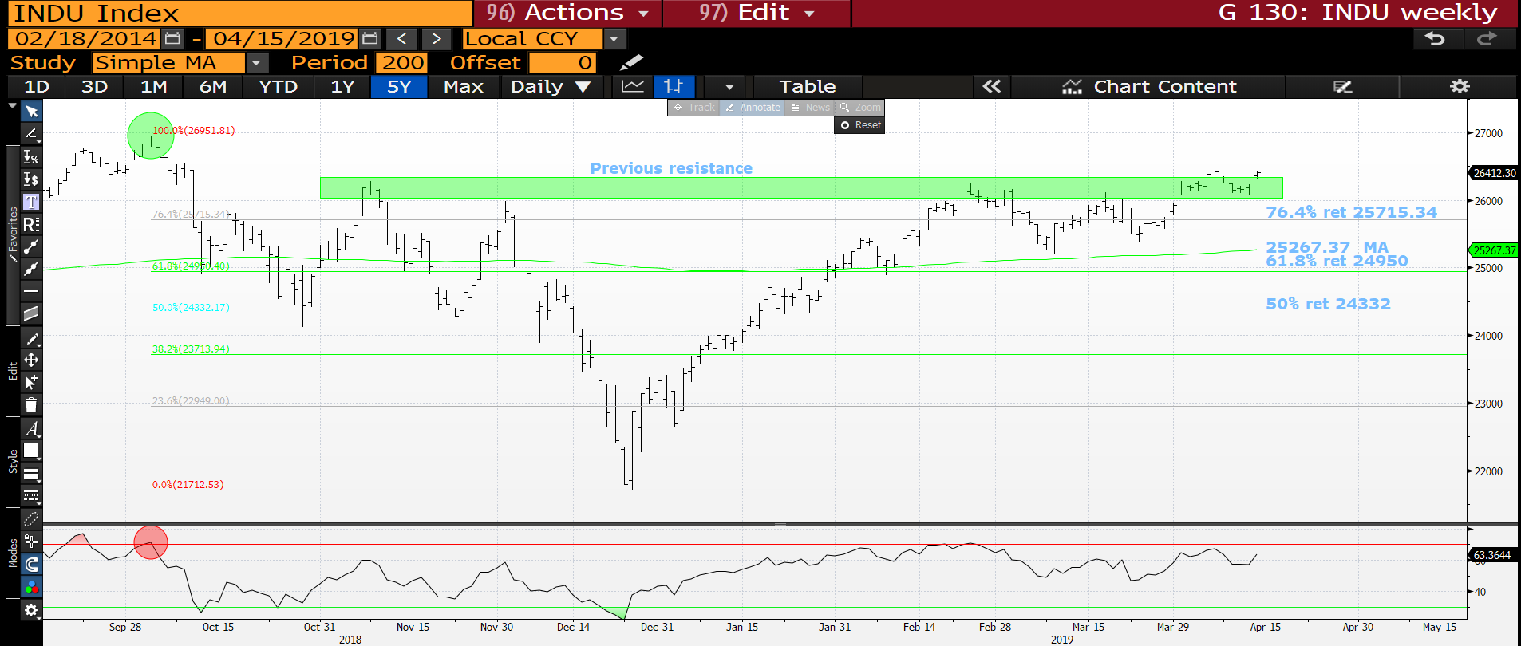
DOW daily : Some upside progress but seems limited.

Slide 36
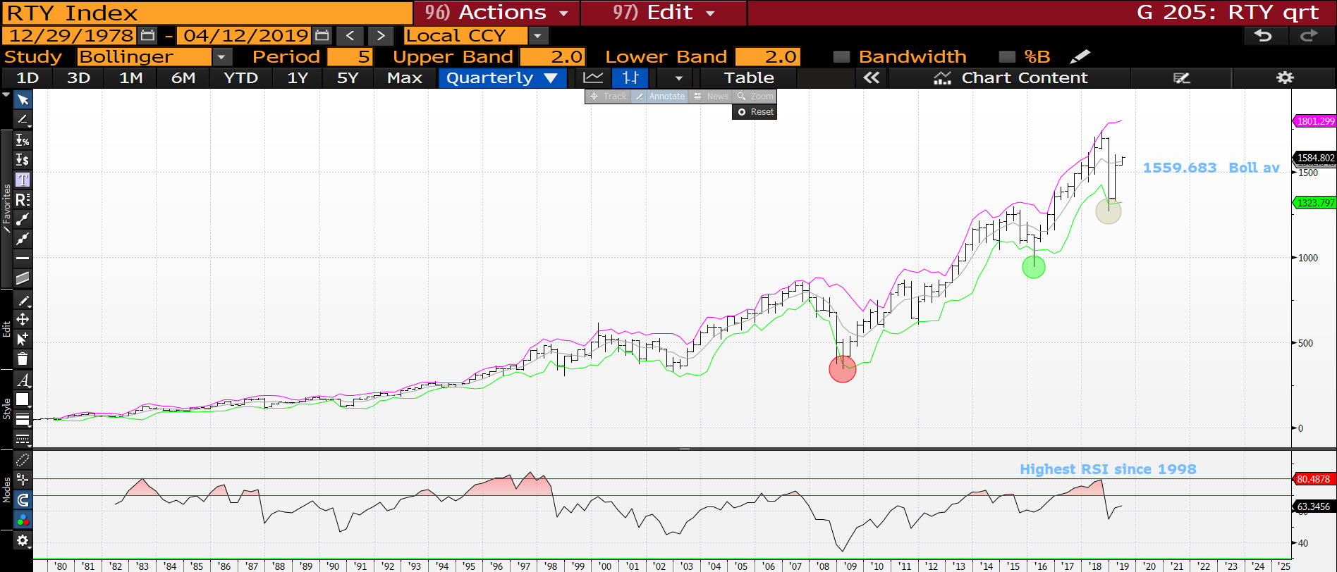
Russell quarterly : We have had a sizeable bounce but looks doubtful it will repair the terminal damage. Ideally we need to REMAIN below the 1559.683 bollinger average.

Slide 37
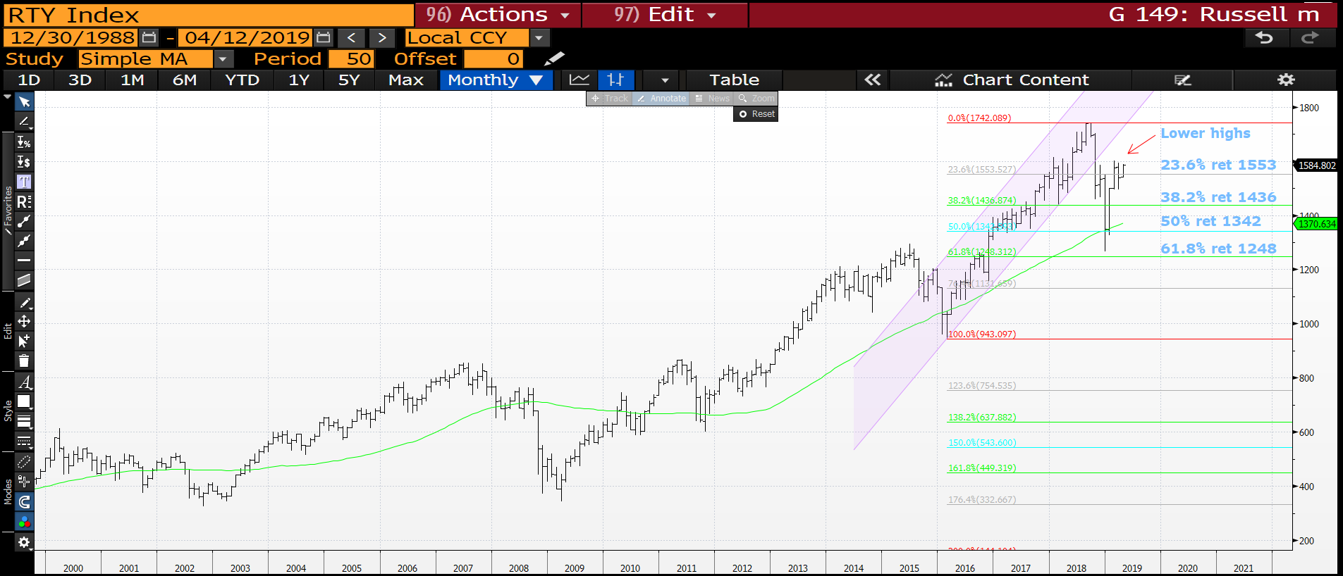
Russell monthly : Currently we REMAIN below last months HIGH and teasing the
23.6% ret 1553.

Slide 38
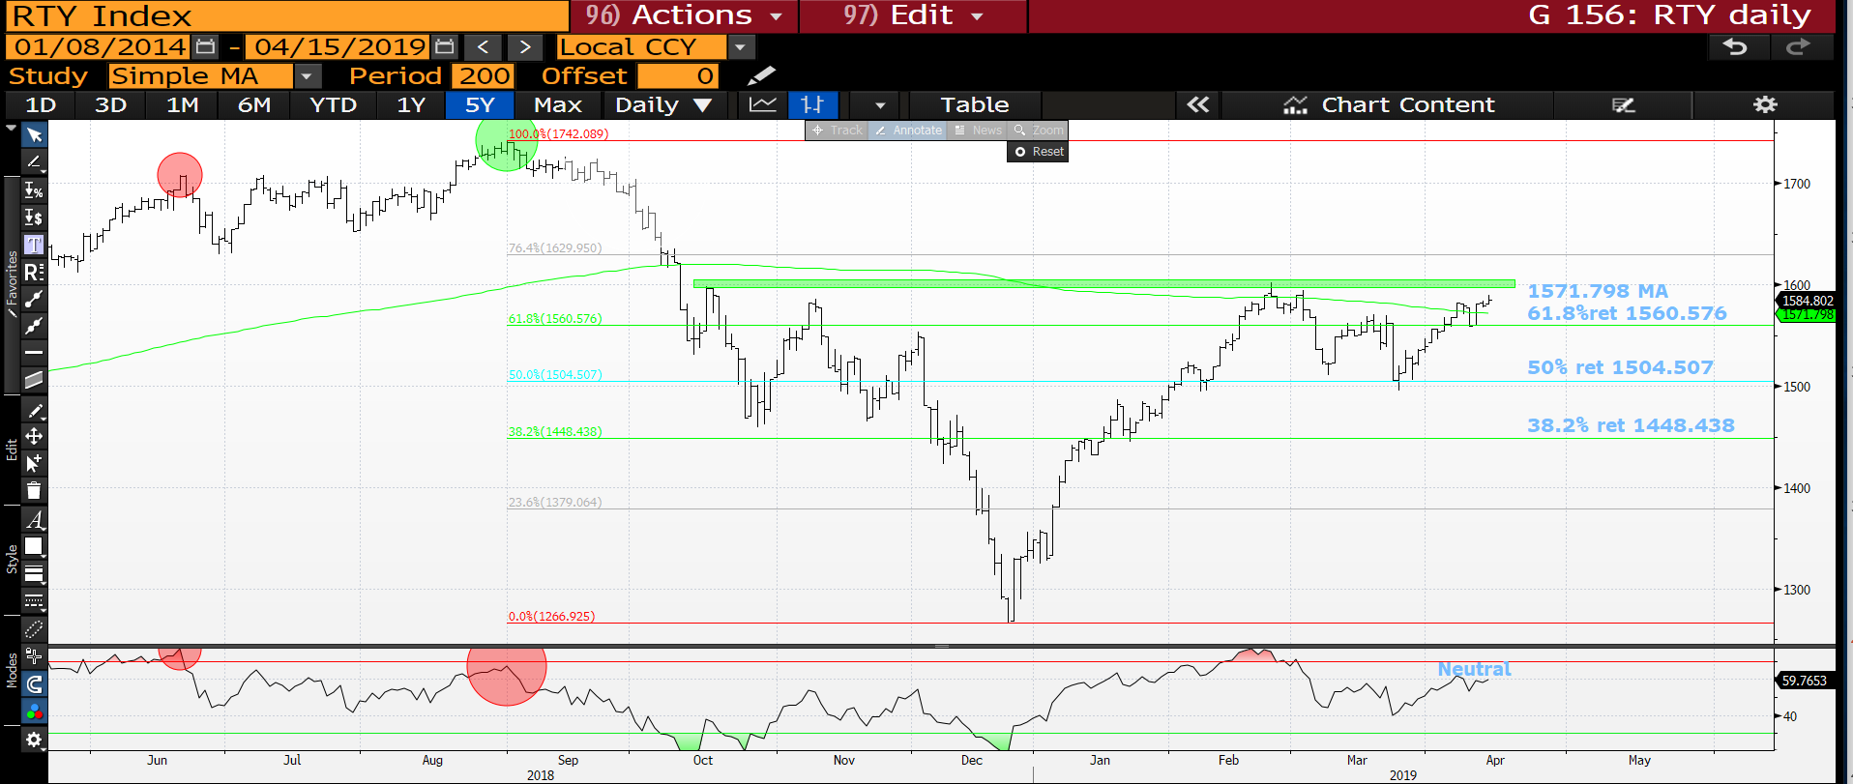
Russell daily : Still a VERY negative chart but ideally we need to make progress toward the
61.8% ret 1560.576.

Slide 39
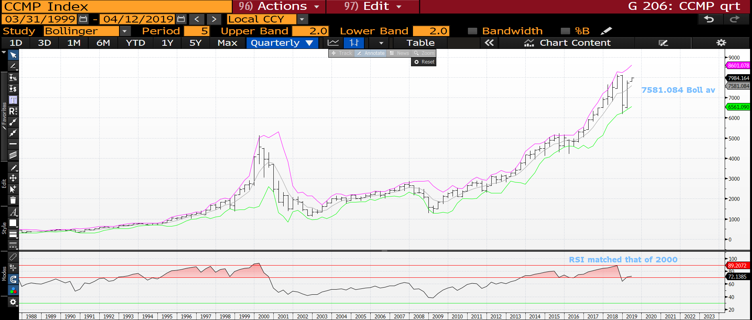
CCMP quarterly : We are now above last months high but a move sub the 7581.084 bollinger average will help.

Slide 40
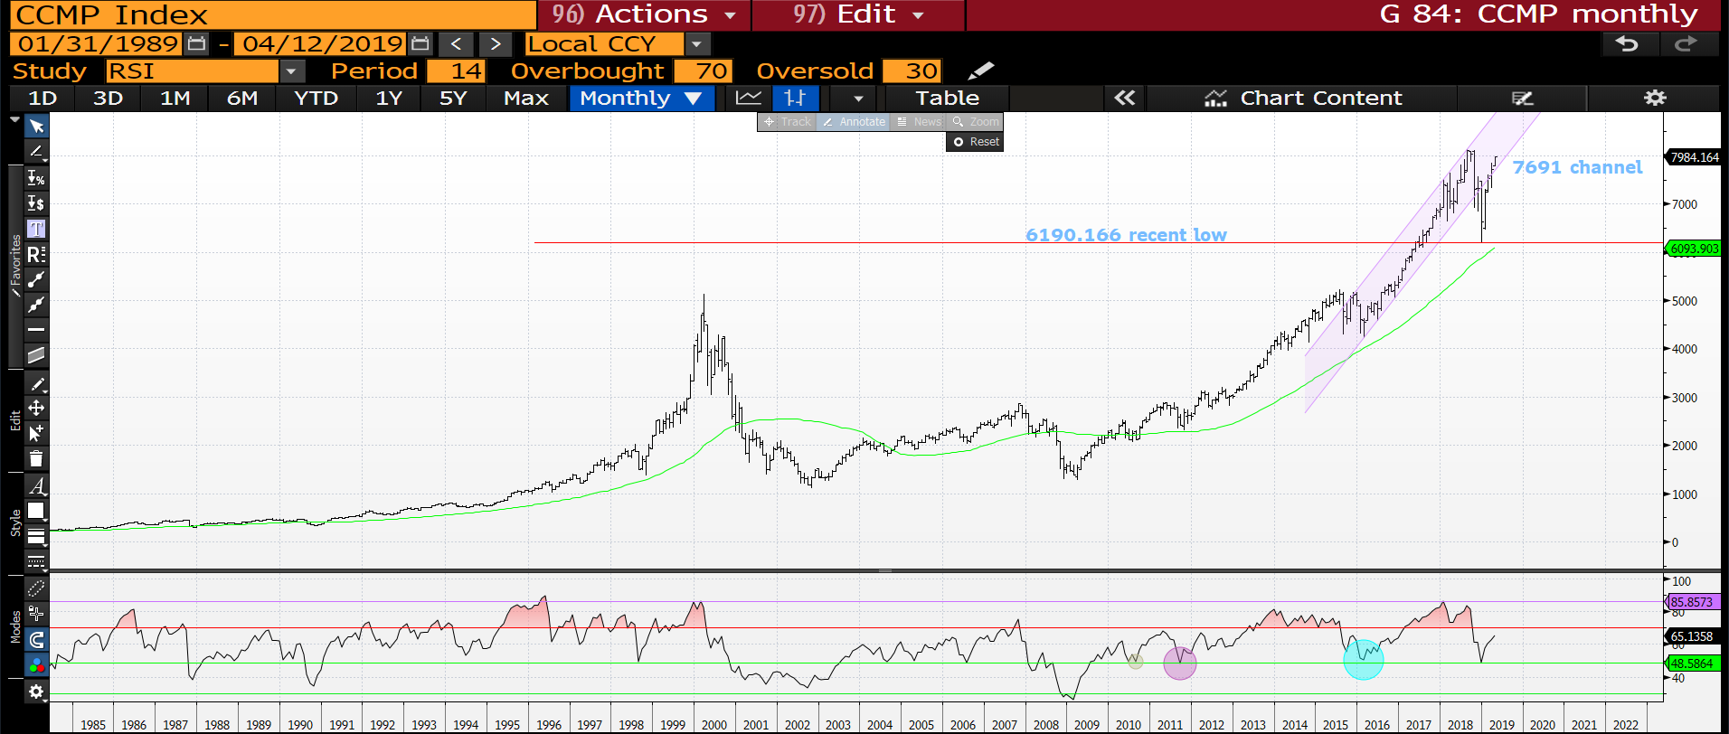
CCMP monthly : We have opened inside the channel 7691 so a lot to do to FAIL.

Slide 41
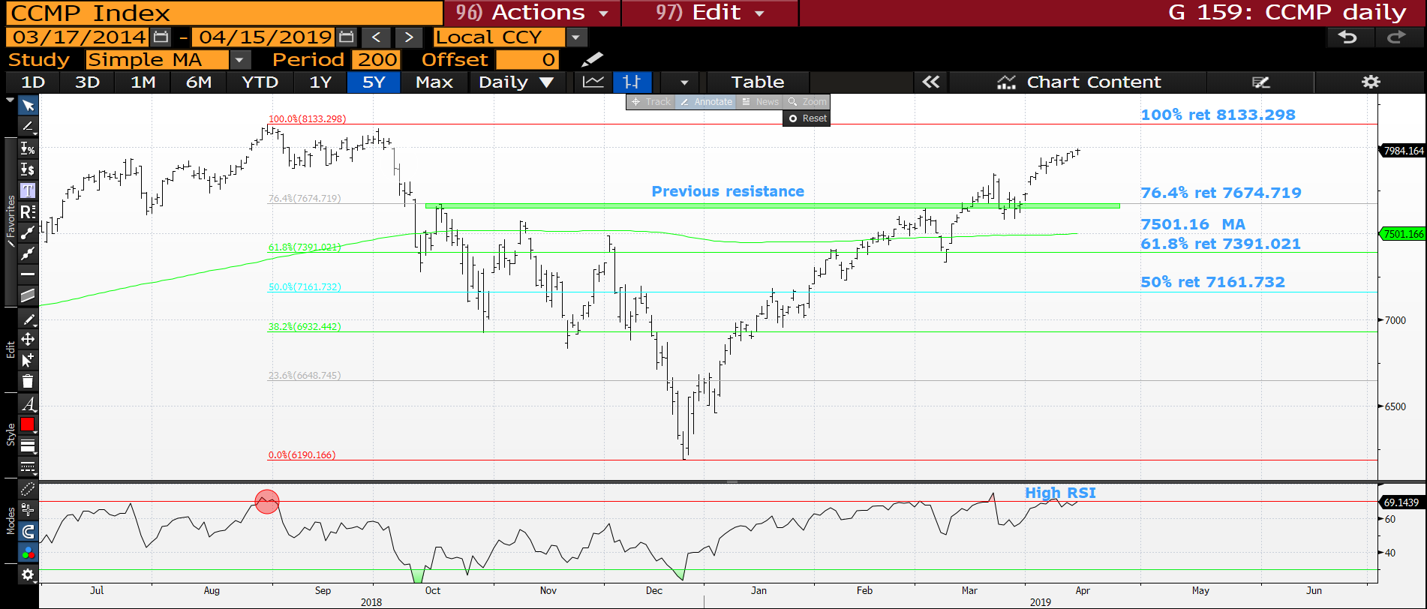
CCMP monthly : We have breached the previous resistance but the RSI is now dislocated, we need to head lower soon.

Slide 42
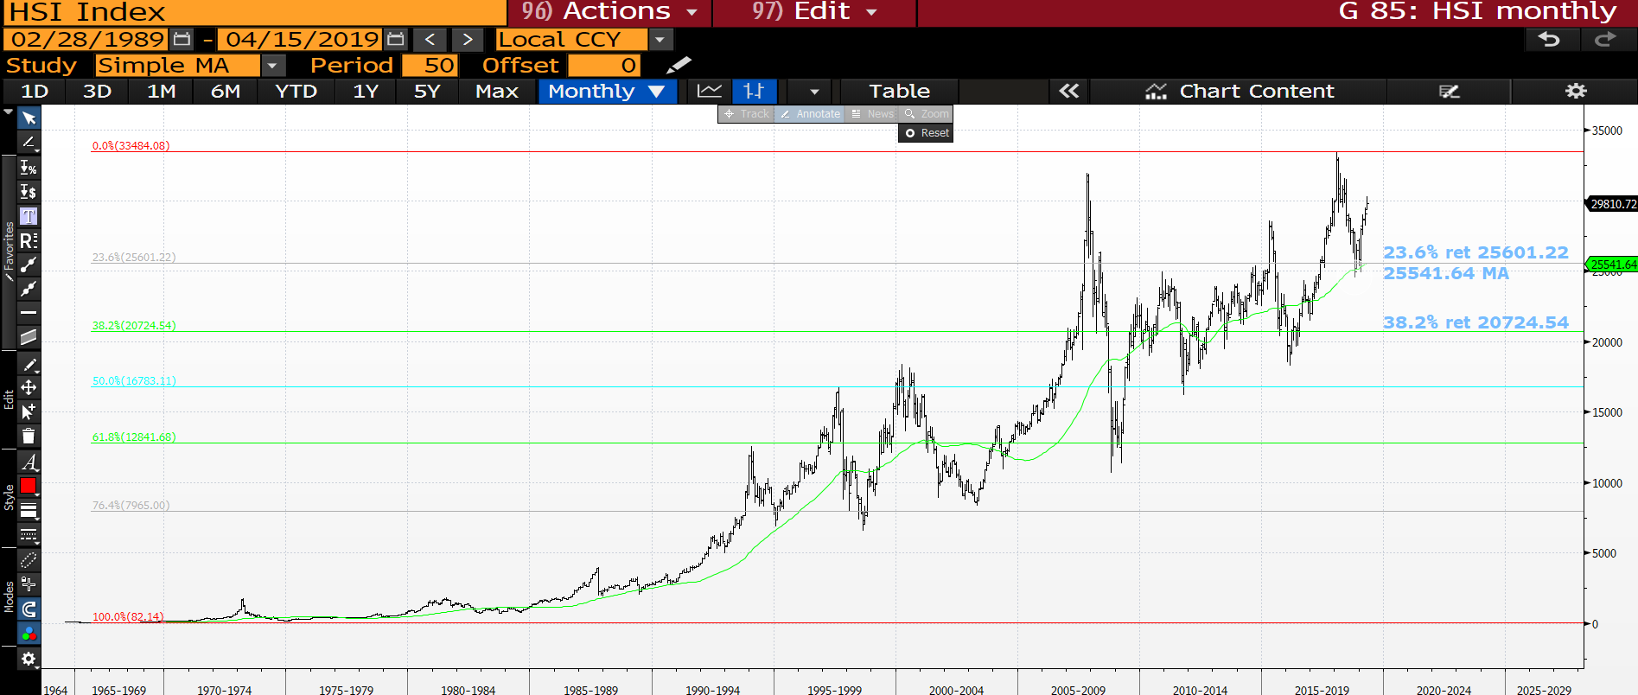
Hang Seng monthly : This is the biggest obstacle to a any short as this market formed a MAJOR base against its long-term moving average 25547.83.

Slide 43
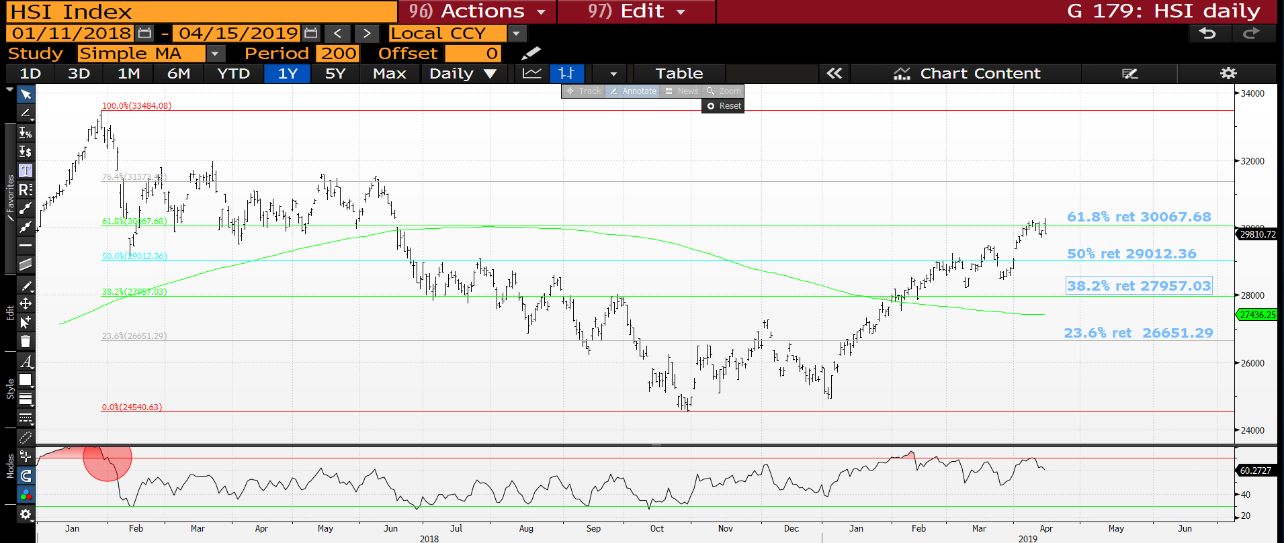
Hang Seng daily : The RSI is now HIGH so ideally we reject the 61.8% ret 30067.68 and head lower.

Slide 44
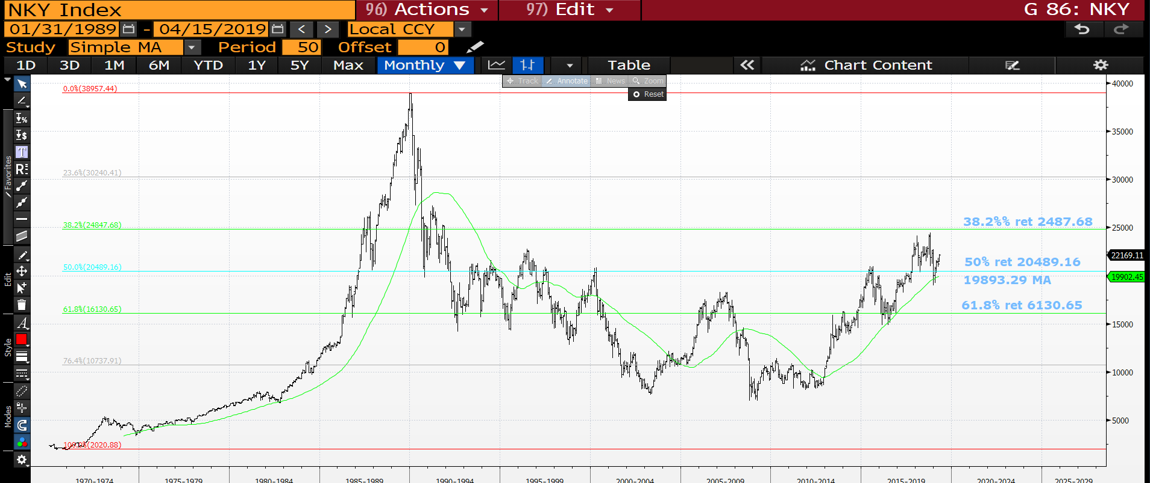
Nikkei monthly : A similar story to the Hang Seng in that we need to breach the 50% ret 20489.16.

Slide 45
FX UPDATE
FX UPDATE :
EURO : The EURO is “HOTTING UP” as we ease toward a Brexit conclusion. Sub 1.1241 will be catastrophic. If 1.1241 is ever breached then EUROPE-EU has a MAJOR CREDIBILITY ISSUE. We have a major test on right now as we TEASE constant moving average resistance 1.1358.
EUR GBP I have long favoured a short in this and the market looks poised to stretch its legs, am convinced this will come with the EURO breaching 1.1241. This could be the STAR trade for 2019.
The DXY index is teasing the 50% ret 95.859 with little RSI drive.
EM now steeping forward as MANY multi year tops are close to being confirmed. EM is a firm favourite with REAL MONEY.

Slide 46
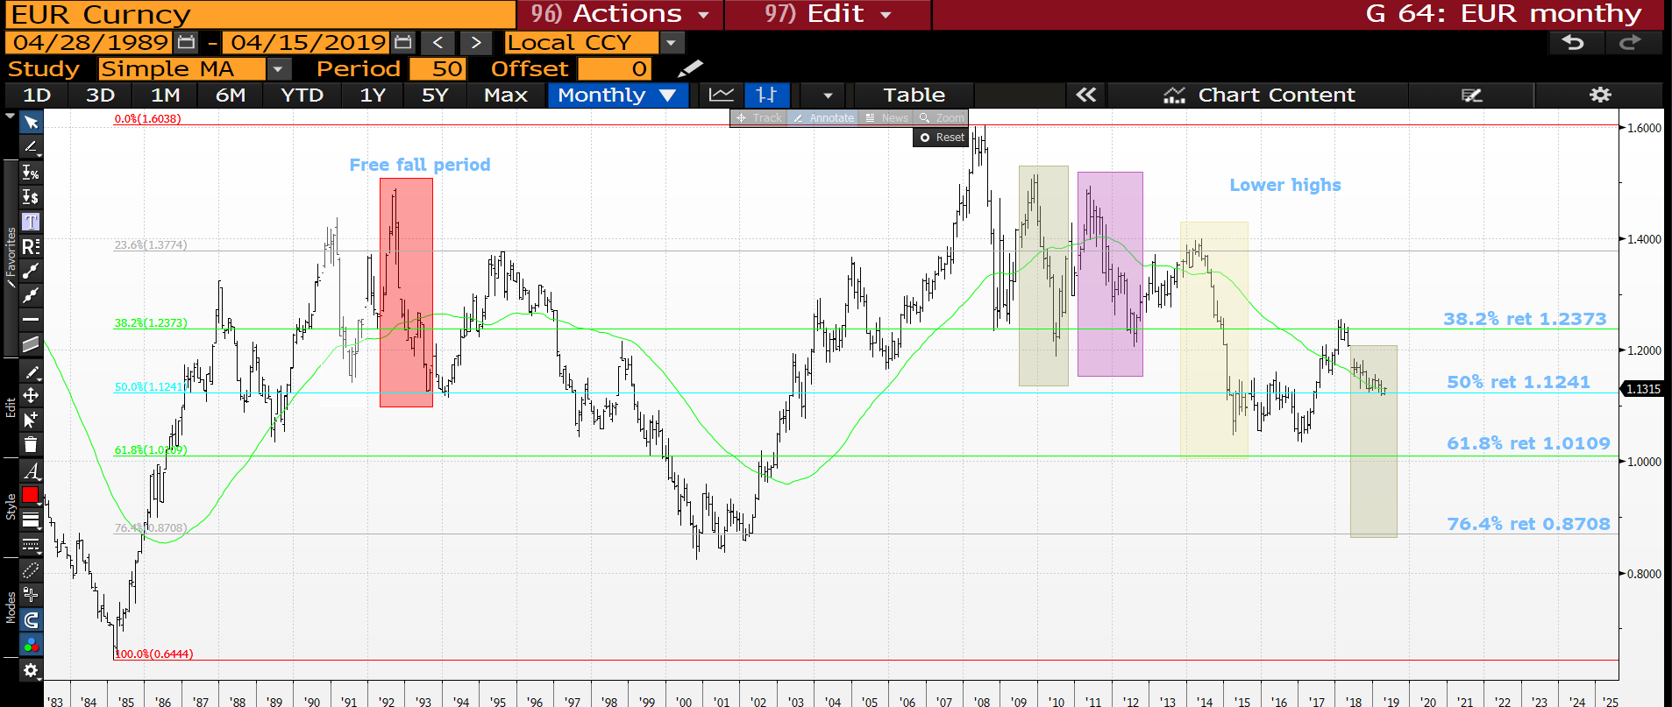
EUR USD monthly : The niggle here is we have HELD the 50% ret 1.1241 but continue to trade sideways with little bounce. Sub 1.1241 we freefall, there are previous range extensions highlighted. If we fail the subsequent move will be HARD AND FAST.

Slide 47
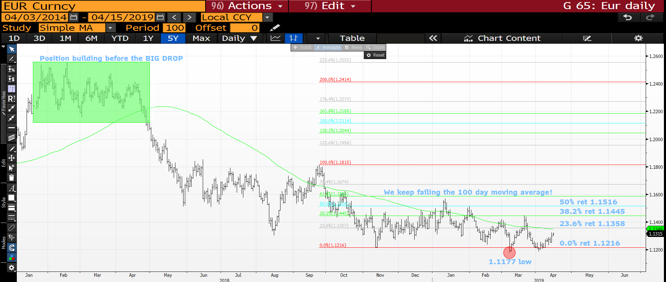
EUR USD daily : A very sideways market BUT it remains heavy, 23.6% ret 1.1358 resistance looms.

Slide 48
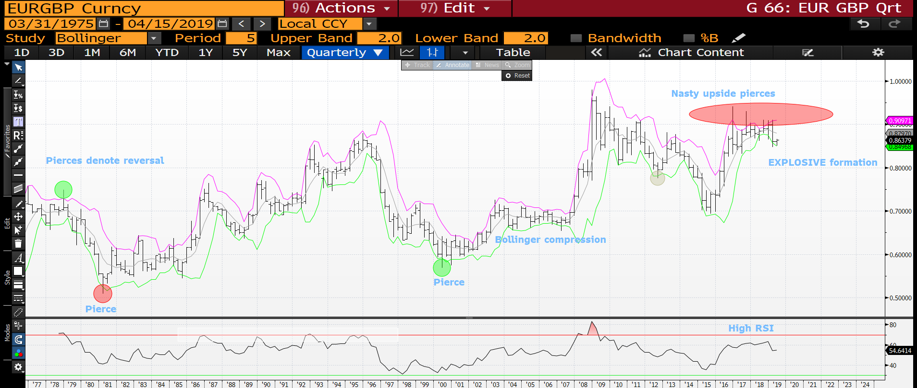
EUR GBP quarterly : This is a VERY RARE formation and a MEGA bearish one for the EURO over the POUND. We have SEVERAL upside pierces and coiling formation! For obvious reasons the one to watch but the speed of the move will be the killer blow!

Slide 49
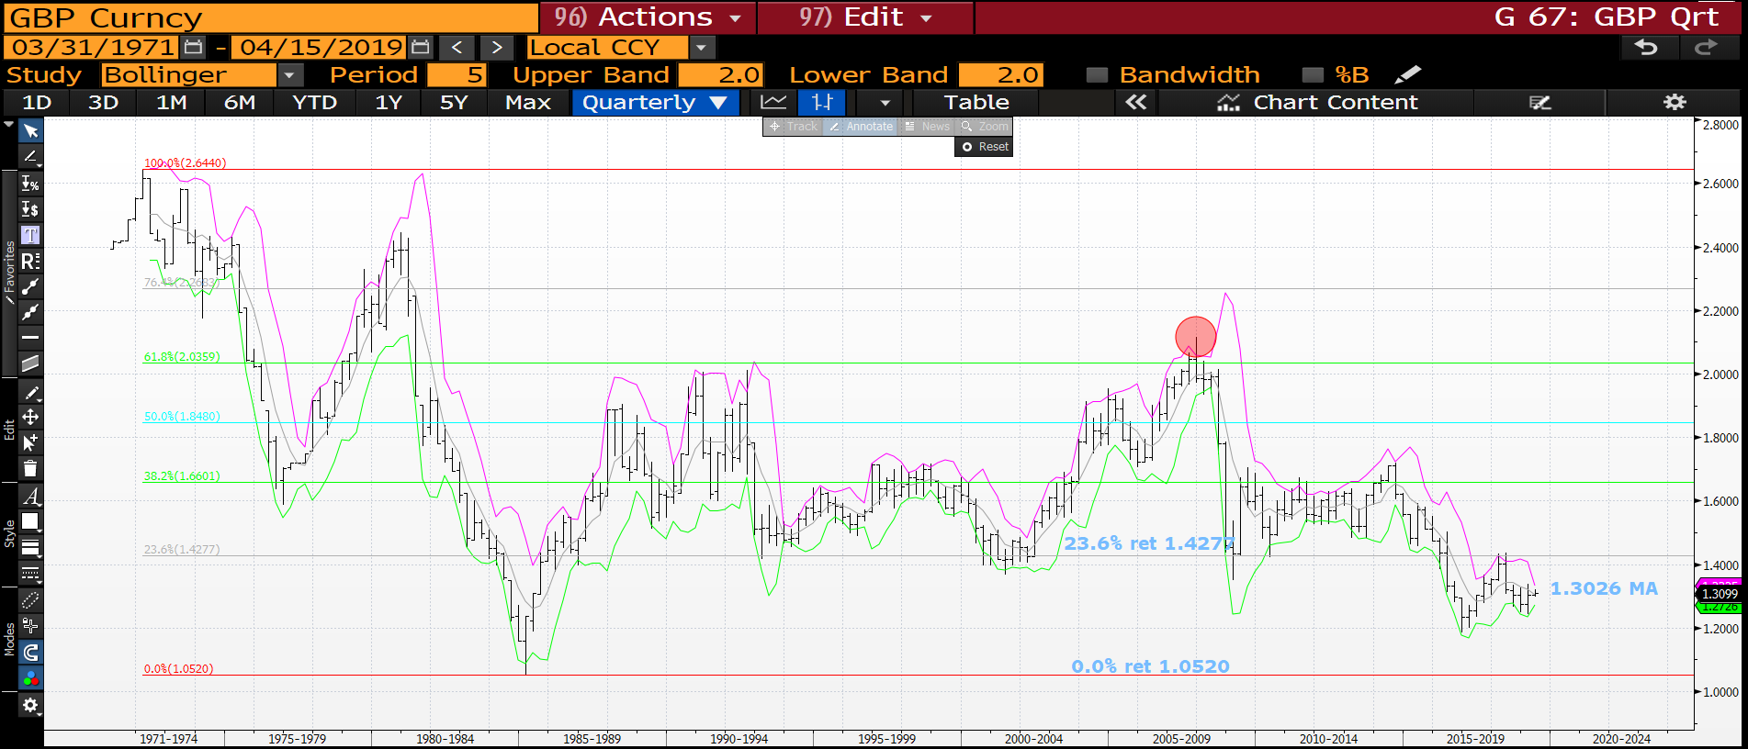
Cable quarterly : The bollingers have narrowed reflecting the stalemate over Brexit.

Slide 50
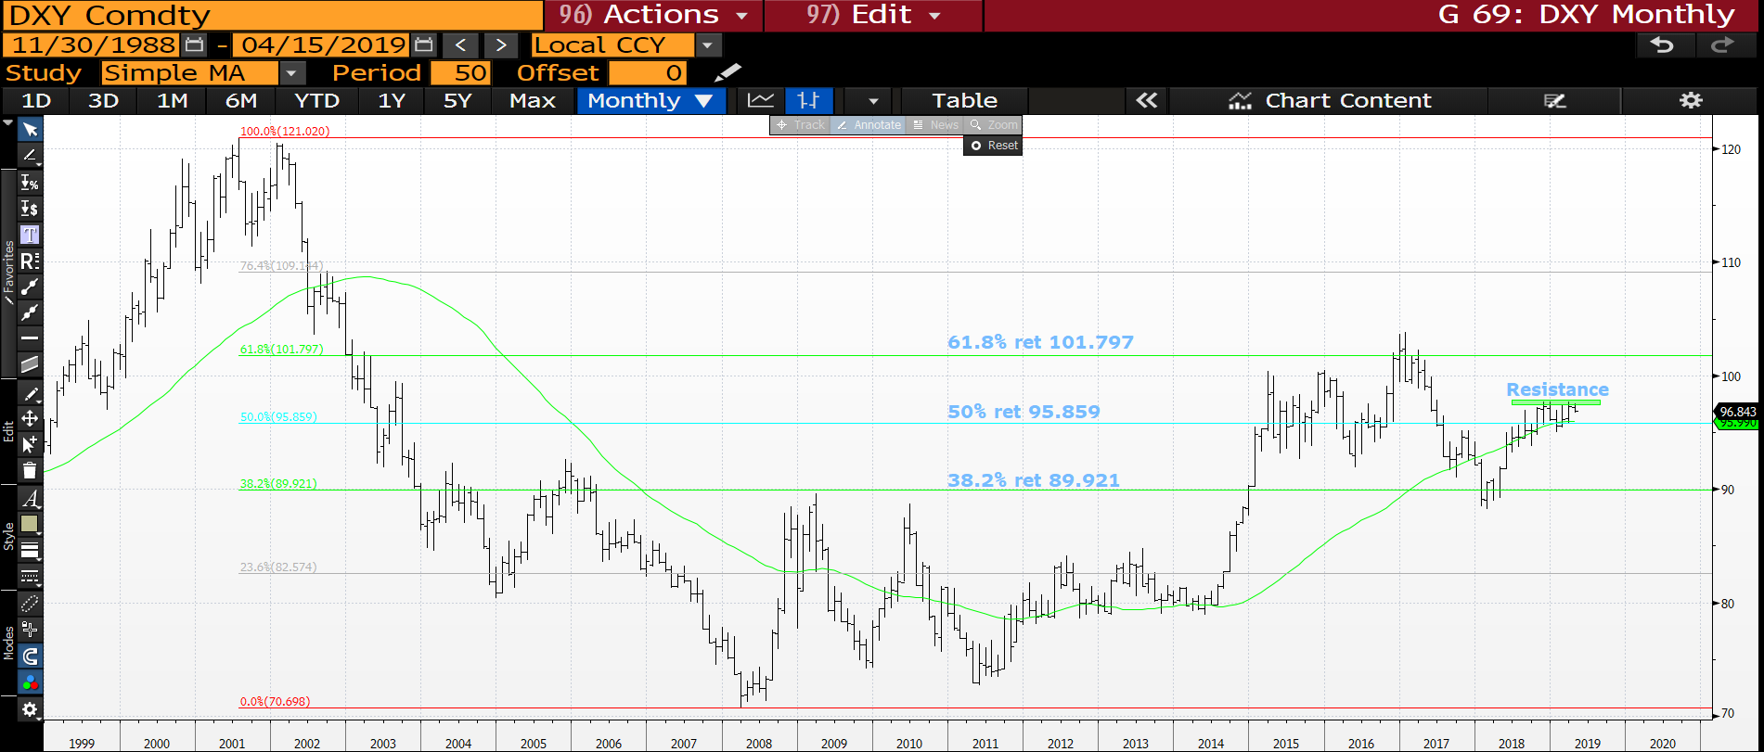
DXY monthly : A tricky location and rather a neutral one being at a 50% ret 95.859 of the last 18 years. Performance looks limited but sub the 50% ret 95.859 is bearish.

Slide 51
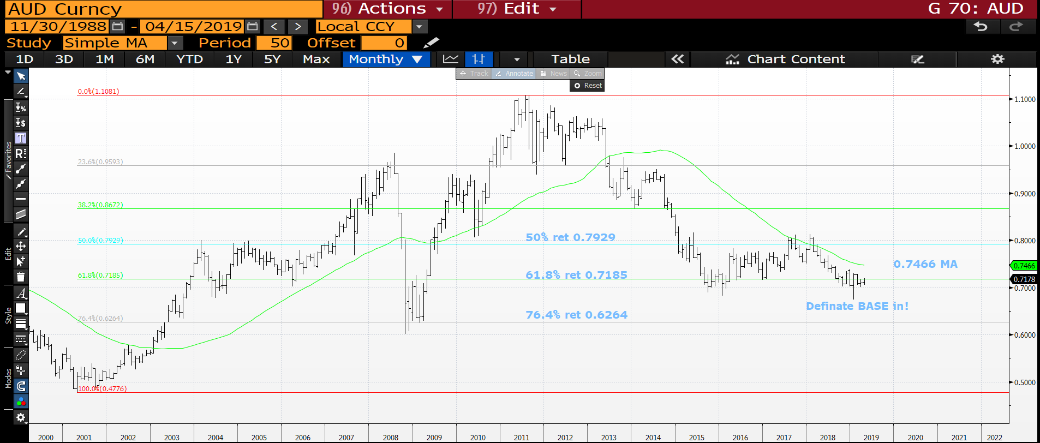
AUD USD monthly : AUD low in place and now ready for a decent move higher. The latest pierces are very positive. Above the 61.8% ret 0.7185 will help ALOT.

Slide 52
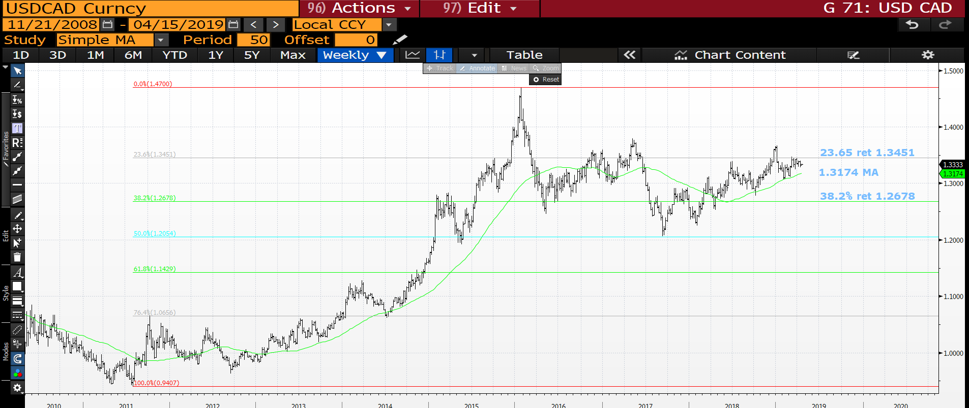
USD CAD weekly : The moving average continues to be the solid support on any dip, next step is to breach the 23.6% ret 1.3451.

Slide 53
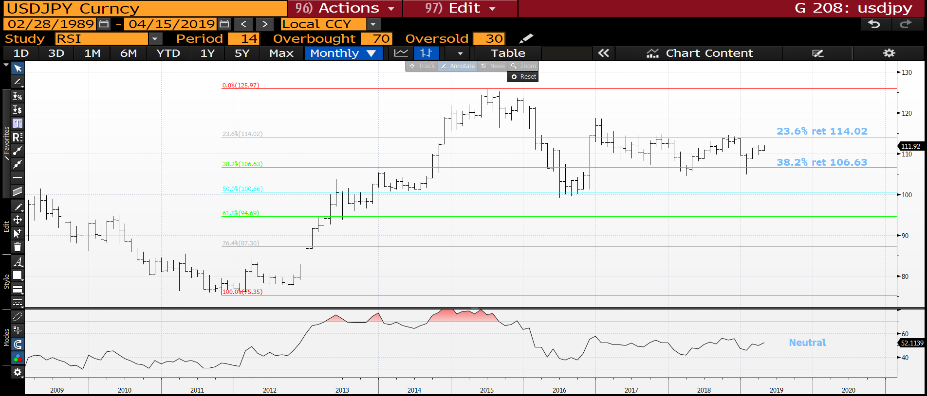
USD JPY monthly : I had to include this but the RSI and market is very neutral.

Slide 54
EM UPDATE
EM : A significant proportion of the EM crosses have created multi year tops and should see EM continue to perform regardless of USD direction. We are on the move LOWER again.
MANY USD-EM crosses now have SIZEABLE long-term tops formed. I think it is a combination of EM relief that the Turkey-Argentina situation is improving and the DXY losing momentum, more bias on the former for influence.
USD MXN continues to reject decent trend resistance at 20.6155 AND poised to break lower!

Slide 55
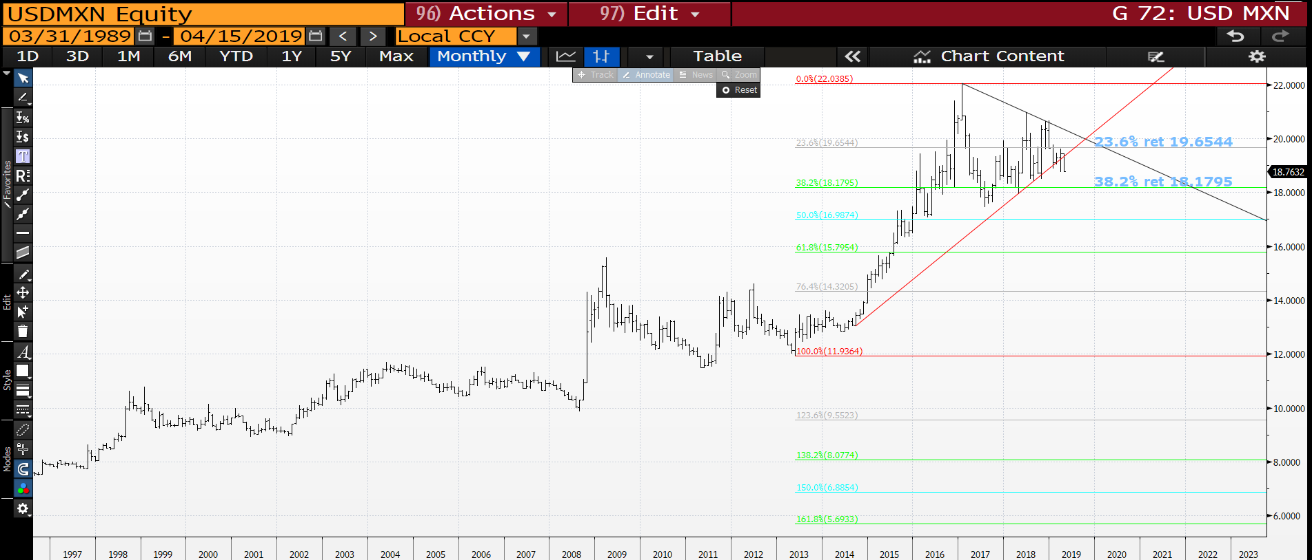
USD MXN monthly : We have broken the out of the VERY TEDIOUS triangle so the next target is the 38.2% ret 18.1795.

Slide 56
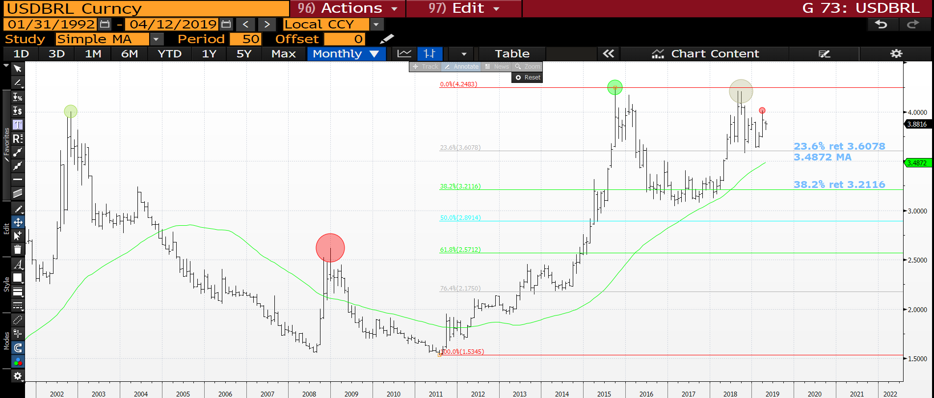
USD BRL monthly : We now have a very sizeable volume top and any breach of the 23.6% ret 3.6078 will be HUGE.

Slide 57

GTBRL10Y weekly : Yields have to continued to remain sub the 100% ret 9.117.

Slide 58

USD TRY monthly : The one fly in the ointment but whilst sub the 23.6% ret 5.8094 all remains bearish.

Slide 59

USD ZAR monthly : We continue to fail and should shortly be breaching the 100% ret 13.8401, THEN we head a lot LOWER.

Slide 60

USD RUB monthly : A nice break of the recent low and the next big test the 38.2% ret 61.9293.

Slide 61

USD CNH monthly : Certainly one to note going forward given its TECHNICAL HIT! We have failed the multi year 100% ret 6.7850 and heading toward 6.6000.

Slide 62

USD INR monthly : A BIG ONE for 2019 as PLENTY of downside possibility. The RSI is as HIGH as September 2013 and we APPEAR to be forming a TOP.

Slide 63

CL1 monthly : We appear to be stalling at the 61.8% ret 62.65 and the daily endorses a major failure from here.

Slide 64

CL1 daily : The RSI has been this extended before in October 2018, not difficult to see the outcome!

Slide 65

GOLD monthly : This has lacked any REAL momentum since 2013 but does look to be benefiting from the usual SAFE HAVEN view. Whilst above the 38.2% ret 1283.53 it carries a positive tone and the CLEANEST safe haven.

Slide 66


